Slide 1
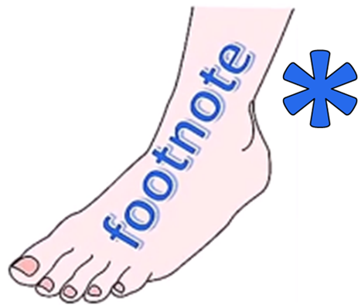
ENGLISH LANGUAGE STUDY
GET
HAS OTHER IMPORTANT USES
SEE THE
USE OF ENGLISH
PHRASAL VERBS
LESSON
GET
ALSO SEE THE
USE OF ENGLISH
IDIOMS
LESSON

