Slide 1
WE ASK A LOT OF QUESTIONS !
QUESTIONS OF PLACE AND TIME
QUESTIONS ABOUT EVENTS AND OPINIONS
ASKING QUESTIONS IS A VERY IMPORTANT ACTIVITY IN OUR LIVES

Slide 2
QUESTIONS
CAN BE MADE FROM STATEMENTS
STATEMENT QUESTION
BECOMES
They will arrive
Will they arrive?
THIS CHANGES
TO THAT

Slide 3
TYPICAL EXAMPLES
OF STATEMENTS MADE INTO QUESTIONS
NOTICE THE CHANGE!
STATEMENTS QUESTIONS
BECOMES
Can she
exchange it?
She can
exchange it

Slide 4
BECOMES
She can
exchange it
Can she
exchange it?
BECOMES
She can
exchange it
Can she
exchange it?
BECOMES
She can
exchange it
Can she
exchange it?

Slide 5
TYPICAL EXAMPLES
OF STATEMENTS MADE INTO QUESTIONS
STATEMENTS QUESTIONS
I am eating your sandwich
You were on the wrong bus
She can exchange it
We have paid online
They will arrive this evening
Am I eating your sandwich?
Were you on the wrong bus?
Can she exchange it?
Have we paid online?
Will they arrive this evening?

Slide 6
WHEN WE ASK QUESTIONS
WE CAN ALSO USE
THE WH-QUESTION WORDS

Slide 7
THE MAIN QUESTION WORDS
WHO
PERSON QUESTION
WHERE
PLACE QUESTION
WHEN
TIME QUESTION
WHY
REASON QUESTION

Slide 8
THE MAIN QUESTION WORDS
WHAT
FACT QUESTION
WHICH
CHOICE QUESTION
HOW
METHOD QUESTION

Slide 9
KEY EXAMPLES
WHO ARE YOU?
PERSON
WHERE DO YOU LIVE?
PLACE
WHEN DOES JANE GO
SHOPPING?
TIME
WHY DO YOU LIKE MUSIC?
REASON

Slide 10
KEY EXAMPLES
WHAT IS YOUR JOB?
FACT
WHICH COLOUR DO YOU LIKE?
CHOICE
*
HOW DO YOU TRAVEL?
METHOD

Slide 11
NOTICE THIS!
*
HOW
IS ALSO USED AS
A WH-QUESTION WORD

Slide 12
NOTICE THIS!
METHOD QUESTION
HOW CAN I GET TO EGYPT?
TAKE A FLIGHT!
*
HOW
CONDITION QUESTION
HOW IS PETER?
HE IS FIT AND WELL

Slide 13
CONDITION QUESTION
I WONDER HOW HE IS?

Slide 14
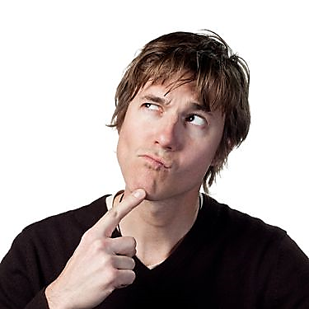
CONDITION QUESTION
I WONDER HOW SHE IS?

Slide 15
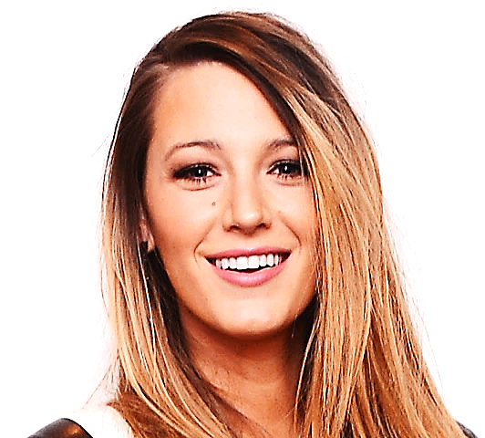
CONDITION QUESTION
THEY ARE BOTH FINE, AREN’T THEY?

Slide 16
METHOD QUESTION
HOW WOULD I KNOW?
cut

Slide 17
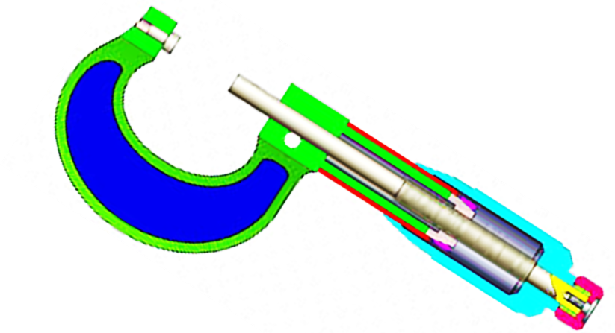
METHOD QUESTION
HOW CAN I USE THIS TOOL?

Slide 18
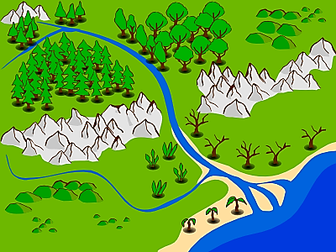
METHOD QUESTION
HOW DO WE GET TO THE MOUNTAINS FROM HERE?

Slide 19
METHOD QUESTION
HOW CAN I LEARN ENGLISH?

Slide 20
METHOD QUESTION
I DON’T KNOW HOW TO DRIVE
I MUST LEARN!

Slide 21
LISTENING PRACTICE
A TELEPHONE INTERVIEW
JUST LISTEN...

Slide 22
LISTENING PRACTICE
A TELEPHONE INTERVIEW
WHO ARE YOU? MY NAME’S BOB
WHERE DO YOU LIVE? I LIVE IN LONDON
ARE YOU ENGLISH? NO, I’M CANADIAN
WHAT IS YOUR JOB? I’M AN ARTIST
WHY DO YOU LIKE ART?
BECAUSE I LOVE SHAPES AND COLOURS
WHICH COLOUR DO YOU LIKE? ALL OF THEM!
HOW DO YOU TRAVEL TO WORK? ON FOOT
WHEN DO YOU RELAX? AFTER WORK!

Slide 23
A TELEPHONE INTERVIEW

Slide 24
CONFIRMATION QUESTIONS !

Slide 25
CONFIRMATION QUESTIONS
IT IS A NICE DAY,
ISN’T IT?
ANSWER THIS
NOT THIS

Slide 26
CONFIRMATION QUESTIONS
THIS IS ASKING YOU TO ANSWER
IT IS A NICE DAY, ISN’T IT?
SO
ANSWER THIS
NOT THIS!

Slide 27
YES!
IT IS A NICE DAY,
ISN’T IT?
IT ISN’T A NICE DAY,
IS IT?
NO
NEGATIVE
ANSWER
EXPECTED

Slide 28
YES!
IT IS …………..,
ISN’T IT?
IT ISN’T ………….,
IS IT?
NO
NEGATIVE
ANSWER
EXPECTED

Slide 29
TYPICAL EXAMPLES
IT IS …………..,
ISN’T IT?
IT ISN’T ………….,
IS IT?

Slide 30
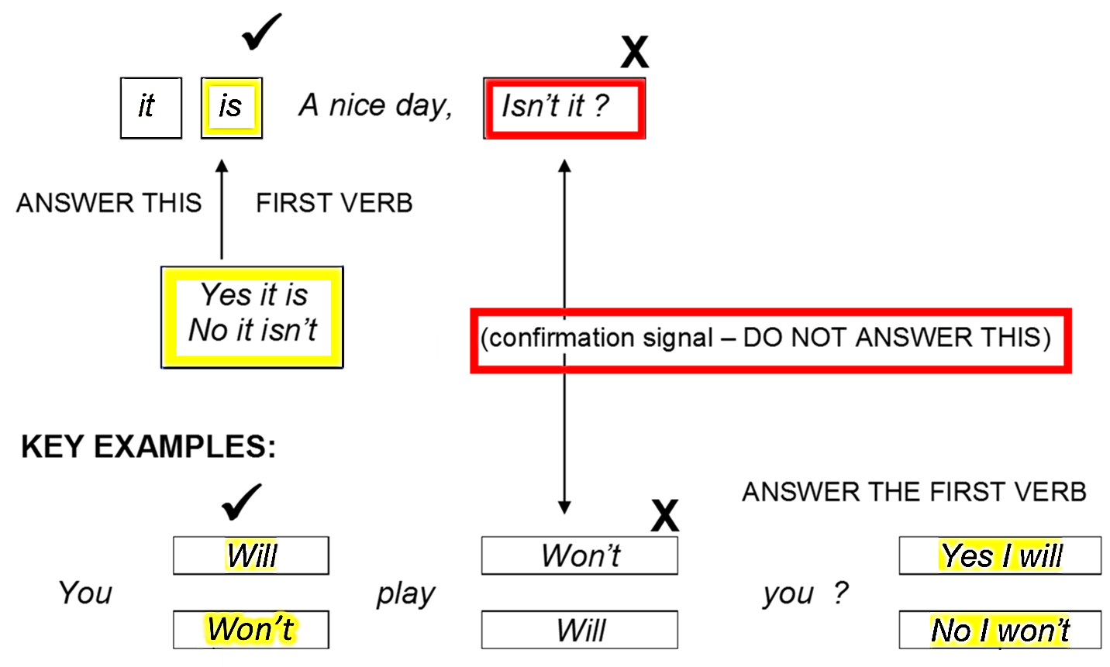
OVERVIEW: CONFIRMATION QUESTION
DON’T ANSWER THIS!
ANSWER THIS!

Slide 31
DON’T YOU?
YOU DO LIKE FRUIT,
IT IS A NICE DAY,
ISN’T IT?
IT IS A NICE DAY,
ISN’T IT?
IT IS A NICE DAY,
ISN’T IT?
IT IS A NICE DAY,
ISN’T IT?

Slide 32
CAN CAN’T
WILL WON’T
SHOULD SHOULDN’T
MUST MUSN’T
DON’T YOU?
YOU DO LIKE FRUIT,
DO YOU?
YOU DON’T LIKE FRUIT,
DON’T YOU?
YOU DO LIKE FRUIT,
DO YOU?
YOU DON’T LIKE FRUIT,
DON’T YOU?
YOU DO LIKE FRUIT,
DO YOU?
YOU DON’T LIKE FRUIT,

Slide 33
IT IS A NICE DAY,
ISN’T IT?
IT IS A NICE DAY,
ISN’T IT?
IT IS A NICE DAY,
ISN’T IT?
IT IS A NICE DAY,
ISN’T IT?
IT IS A NICE DAY,
ISN’T IT?

Slide 34
TYPICAL EXAMPLES

Slide 35
LISTENING PRACTICE
JUST LISTEN...

Slide 36
LISTENING PRACTICE
A KID TALKS TO AN ARTIST
WHO ARE YOU? MY NAME’S BOB
WHERE DO YOU LIVE? I LIVE IN LONDON
ARE YOU ENGLISH? NO, I’M CANADIAN
WHAT IS YOUR JOB? I’M AN ARTIST
WHY DO YOU LIKE ART?
BECAUSE I LOVE SHAPES AND COLOURS
WHICH COLOUR DO YOU LIKE? ALL OF THEM!
HOW DO YOU TRAVEL TO WORK? ON FOOT
WHEN DO YOU RELAX? AFTER WORK!

Slide 38
TYPICAL EXAMPLES

Slide 39
TYPICAL EXAMPLES

Slide 41
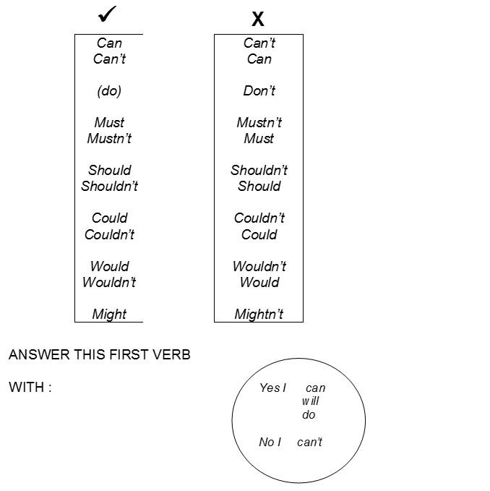
*
*
*

Slide 43
TYPICAL EXAMPLES
END MARKER
What (What do you want for dinner?)
Who (Who do you think will win the election?)
Whom (I want to know to whom I should address this letter.)
Whose (Whose sock is this?)
Which (Which of these shirts should I buy?)
When (When does the concert begin?)
Where (Where should we visit in Spain?)
Why (Why is the sky blue?)
How (How do we get there from here?)

Slide 44
LISTENING PRACTICE
A KID TALKS TO AN ARTIST
MY NAME’S BOB
I LIVE IN LONDON
NO, I’M CANADIAN
I’M AN ARTIST
BECAUSE I LOVE SHAPES AND COLOURS
ALL OF THEM!
ON FOOT
AFTER WORK!

