Slide 1
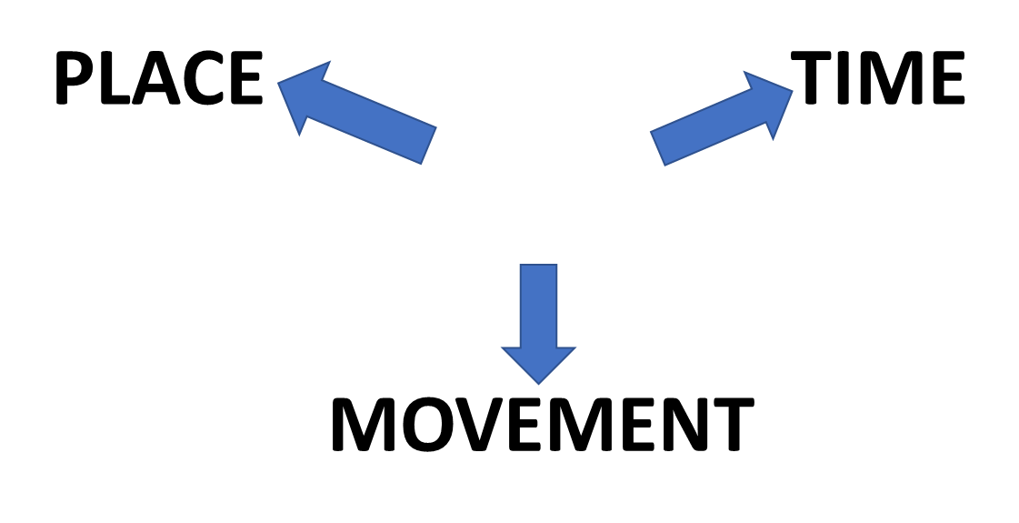
PREPOSITIONS
IN
ON
AT

Slide 2
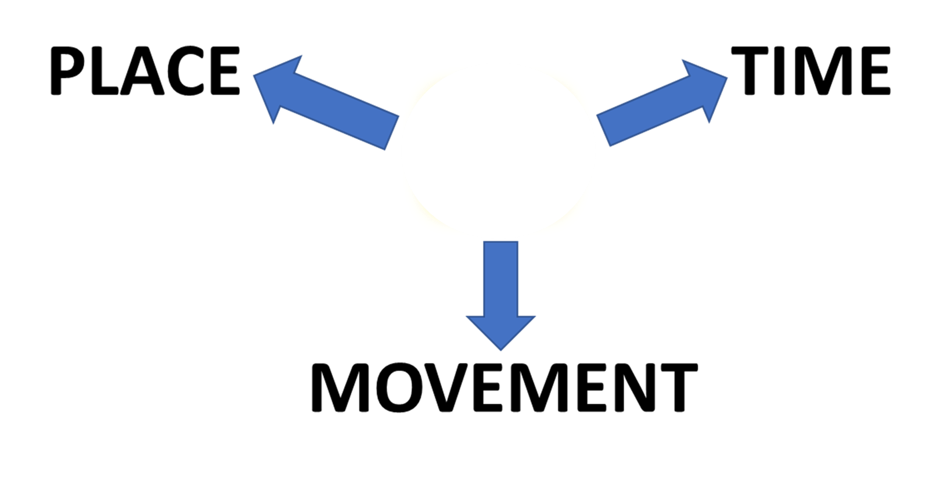
PREPOSITIONS
IN

Slide 3
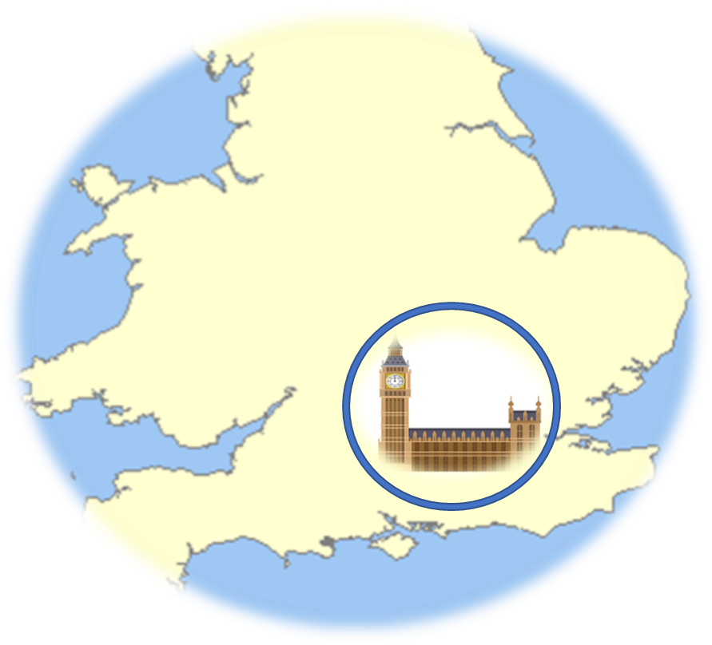
PLACE
JENNY LIVES
IN LONDON

Slide 5
TIME

Slide 6
MOVEMENT

Slide 7
PREPOSITIONS
IN

Slide 8
PREPOSITIONS
ON

Slide 9
PLACE
JENNY LIVES
IN LONDON

Slide 10
TIME

Slide 11
MOVEMENT

Slide 12
PREPOSITIONS
ON

Slide 13
PREPOSITIONS
AT

Slide 14
PLACE
BIG BEN IS
ON
THE CLOCK TOWER

Slide 15
TIME

Slide 16
MOVEMENT

Slide 17
PREPOSITIONS
AT

Slide 18
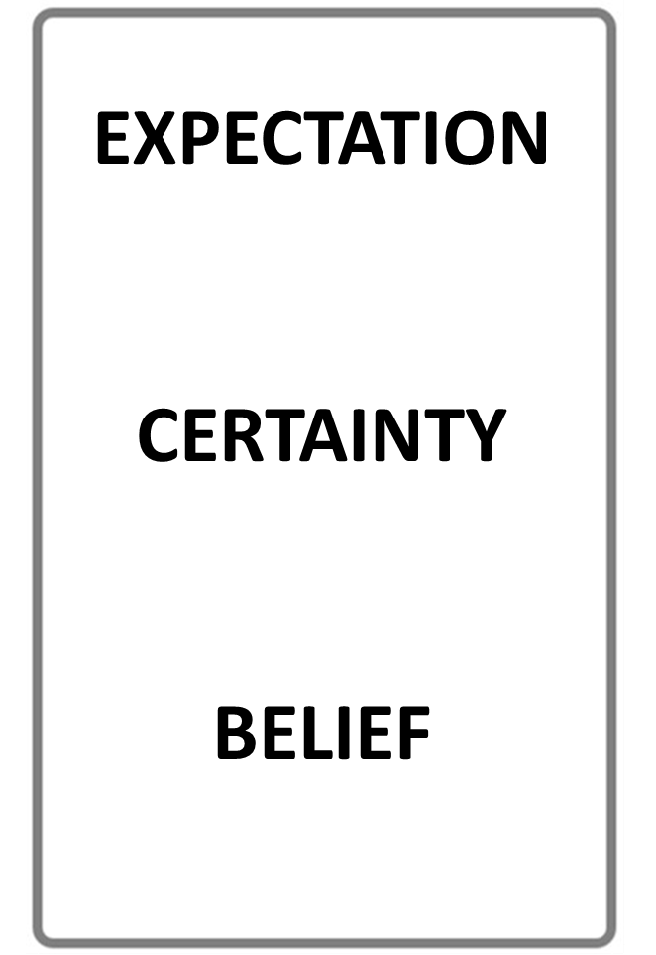
STOP THE VIDEO WHILE YOU CHECK

Slide 19
PREPOSITIONS

Slide 20
LISTENING PRACTICE
JUST LISTEN...

Slide 21
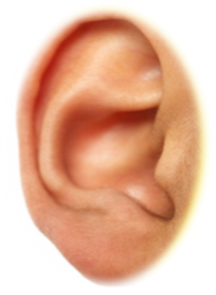
STORY BOARD

Slide 22
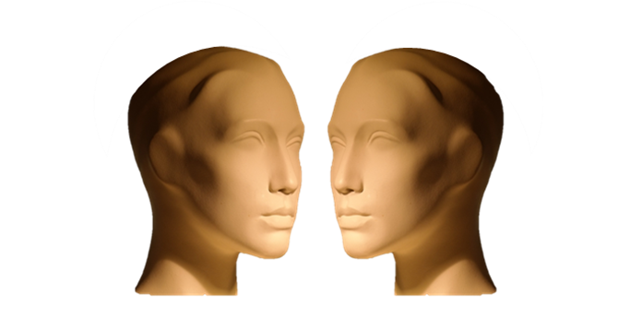
TYPICAL DIALOGUE
JUST LISTEN...

Slide 23
PREPOSITIONS

Slide 24
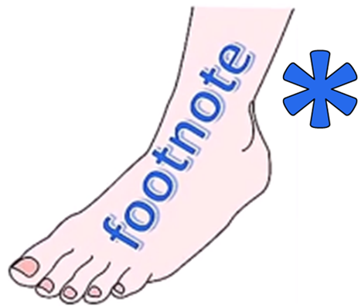
ENGLISH LANGUAGE STUDY
PREPOSITIONS EXPRESS
PLACE
TIME
MOVEMENT

Slide 25
PREPOSITIONS

