Slide 3
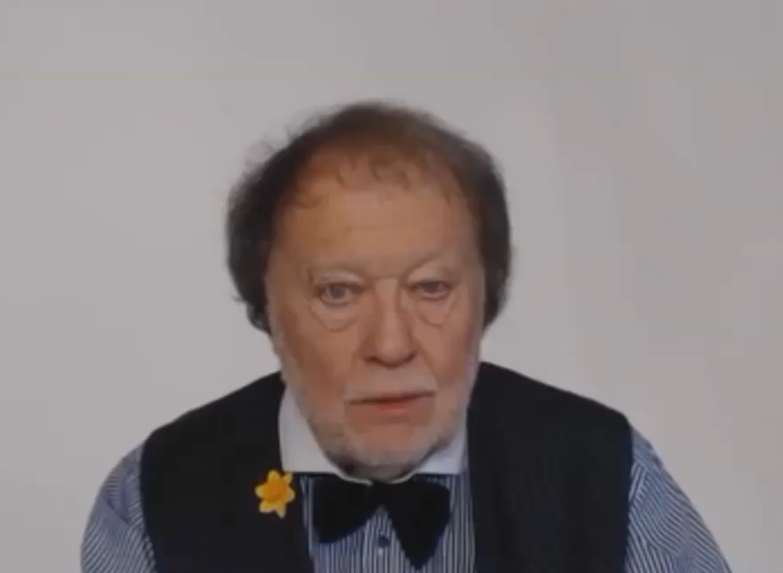
WHAT DO WE DESCRIBE?

Slide 4
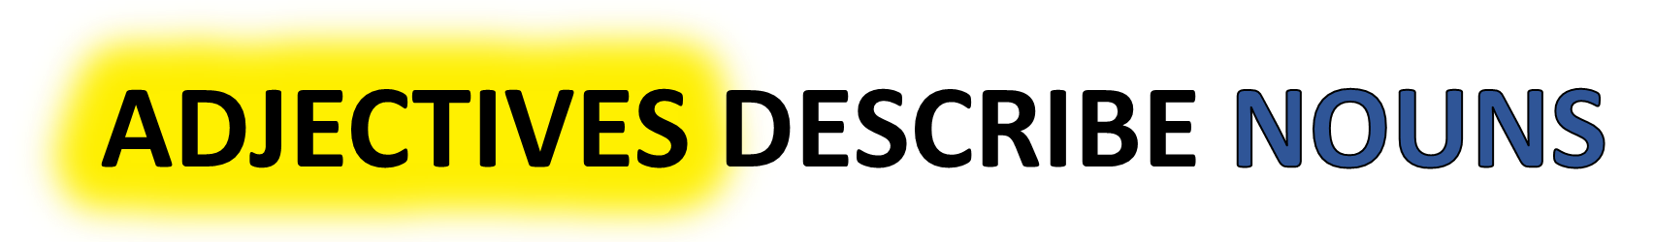
WHAT IS A NOUN ?
WHAT IS AN ADJECTIVE ?
ADVERBS DESCRIBE VERBS
WHAT IS AN ADVERB ?
WHAT IS A VERB ?

Slide 5
WHAT IS A NOUN?
WHAT IS A VERB?

Slide 6

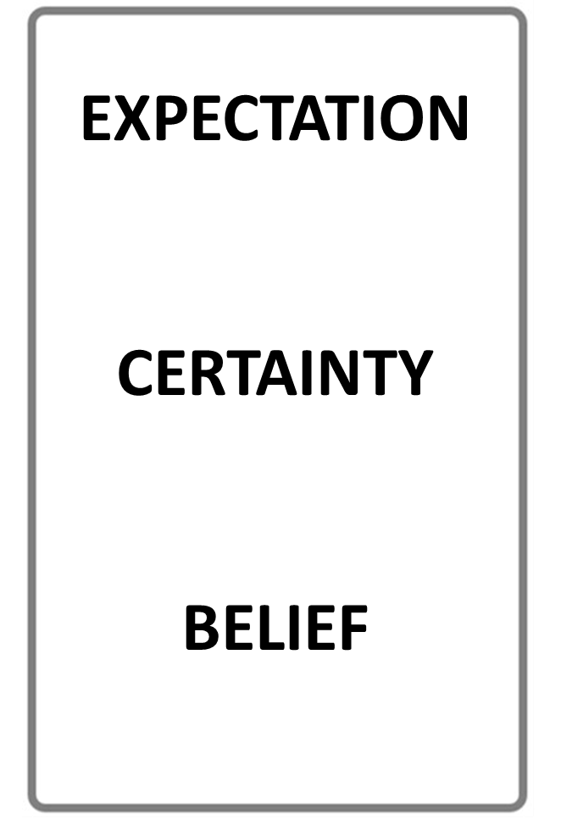


NOUN
VERB
NAME OF A THING
AN ACTIVITY WORD
STOP THE VIDEO WHILE YOU CHECK

Slide 7
USING ADJECTIVES AND ADVERBS
WHAT IS AN ADJECTIVE?
WHAT IS AN ADVERB?

Slide 8
ADJECTIVE
ADVERB
DESCRIBES A NOUN
DESCRIBES A VERB
STOP THE VIDEO WHILE YOU CHECK

Slide 9
KEY
ADJECTIVE EXAMPLE

Slide 10
KEY
ADVERB EXAMPLE

Slide 11
KEY
NOUN EXAMPLE

Slide 12
KEY
VERB EXAMPLE

Slide 13
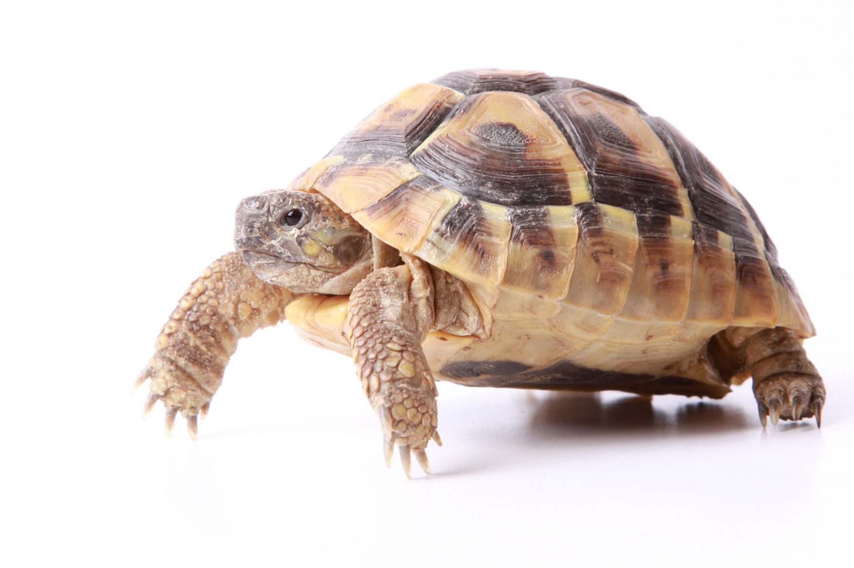

ADJECTIVE
THIS IS A SLOW ANIMAL
THE
ADJECTIVE DESCRIBES
THE NOUN

Slide 14


THE BUTTERFLIES ARE FLYING SLOW LY
DESCRIBES
THE
VERB

Slide 15
ADJECTIVES
ADVERBS
DESCRIBE
DESCRIBE
NOUNS
VERBS

Slide 16
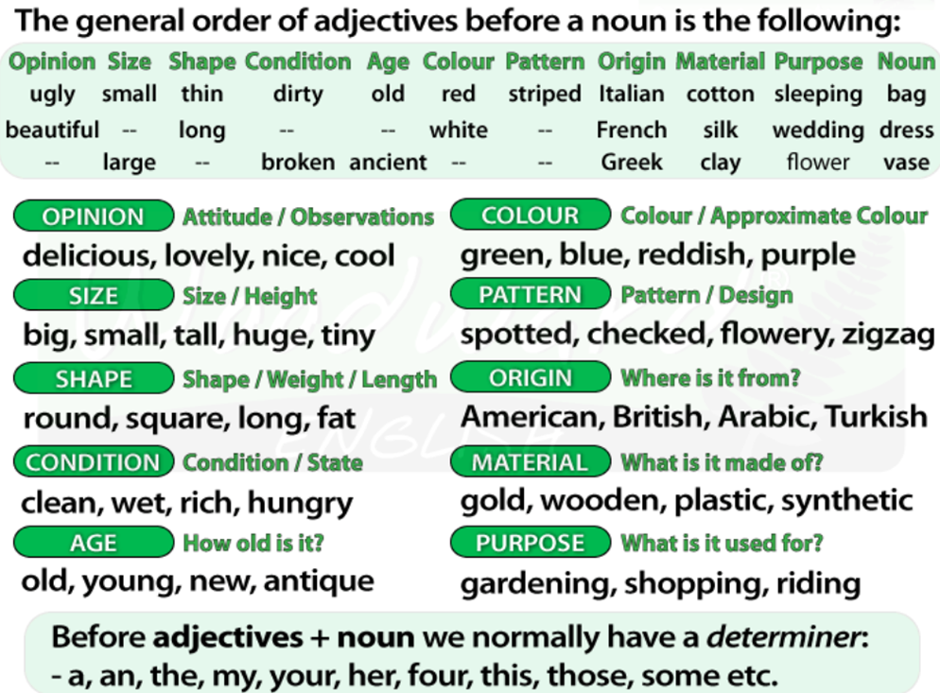
USING ADJECTIVES AND ADVERBS

Slide 17
USING ADJECTIVES AND ADVERBS
WHAT IS AN ADJECTIVE?
WHAT IS AN ADVERB?

Slide 19
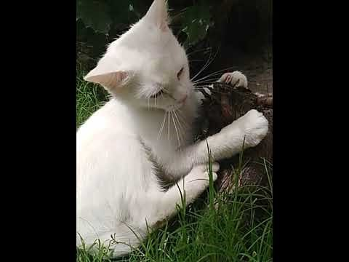

Slide 20


Slide 22
Quantity or number.
Quality or opinion.
Size.
Age.
Shape.
Color.
Proper adjective (often nationality, other place of origin, or material)
Purpose or qualifier.

Slide 23
that horrible big fierce dog
It is very unusual to have more than three adjectives.
Adjectives usually come in this order:
1 2 3 4 5 6 7 8
General
opinion Specific
opinion Size Shape Age Colour Nationality Material
We use some adjectives only after a link verb:
afraid alive alone asleep
content glad ill ready
sorry sure unable well
Some of the commonest -ed adjectives are normally used only after a link verb:
annoyed; finished; bored; pleased; thrilled
We say:

Slide 24
Adjectives usually come in this order:
1 | 2 | 3 | 4 | 5 | 6 | 7 | 8
General opinion | Specific opinion | Size | Shape | Age | Colour | Nationality | Material

Slide 25
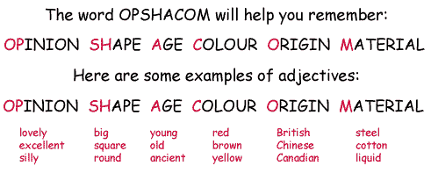

Slide 26
ADVERBS

Slide 27
ADJECTIVE
ADVERB
DESCRIBES A NOUN
DESCRIBES A VERB
STOP THE VIDEO WHILE YOU CHECK

