Slide 2

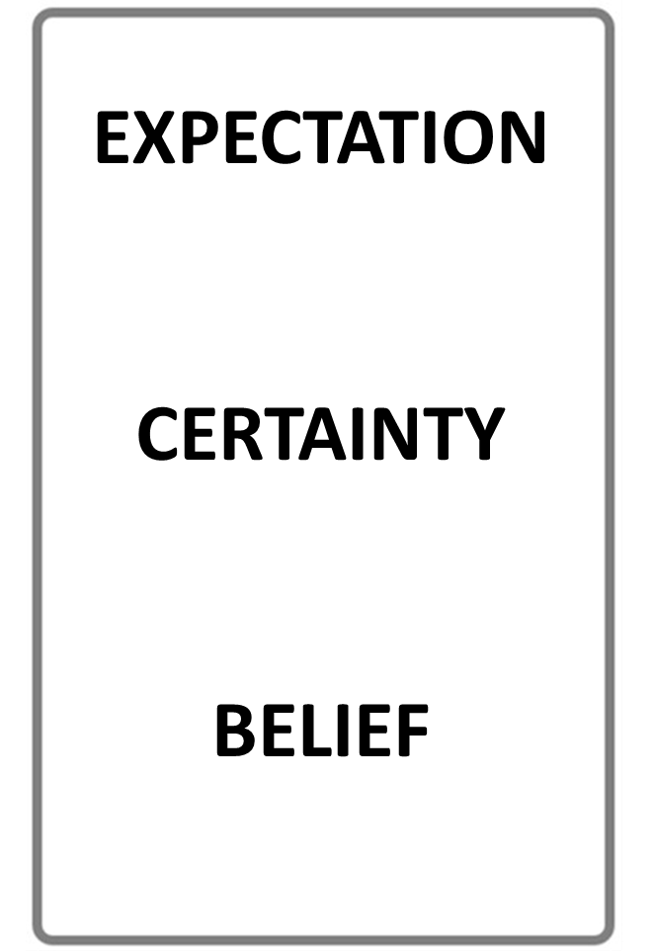


NOUN
VERB
NAME OF A THING
AN ACTIVITY WORD
STOP THE VIDEO WHILE YOU CHECK

Slide 3
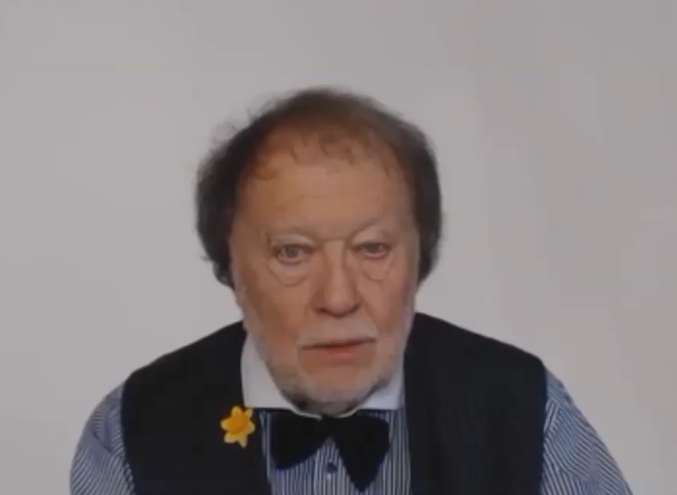

Slide 4
USING ADJECTIVES AND ADVERBS
WHAT IS AN ADJECTIVE?
WHAT IS AN ADVERB?

Slide 5
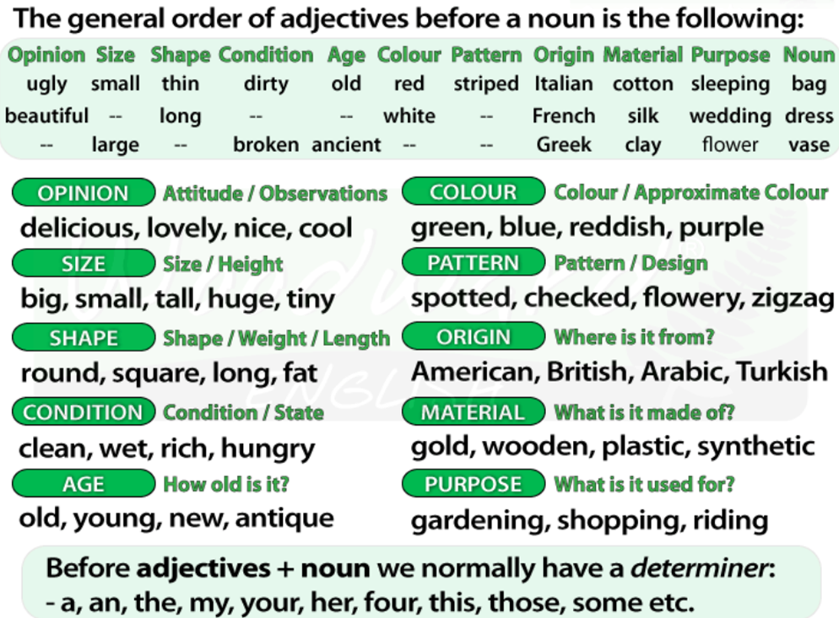
USING ADJECTIVES AND ADVERBS

Slide 6
WHAT IS A NOUN?

Slide 7
WHAT IS A VERB?

Slide 8
WHAT IS AN NOUN?

Slide 9
USING ADJECTIVES AND ADVERBS
WHAT IS AN ADJECTIVE?
WHAT IS AN ADVERB?

Slide 10
ADJECTIVE
ADVERB
DESCRIBES A NOUN
DESCRIBES A VERB
STOP THE VIDEO WHILE YOU CHECK

Slide 11
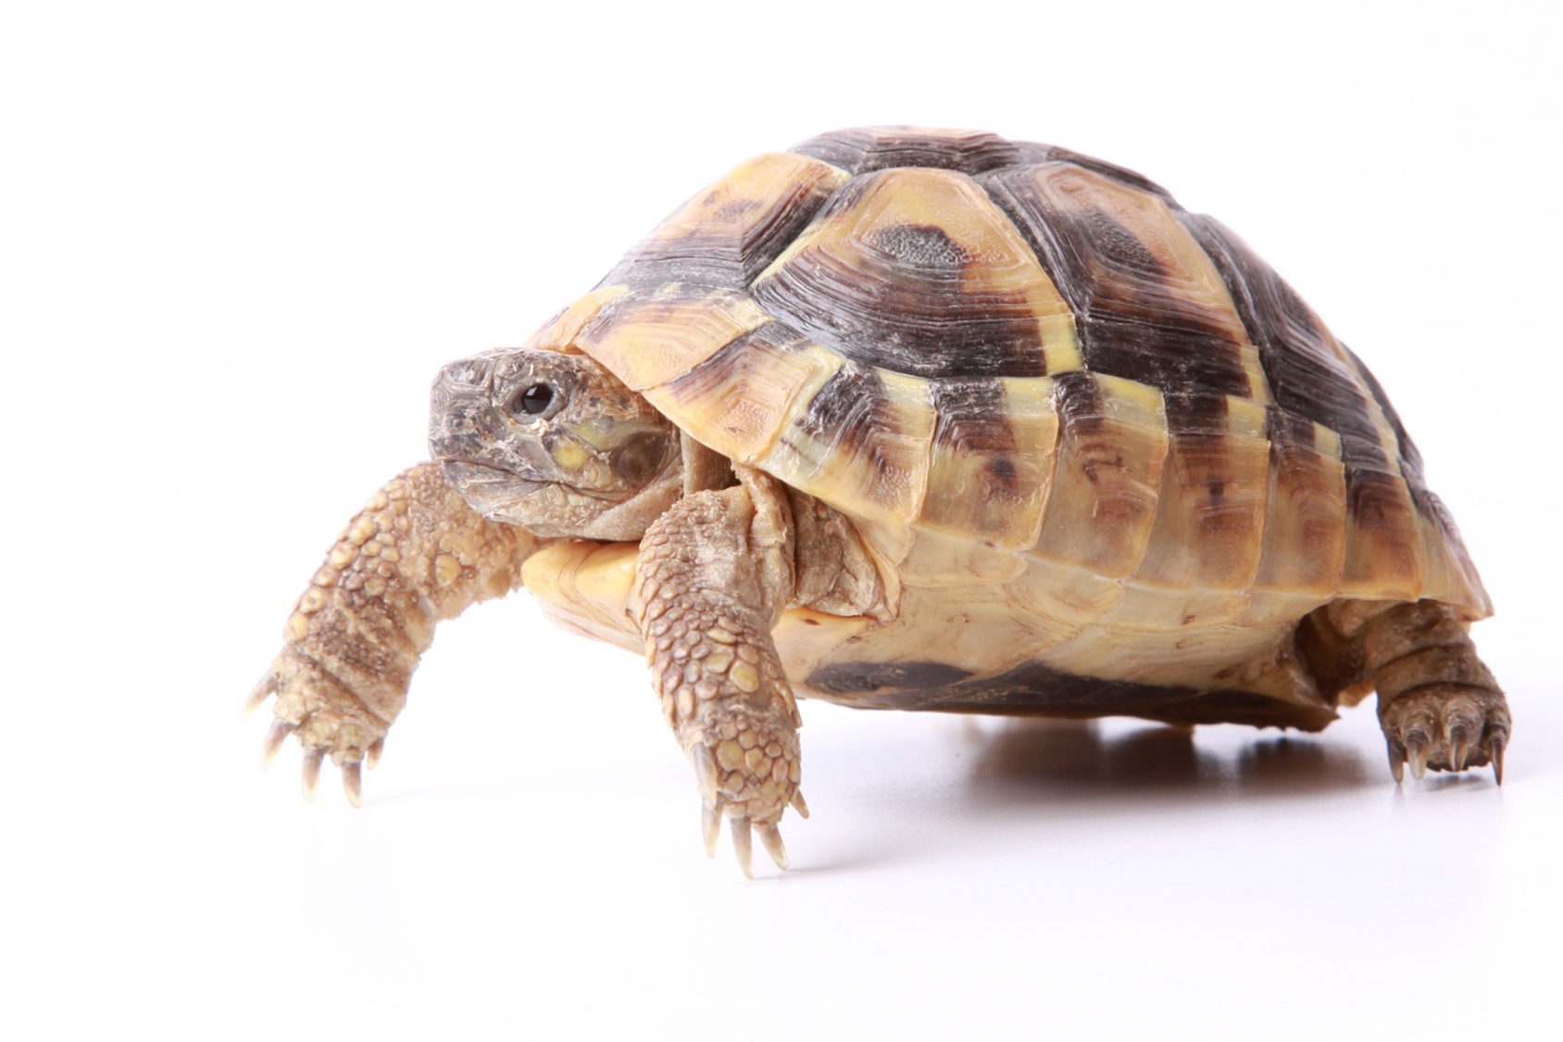

ADJECTIVE
THIS IS A SLOW ANIMAL
THE
ADJECTIVE DESCRIBES
THE NOUN

Slide 12
ADJECTIVE
THIS IS A SLOW ANIMAL
THE
ADJECTIVE DESCRIBES
THE NOUN

Slide 13


THE BUTTERFLIES ARE FLYING SLOW LY
DESCRIBES
THE
ADVERB

Slide 15
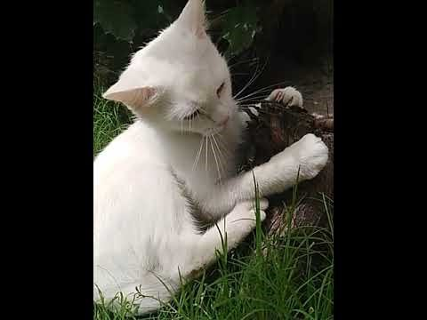

Slide 16
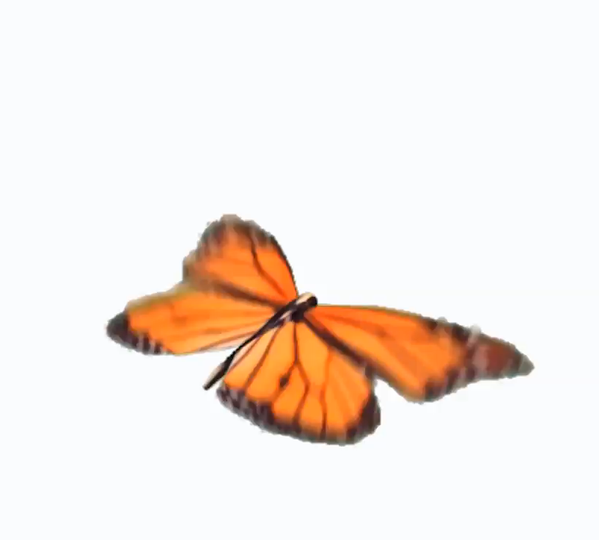

Slide 17
Quantity or number.
Quality or opinion.
Size.
Age.
Shape.
Color.
Proper adjective (often nationality, other place of origin, or material)
Purpose or qualifier.

Slide 18
that horrible big fierce dog
It is very unusual to have more than three adjectives.
Adjectives usually come in this order:
1 2 3 4 5 6 7 8
General
opinion Specific
opinion Size Shape Age Colour Nationality Material
We use some adjectives only after a link verb:
afraid alive alone asleep
content glad ill ready
sorry sure unable well
Some of the commonest -ed adjectives are normally used only after a link verb:
annoyed; finished; bored; pleased; thrilled
We say:

Slide 19
Adjectives usually come in this order:
1 | 2 | 3 | 4 | 5 | 6 | 7 | 8
General opinion | Specific opinion | Size | Shape | Age | Colour | Nationality | Material

Slide 20
