Slide 2
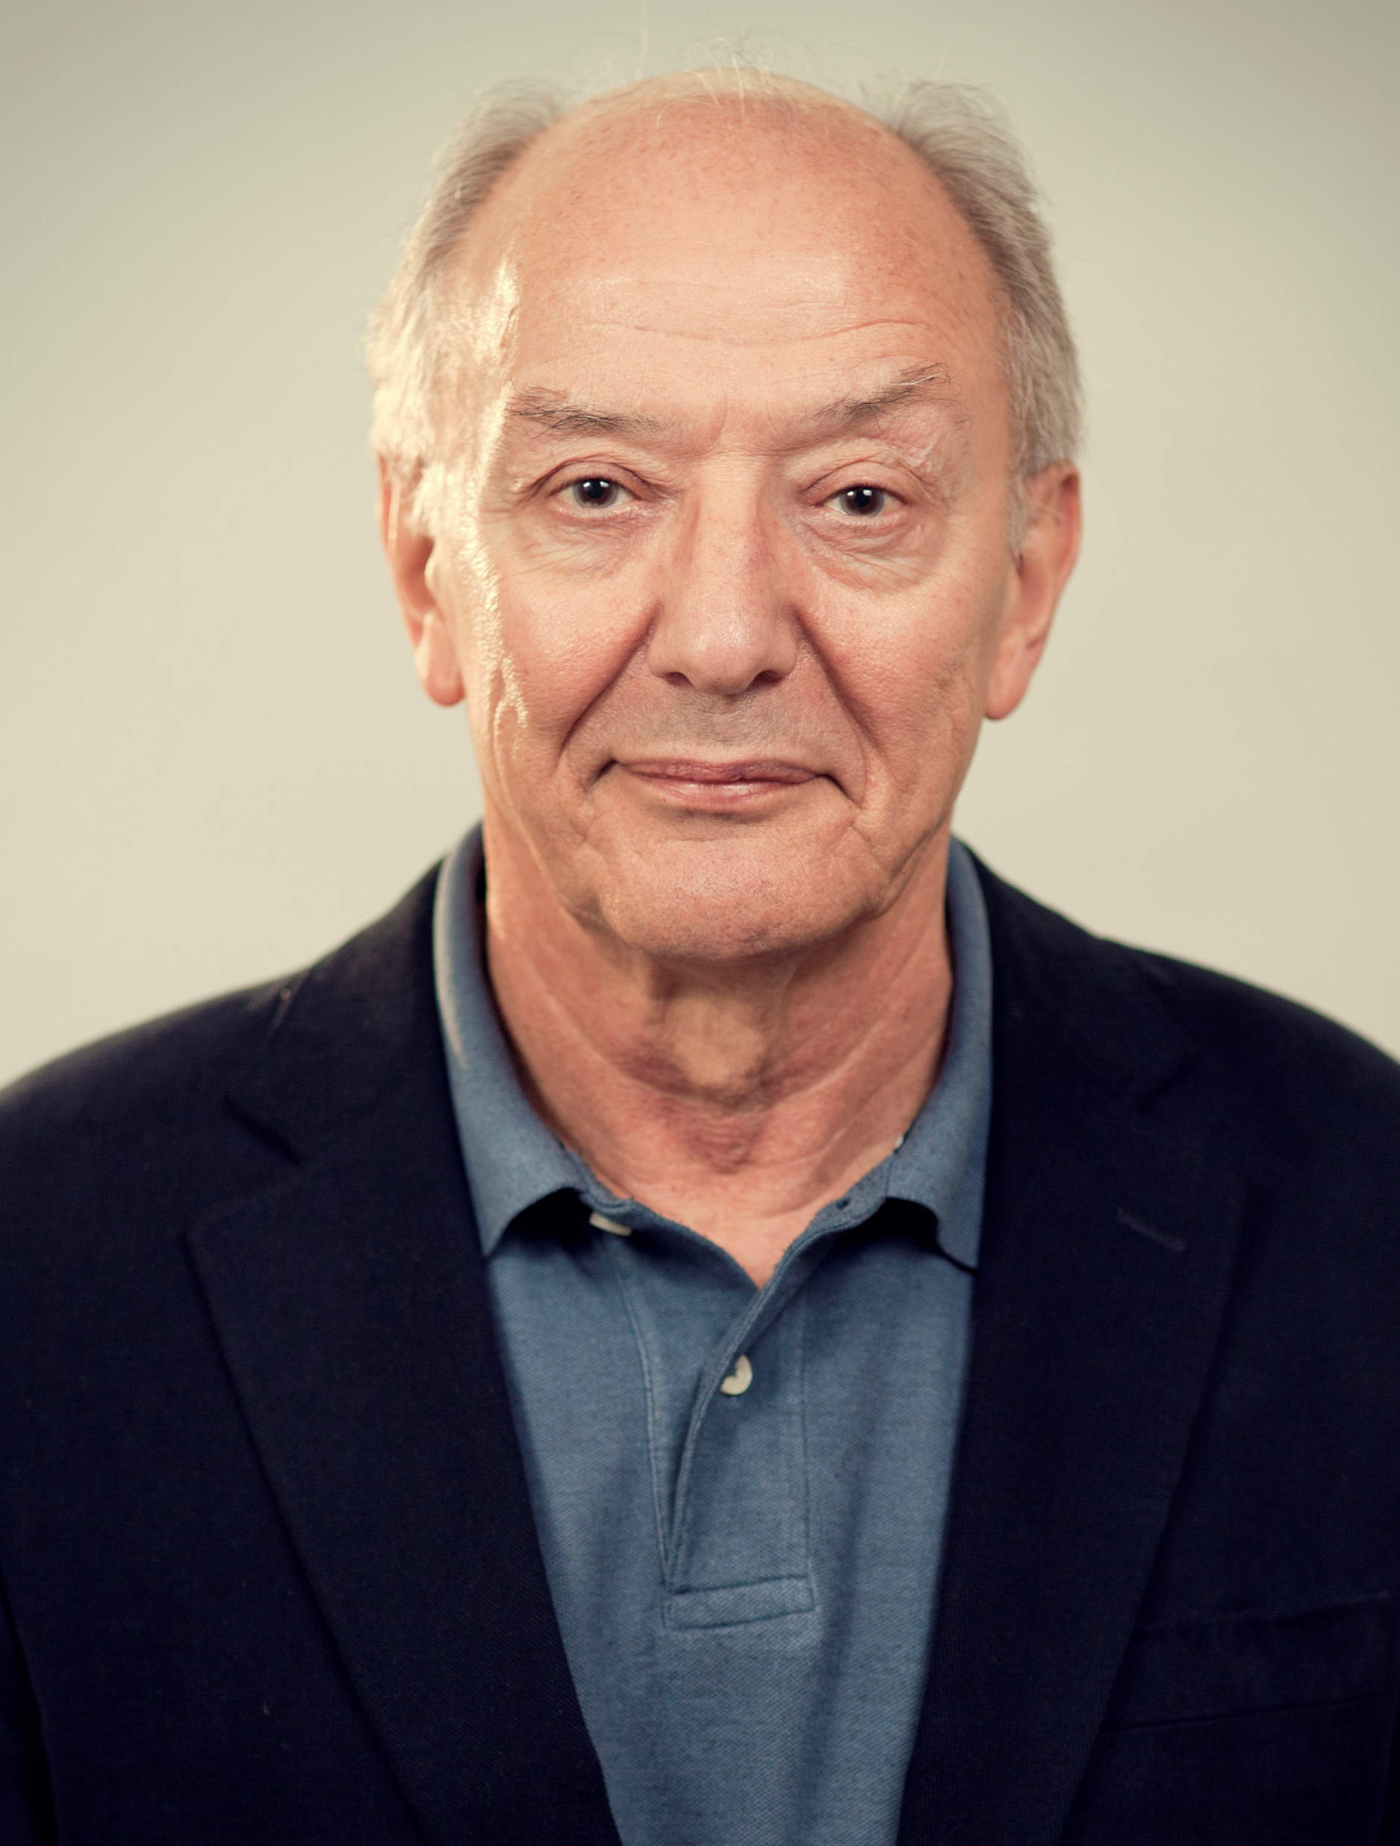

Slide 4
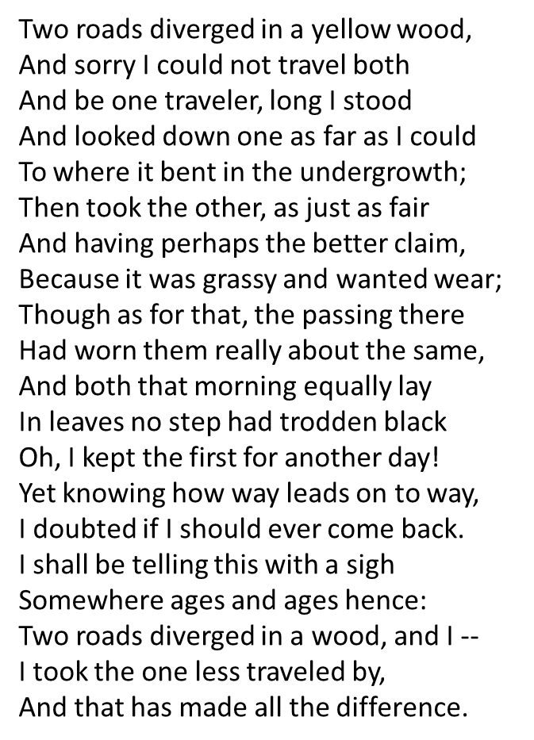
A WORD FROM ROBERT FROST
THANKS CHUM-YOU CERTAINLY MAKE A DIFFERENCE
HAPPY BIRTHDAY!

