Slide 3
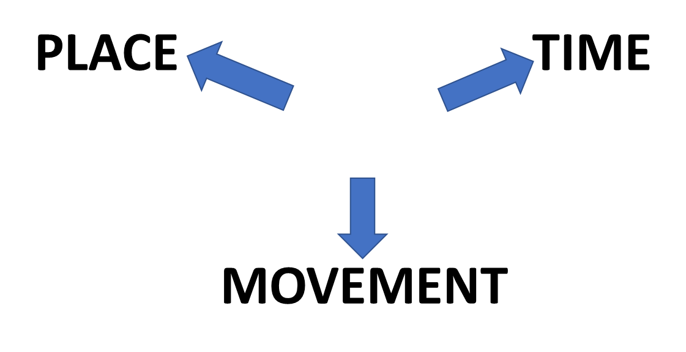

Slide 4
BY
NEAR POSITION OR LOCATION
TIME LIMIT OR
PERIOD OR SEASON
TRAVEL OR METHOD

Slide 5
NEAR POSITION OR LOCATION
BY
BY
WE LIVE THE SEA

Slide 6
TIME LIMIT
BY
BY
MIDNIGHT MOST CHILDREN ARE ASLEEP

Slide 7
BY
TRANSPORT
BY
WE OFTEN TRAVEL TRAIN

Slide 8
BY
BY
MANY CARS ARE POWERED ELECTRICITY

Slide 12
BY
NEAR POSITION OR LOCATION
TIME LIMIT OR
PERIOD OR SEASON
TRAVEL OR METHOD

Slide 13
BY
WITH
FROM

Slide 14
TYPICAL USE OF
BY

Slide 16
TYPICAL USE OF
BY

Slide 17
NEAR POSITION OR LOCATION
TIME LIMIT OR
PERIOD
OR
SEASON
TRAVEL
OR METHOD

Slide 18
NEAR POSITION OR LOCATION

Slide 19
KEY EXAMPLES
TRAVELLING BY TRAIN BY NIGHT
WALKING BY THE RIVER THAMES
POWERED BY ELECTRICITY
BY MIDNIGHT MOST CHILDREN ARE ASLEEP
LIVING BY THE SEA
THE UNIVERSITY IS BY THE SEA
POEMS WRITTEN BY CHILDREN
BY BUILDING A TEAM WE CAN

Slide 20
KEY EXAMPLES

Slide 22
TOGETHER
SAME TIME
SAME DIRECTION

Slide 23
BY

Slide 24
BY

Slide 26
KEY EXAMPLES
WITHIN THE PARK
WITH SOME FRIENDS
WITH GOOD TOOLS
WITH NO DELAY
WITH NO TIME TO LOSE
BOB IS WITH PETER

Slide 27
ALSO……..
WE CAN BUILD SOFTWARE WITH
THIS DATA
XXXXX
WITH
XXXXX
EXPERIENCE AND RESULTS

Slide 28
ALSO……..
A MAN
WITH
RED HAIR
OWNERSHIP

Slide 31
START
LEAVING

Slide 32
BY
HERE THE CITY IS 12 MILES AWAY

Slide 33
START
NEXT WEEK THE NEW SHOP WILL BE OPEN

Slide 34
WE DROVE AWAY PARIS IN A HURRY!
FROM

Slide 35
KEY EXAMPLES
THE NEW LIBRARY WILL BE OPEN FROM NEXT WEDNESDAY
FROM HERE THE CITY IS 12 MILES AWAY
JACK COMES FROM SCOTLAND
I GOT THIS BOOK FROM JANE
FROM MY UNDERSTANDING THERE ARE ABOUT 10 MILLION PEOPLE LIVING IN
AND AROUND LONDON
HE RAN AWAY FROM HOME WHEN HE WAS 12 YEARS OLD
TIME
DISTANCE
PLACE
PLACE
MOVEMENT
XXXX

Slide 36
LISTENING PRACTICE
JUST LISTEN...

Slide 37
BY
WITH
FROM
USUAL USES!

Slide 38
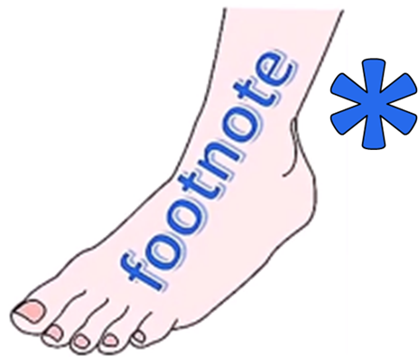
ENGLISH LANGUAGE STUDY
PREPOSITIONS STUDY

Slide 40
STORY BOARD

Slide 41
STORY BOARD

Slide 42
STORY BOARD

Slide 44
BY

Slide 45
BY

Slide 48
BY

Slide 49
BY
BY
WE OFTEN TRAVEL TRAIN

Slide 50
BY
BY
WE OFTEN TRAVEL TRAIN

Slide 54
NEAR
POSITION
OR
LOCATION

Slide 55
NEAR
POSITION
OR
LOCATION

Slide 56
NEAR
POSITION
OR
LOCATION

Slide 57
BY
NEAR POSITION OR LOCATION
TIME LIMIT OR
PERIOD OR SEASON
TRAVEL OR METHOD

Slide 58
NEAR POSITION
OR
LOCATION

Slide 59
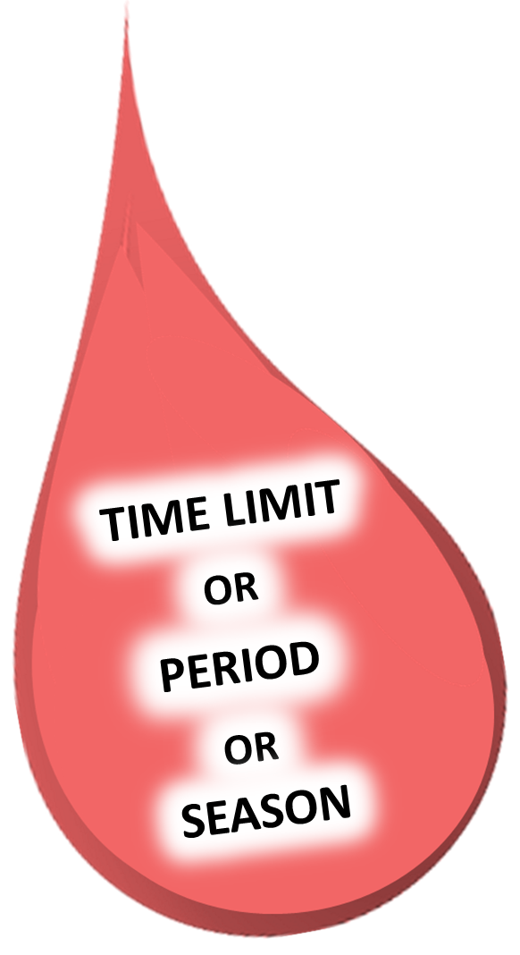

Slide 60
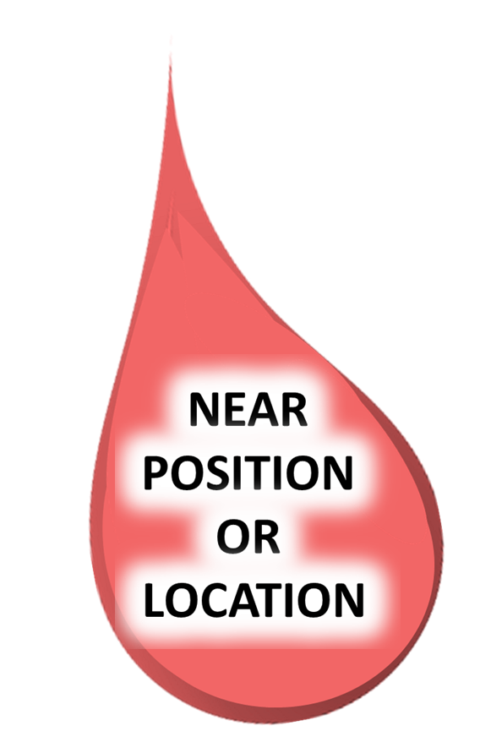

Slide 61
BY
WITH
FROM

Slide 62
BY

