Slide 1
BY
BY

Slide 4
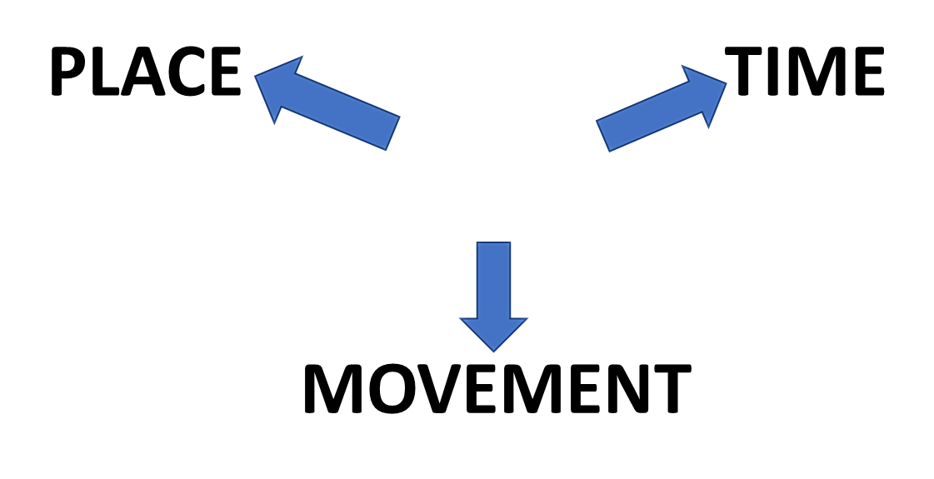
TYPICAL USES OF BY
BY
NEAR POSITION OR LOCATION
TIME LIMIT OR
PERIOD
OR
SEASON
TRAVEL OR METHOD

Slide 5
NEAR POSITION OR LOCATION
BY
BY
WE LIVE THE SEA

Slide 6
TIME LIMIT
BY
BY
MIDNIGHT MOST CHILDREN ARE ASLEEP

Slide 7
BY
TRANSPORT
BY
WE OFTEN TRAVEL TRAIN

Slide 8
BY
BY
MANY CARS ARE POWERED ELECTRICITY

Slide 9
PREPOSITIONS
BY

Slide 10
KEY EXAMPLES
TRAVELLING BY TRAIN BY NIGHT
WALKING BY THE RIVER THAMES
POWERED BY ELECTRICITY
BY MIDNIGHT MOST CHILDREN ARE ASLEEP
LIVING BY THE SEA
THE UNIVERSITY IS BY THE SEA
POEMS WRITTEN BY CHILDREN
BY BUILDING A TEAM WE CAN

Slide 11
TYPICAL USES OF

Slide 13
TOGETHER
SAME TIME
SAME DIRECTION

Slide 14
BY

Slide 15
BY

Slide 16
MOVEMENT
TONY WAS DANCING JULIE

Slide 17
KEY EXAMPLES
WITHIN THE PARK
WITH SOME FRIENDS
WITH GOOD TOOLS
WITH NO DELAY
WITH NO TIME TO LOSE
BOB IS WITH PETER

Slide 18
ALSO……..
WE CAN BUILD SOFTWARE WITH
THIS DATA
XXXXX
WITH
XXXXX
EXPERIENCE AND RESULTS

Slide 19
ALSO……..
A MAN
WITH
RED HAIR
OWNERSHIP

Slide 20
PREPOSITIONS
WITH

Slide 21
TYPICAL USES OF

Slide 22
START
LEAVING

Slide 23
BY
HERE THE CITY IS 12 MILES AWAY

Slide 24
START
NEXT WEEK THE NEW SHOP WILL BE OPEN

Slide 25
WE DROVE AWAY PARIS IN A HURRY!
FROM

Slide 29
KEY EXAMPLES
THE NEW LIBRARY WILL BE OPEN FROM NEXT WEDNESDAY
FROM HERE THE CITY IS 12 MILES AWAY
JACK COMES FROM SCOTLAND
I GOT THIS BOOK FROM JANE
HE RAN AWAY FROM HOME WHEN HE WAS 12 YEARS OLD
TIME
DISTANCE
PLACE
PLACE
MOVEMENT

Slide 30
PREPOSITIONS
FROM

Slide 31
LISTENING PRACTICE
JUST LISTEN...

Slide 32
BY
WITH
FROM
USUAL USES!

Slide 33
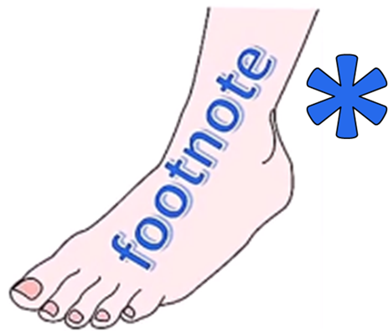
ENGLISH LANGUAGE STUDY
PREPOSITIONS STUDY

Slide 35
STORY BOARD

Slide 36
STORY BOARD

Slide 37
STORY BOARD

Slide 39
BY

Slide 40
BY

Slide 43
BY

Slide 44
BY
BY
WE OFTEN TRAVEL TRAIN

Slide 45
BY
BY
WE OFTEN TRAVEL TRAIN

Slide 49
NEAR
POSITION
OR
LOCATION

Slide 50
NEAR
POSITION
OR
LOCATION

Slide 51
NEAR
POSITION
OR
LOCATION

Slide 52
BY
NEAR POSITION OR LOCATION
TIME LIMIT OR
PERIOD OR SEASON
TRAVEL OR METHOD

Slide 53
NEAR POSITION
OR
LOCATION

Slide 54
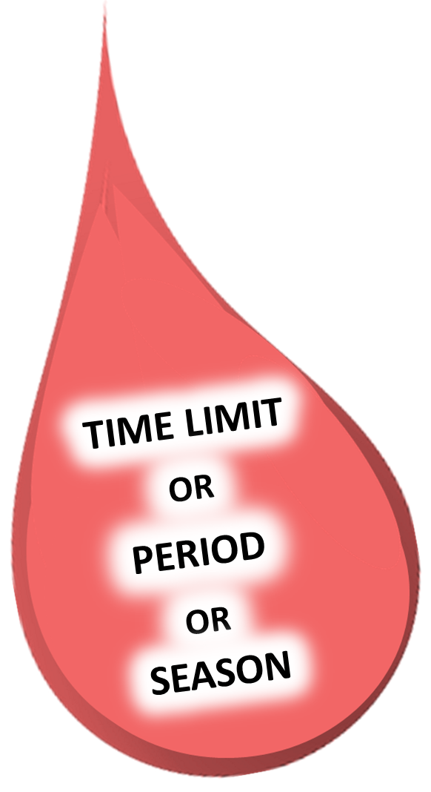

Slide 55
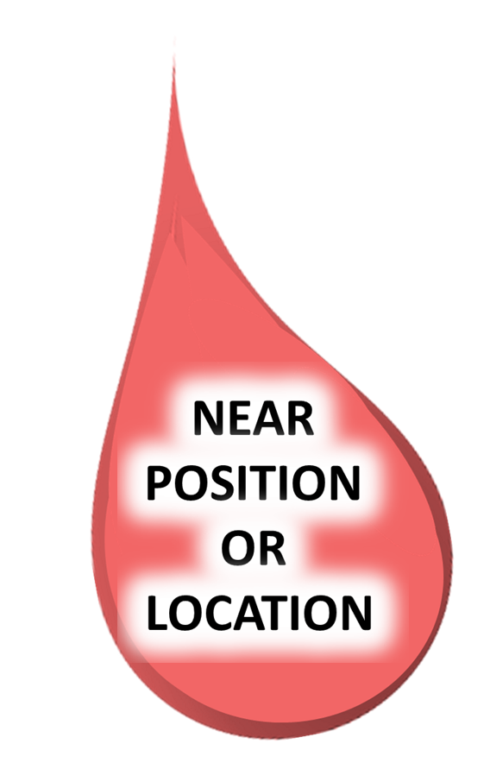

Slide 56
BY
WITH
FROM

Slide 57
BY

Slide 59
BY
NEAR POSITION OR LOCATION
TIME LIMIT OR
PERIOD OR SEASON
TRAVEL OR METHOD

Slide 60
TYPICAL USE OF
BY

Slide 61
NEAR POSITION OR LOCATION

Slide 63
NEAR POSITION OR LOCATION
TIME LIMIT OR
PERIOD
OR
SEASON
TRAVEL
OR METHOD

Slide 64
PREPOSITIONS
WITH

Slide 65
TYPICAL USES OF

Slide 66
START
LEAVING

Slide 67
BY
HERE THE CITY IS 12 MILES AWAY

Slide 68
START
NEXT WEEK THE NEW SHOP WILL BE OPEN

Slide 69
WE DROVE AWAY PARIS IN A HURRY!
FROM

Slide 73
KEY EXAMPLES
THE NEW LIBRARY WILL BE OPEN FROM NEXT WEDNESDAY
FROM HERE THE CITY IS 12 MILES AWAY
JACK COMES FROM SCOTLAND
I GOT THIS BOOK FROM JANE
HE RAN AWAY FROM HOME WHEN HE WAS 12 YEARS OLD
TIME
DISTANCE
PLACE
PLACE
MOVEMENT

