Slide 1
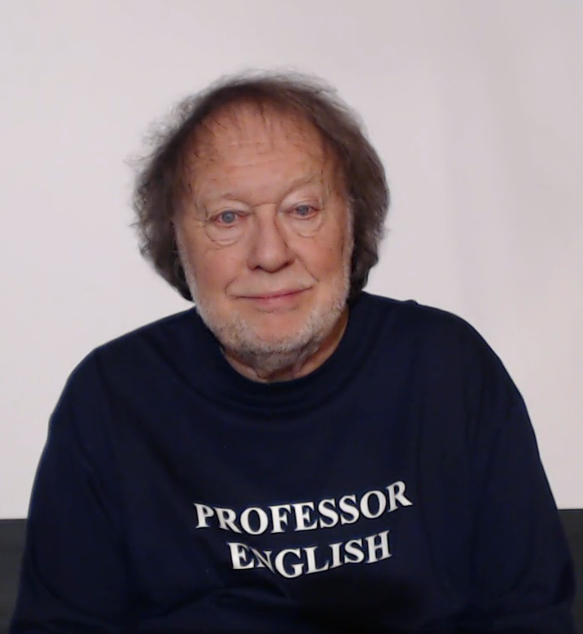
WELCOME
TO
COMPREHENSION

