Slide 1
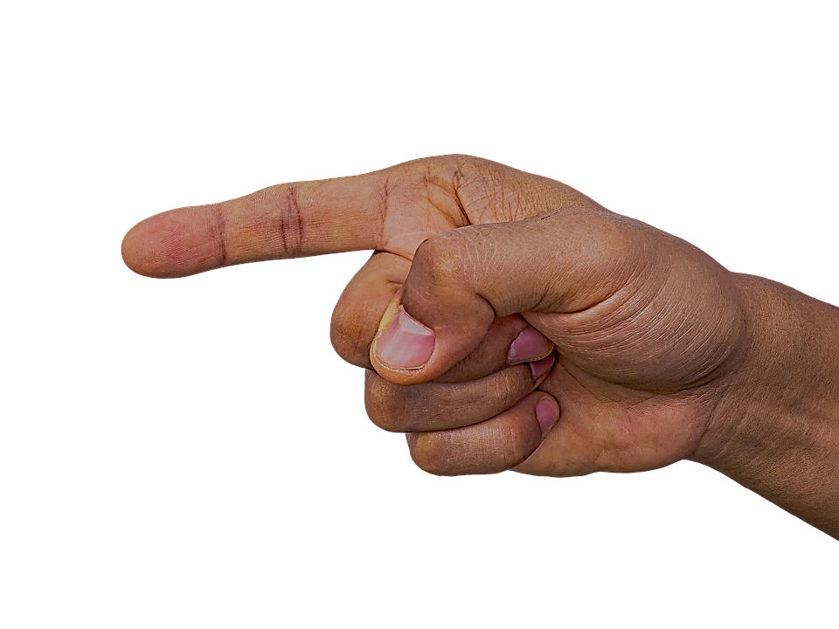
BILLIONS OF PEOPLE LIVE
THIS PLANET
LOCATION

Slide 2
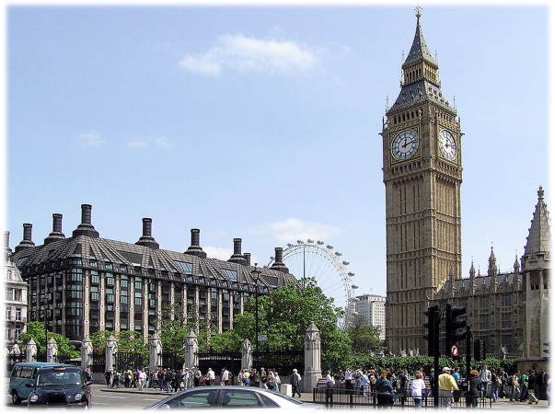
POSITION
ON
MEANS GENERAL OVER POSITION
THE CLOCK IS
ON
THE TOWER
PLACE

Slide 3
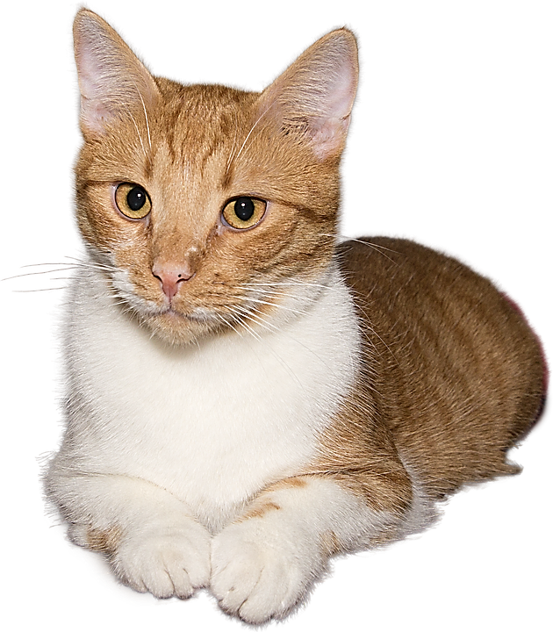
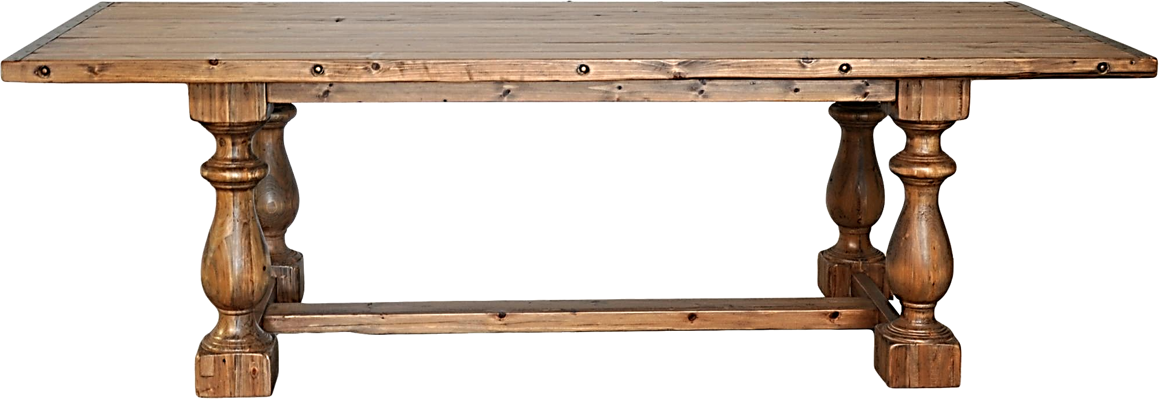
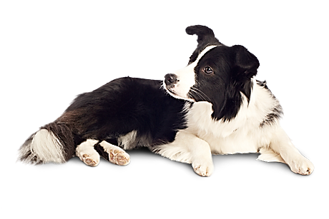
THE CAT IS
ON
THE TABLE
THE DOG IS UNDER
THE TABLE
POSITION

Slide 4
THE CAT IS
ON
THE TABLE
ON
MEANS GENERAL OVER POSITION
POSITION

Slide 5
IMPORTANT NOTE!
PLACE
HAS TWO ASPECTS
LOCATION AND POSITION
GENERAL AREA
EXACT PLACE OR
POINT
STOP THE VIDEO WHILE YOU CHECK

Slide 6
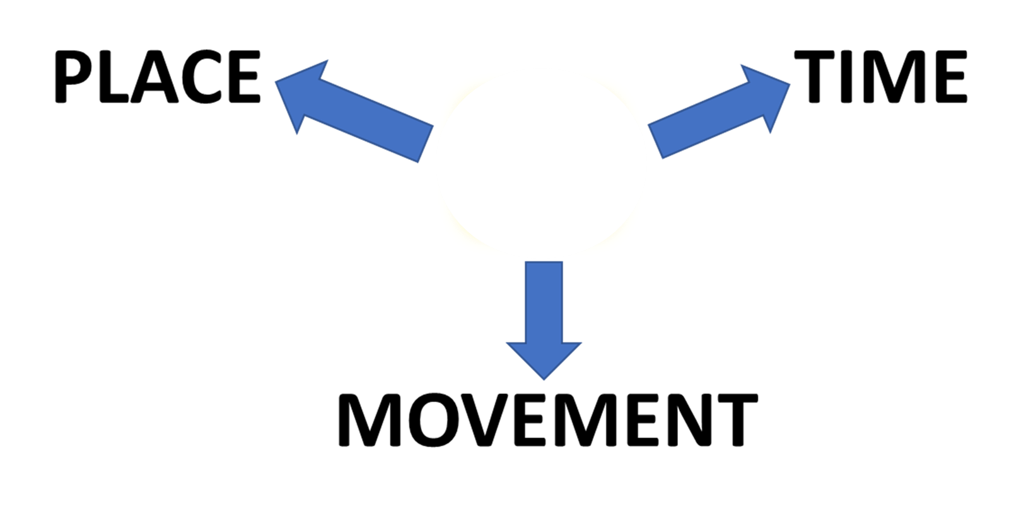
SUMMARY
ON

