Slide 1
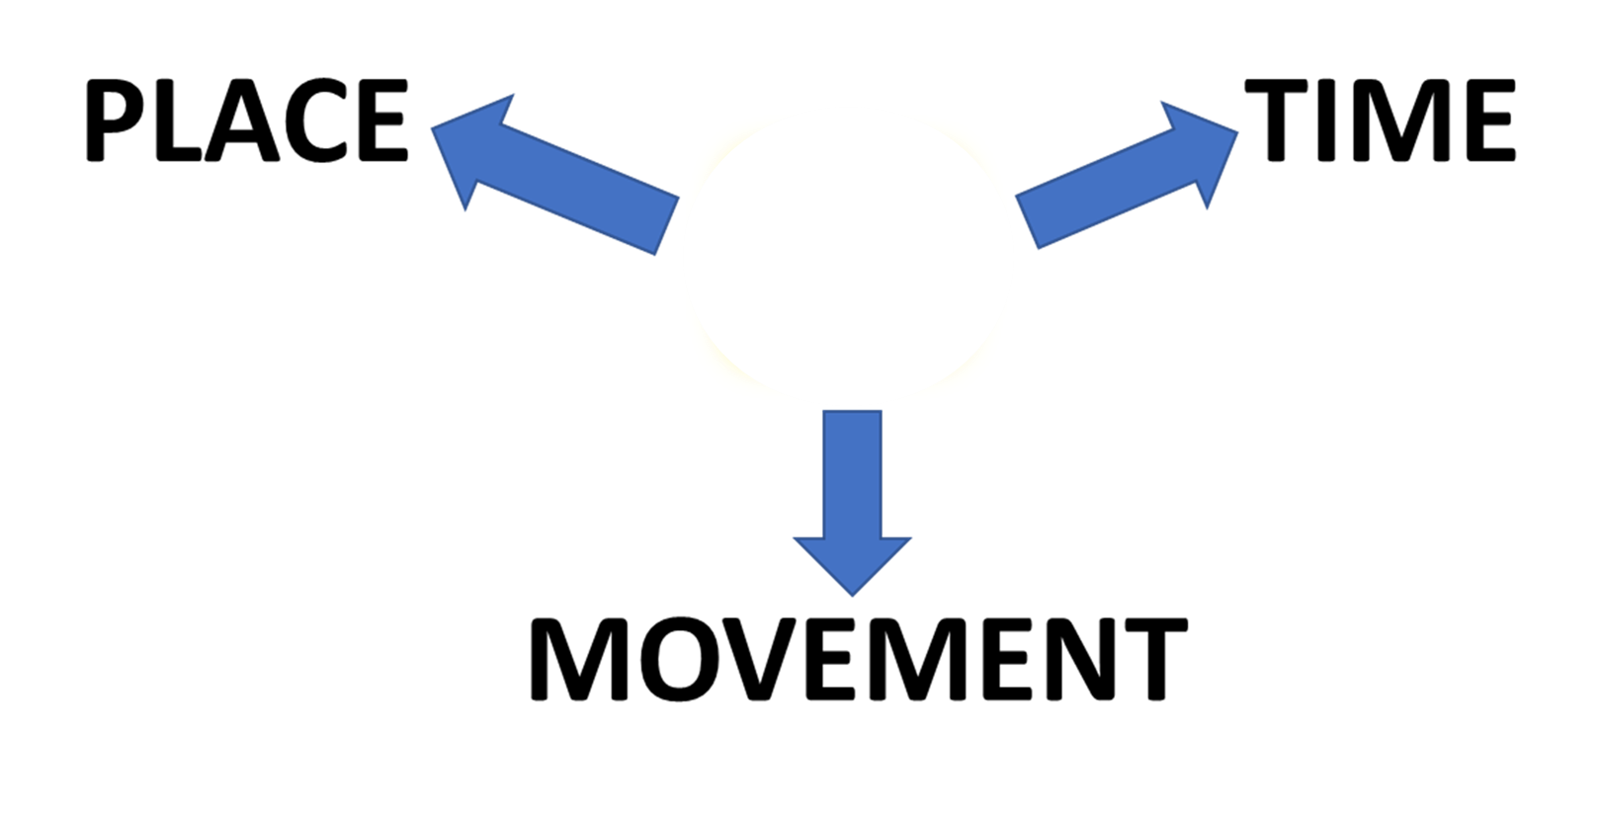
PREPOSITIONS
TIME
ON

Slide 2
PREPOSITIONS
TIME
ON

Slide 3
TIME
IF THE SHIP IS
ON TIME
WE WILL MEET ON FRIDAY
SOON AFTER THREE O’CLOCK

Slide 4
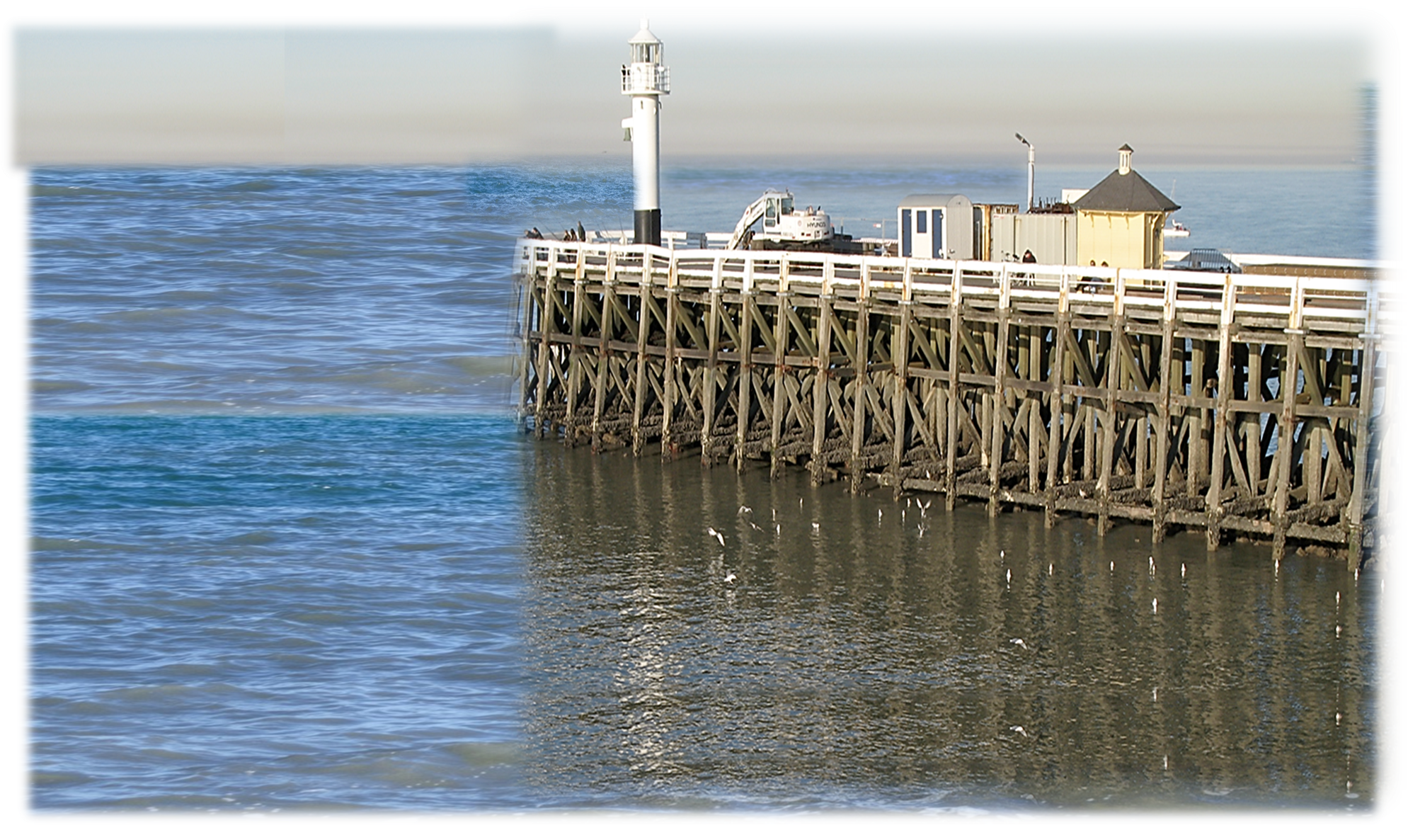
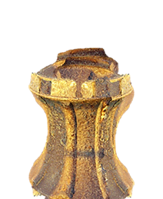

Slide 5
PREPOSITIONS
ON
MOVEMENT

Slide 6
PREPOSITIONS
ON
MOVEMENT

Slide 7
