Slide 1
TYPICAL EXAMPLES!
THE BOOKS ARE THE TABLE
PLACE
CHECK
THIS
WORD
WE PLAY BASKETBALL TUESDAYS
TIME
JOE IS CRUISING A FAST MOTORBOAT
MOVEMENT

Slide 2
TYPICAL EXAMPLES!
NOT MANY PEOPLE LIVE ON THE SCOTTISH ISLANDS
PLACE
WE VISITED VIENNA ON THE WAY TO PRAGUE
I HAVE TRAVELLED HUNDREDS OF MILES ON MY BICYCLE

Slide 3
ON FOR TRANSPORT MOVEMENT
PETER IS VERY FAST A BICYCLE
I CAN ALWAYS RELAX A TRAIN
THERE ARE OFTEN MOVIES AN AEROPLANE
JANE LOVES HOLIDAYS CRUISE SHIPS

Slide 4
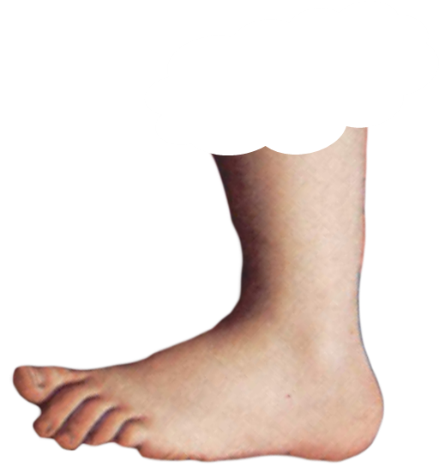
ENGLISH LANGUAGE STUDY
BUT NOTICE
IN A TAXI IN A CAR
FOOTNOTE
FOOTNOTE

Slide 5
ENGLISH LANGUAGE STUDY
CHECK
THIS
WORD
IN TIME
EARLY ENOUGH
ON TIME
PUNCTUALLY ACCORDING TO SCHEDULE
FOOTNOTE
FOOTNOTE

Slide 7
ON
MEANS GENERAL OVER POSITION
ON

Slide 10
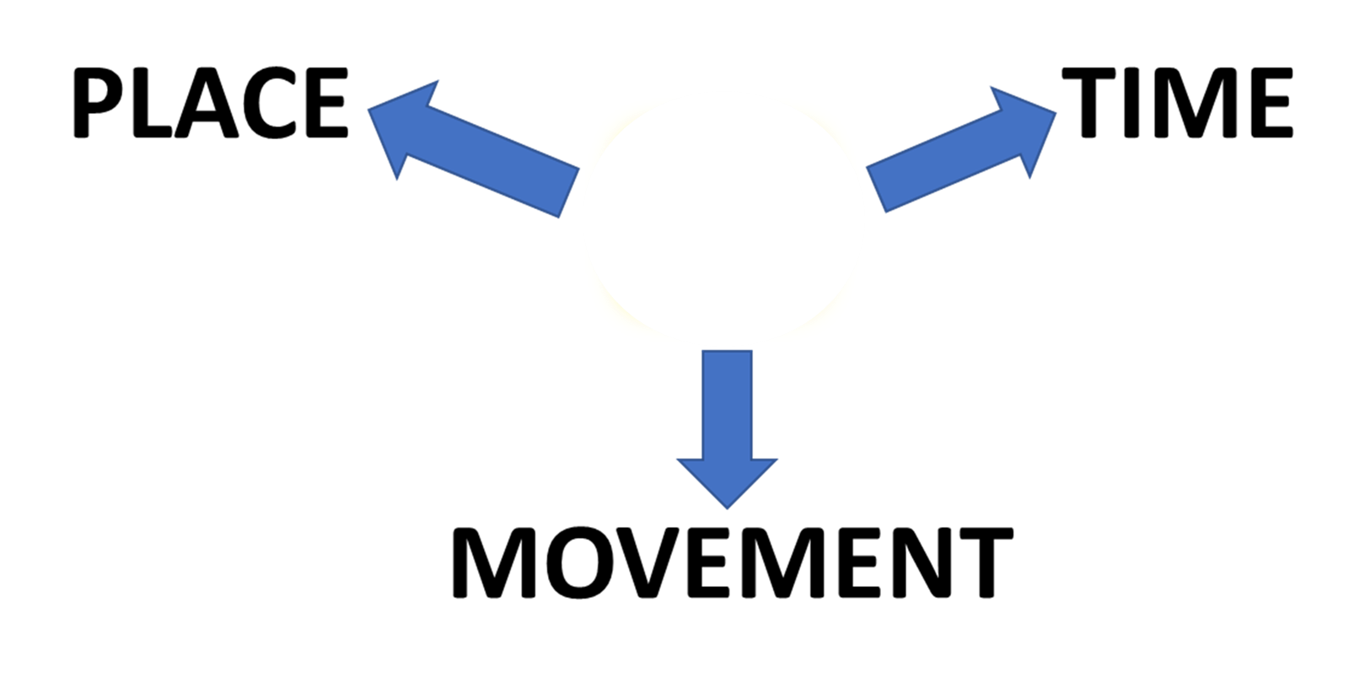
SUMMARY
ON

