Slide 1
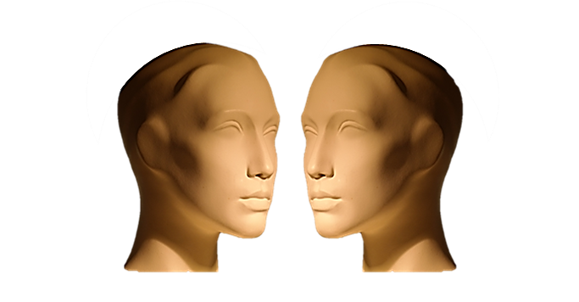
STORY BOARD
JUST LISTEN...

