Slide 1
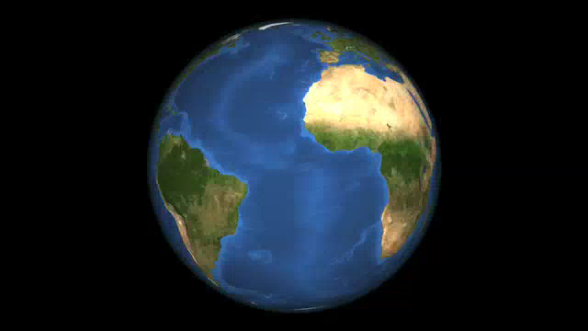

Slide 2
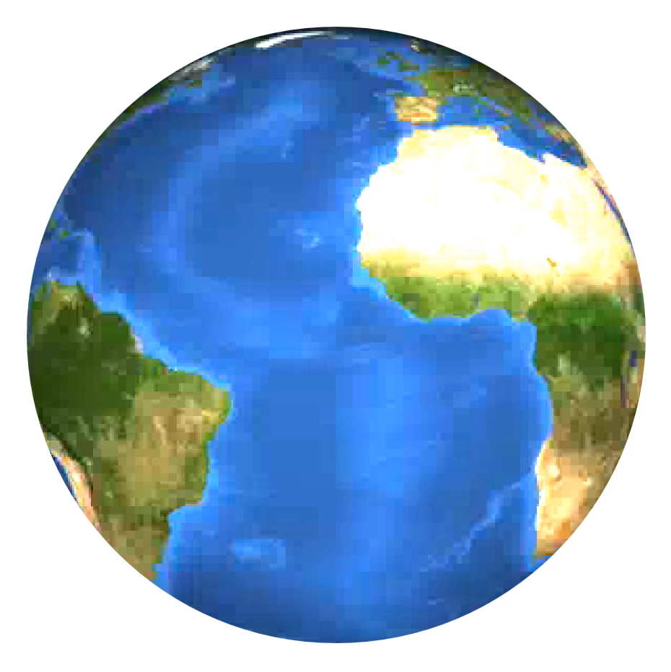
THE WORLD AT LARGE

Slide 3

WE STOP THE WORLD !
TO SHOW YOU SOME
BRILLIANT ASPECTS
OF ART AND MEDIA
WHICH DEFINE
OUR CULTURE

Slide 4


Slide 5
