Slide 1
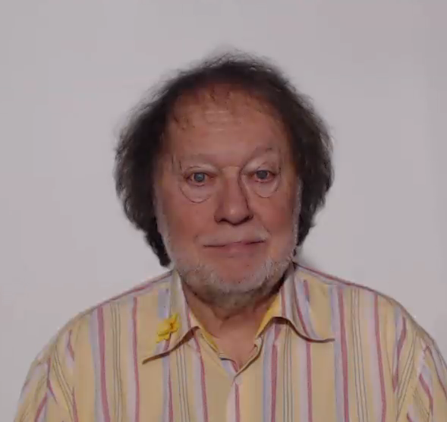
WELCOME
TO
USE OF ENGLISH
PLAY THIS VIDEO OR CHOOSE A LESSON FROM THE LIST BELOW

Slide 2
WELCOME
TO
USE OF ENGLISH
PLAY THIS VIDEO OR CHOOSE A LESSON FROM THE LIST BELOW

Slide 3
USE OF ENGLISH
PLAY THIS VIDEO OR CHOOSE A LESSON FROM THE LIST BELOW

Slide 4
USE OF ENGLISH
PLAY THIS VIDEO OR CHOOSE A LESSON FROM THE LIST BELOW

Slide 5

THE HISTORYSCOPE

