Slide 1
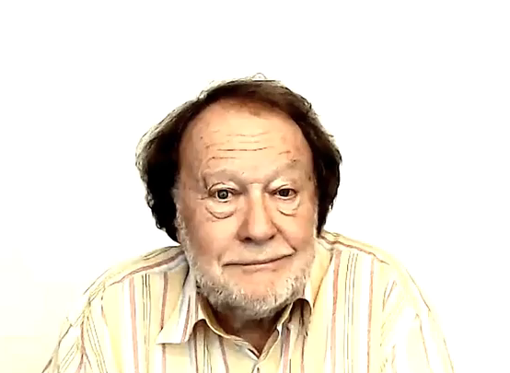
POSSIBILITIES
AND
OBLIGATIONS

