Slide 1
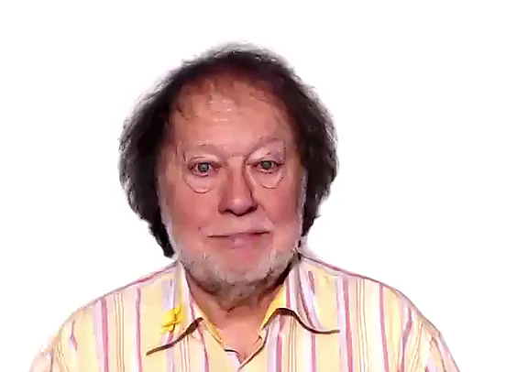
WELCOME
TO
USE OF ENGLISH

