Slide 1
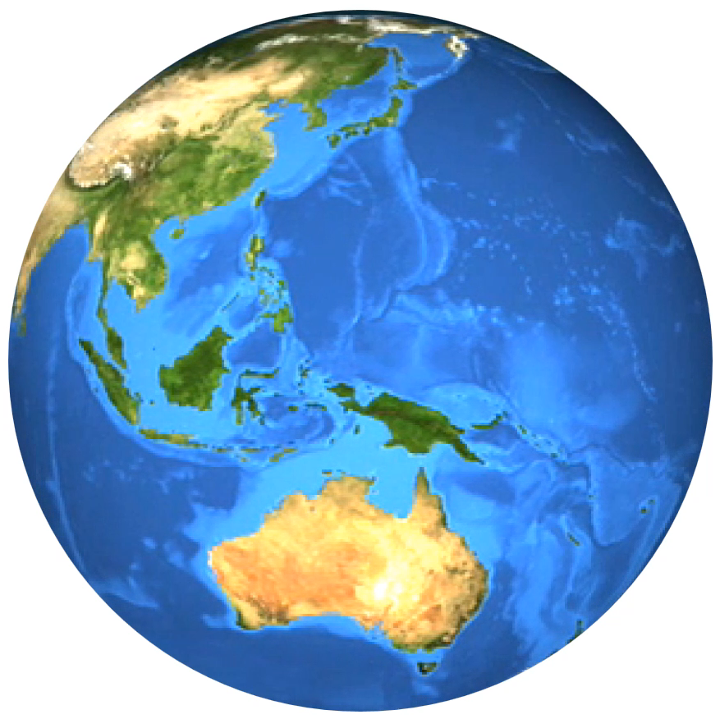
THE WORLD AT LARGE

