Slide 1
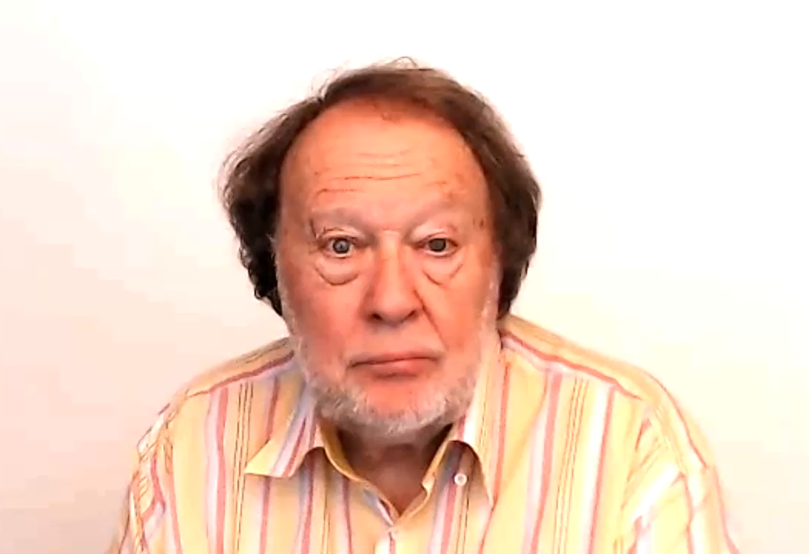
PHRASAL VERBS

