Slide 1
CONTENT
EVENT
SITUATION
FEELING
ATMOSPHERE
MELODY
FACTS

Slide 2
CONTENT
SITUATION
FEELING
ATMOSPHERE
EVENT
FACTS
MELODY

Slide 3
HI!
HERE’S JOKE OF THE DAY

Slide 4
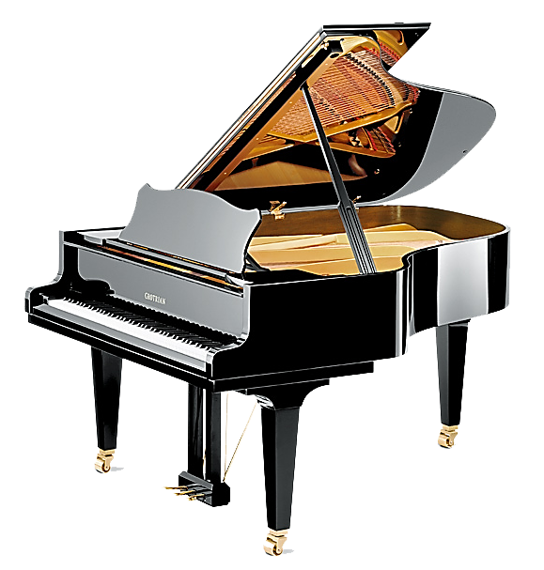

Slide 6
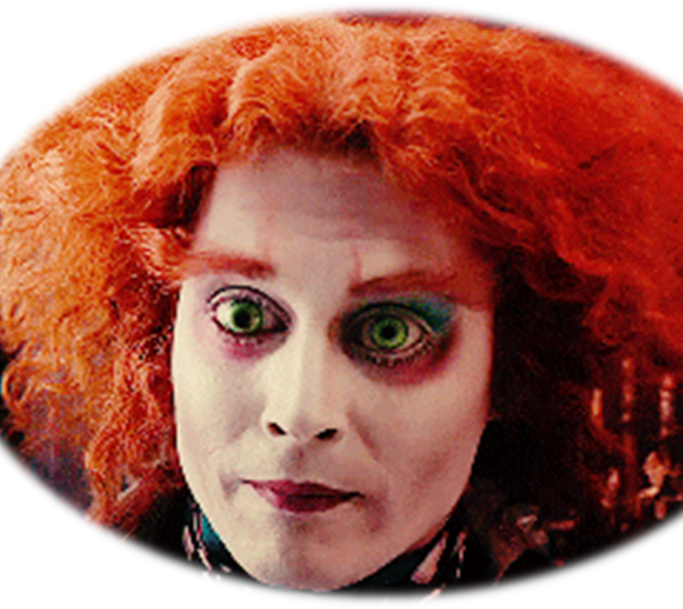
This Photo by Unknown Author is licensed under CC BY-NC

Slide 10
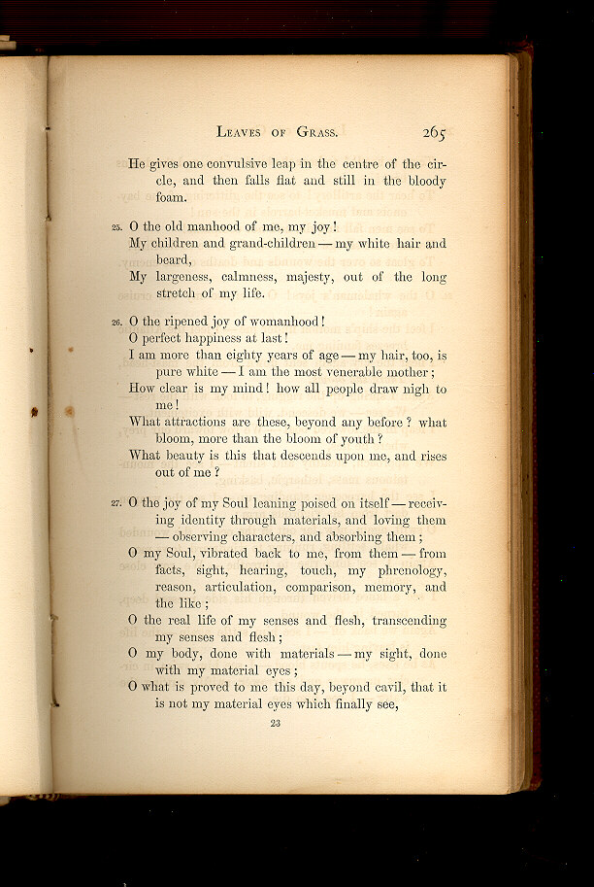
This Photo by Unknown Author is licensed under CC BY-SA-NC

