Slide 1
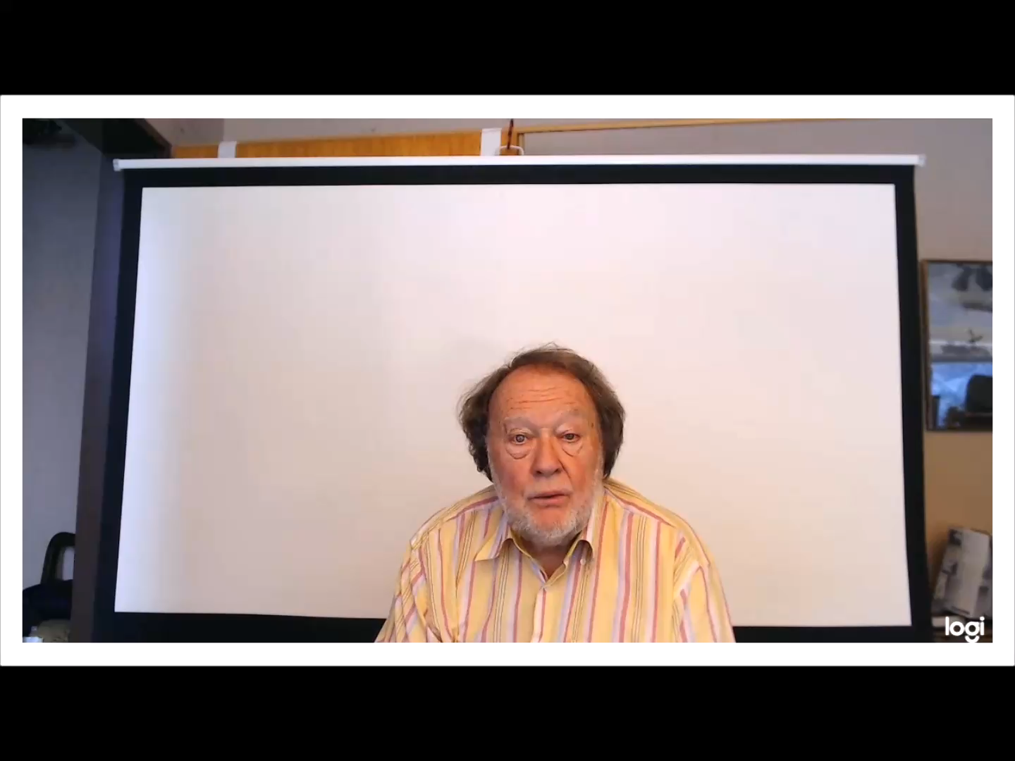
ASSESSING
AND
FORECASTING

