Slide 1
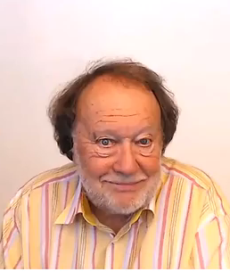
AGREEING
AND
DISAGREEING

