Slide 1
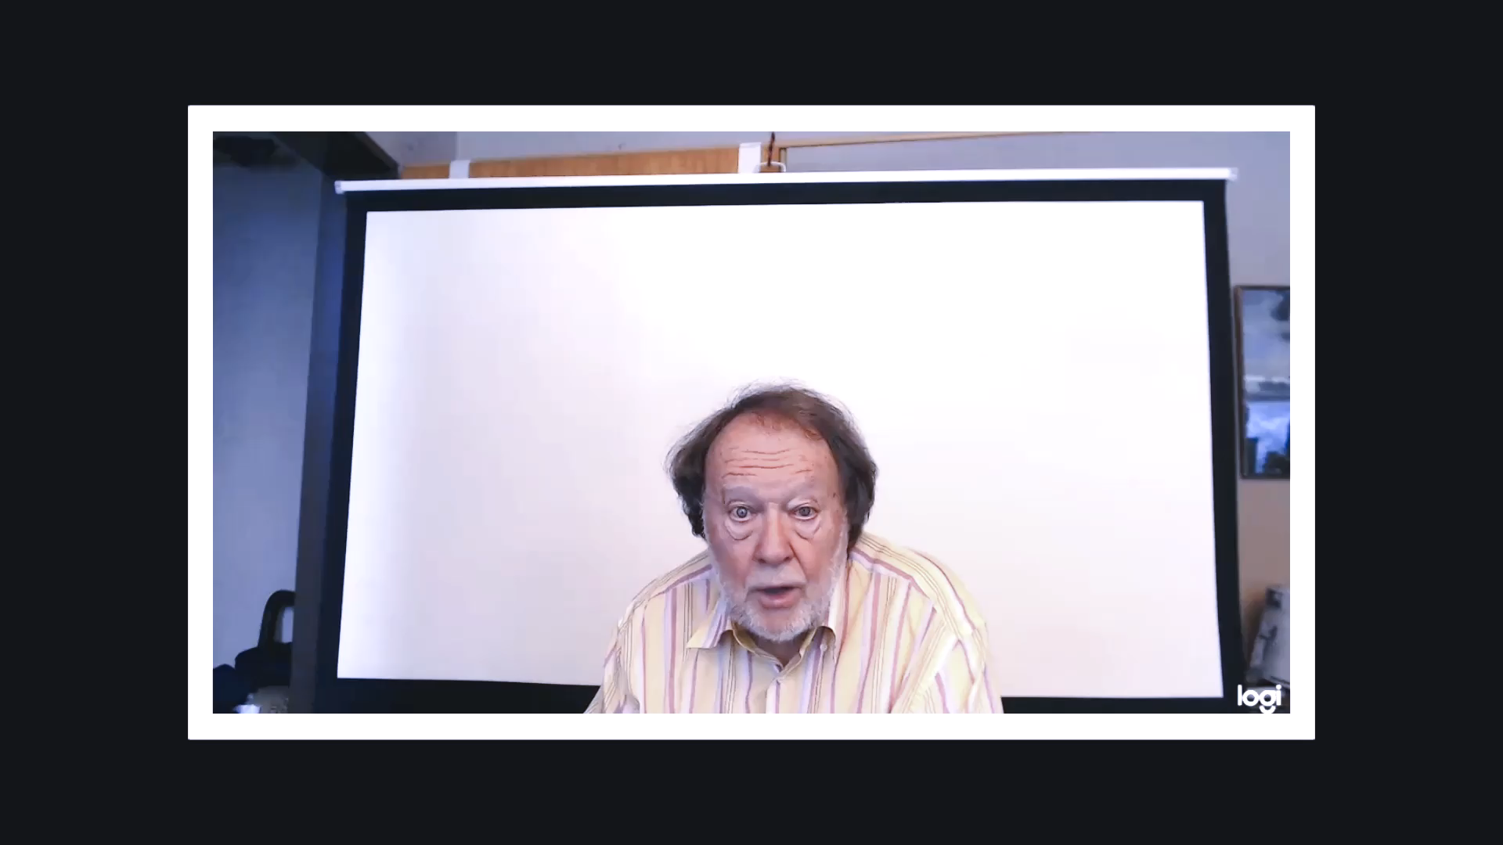
REACTING
AND RESPONDING

