Slide 1
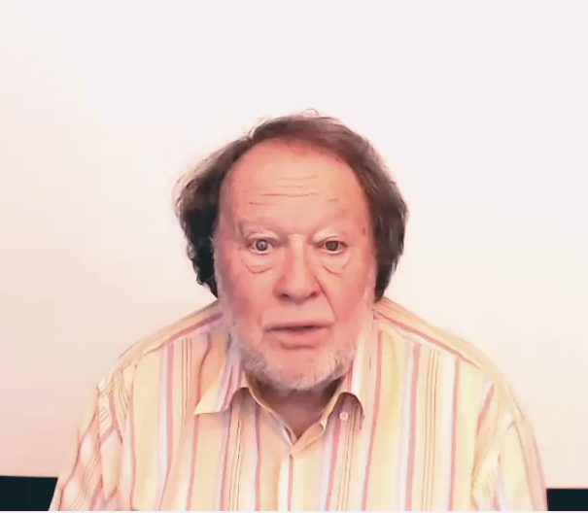
COMPARING
AND
CONTRASTING

