Slide 1
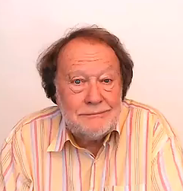
POSSIBILITY
AND
OBLIGATION

