Slide 1
WHAT ARE…
CONTEXTS
?
CHECK THIS WORD

Slide 2
KEY WORDS

Slide 3
KEY WORDS
EVENT
SITUATION

Slide 4
CONTEXTS
All the aspects which define something
are the
CONTEXT

Slide 5
REMEMBER THIS!

Slide 6
ARTS

Slide 7
Typical contexts
HOME
HAPPINESS
FAMILY
FRIENDS

Slide 8
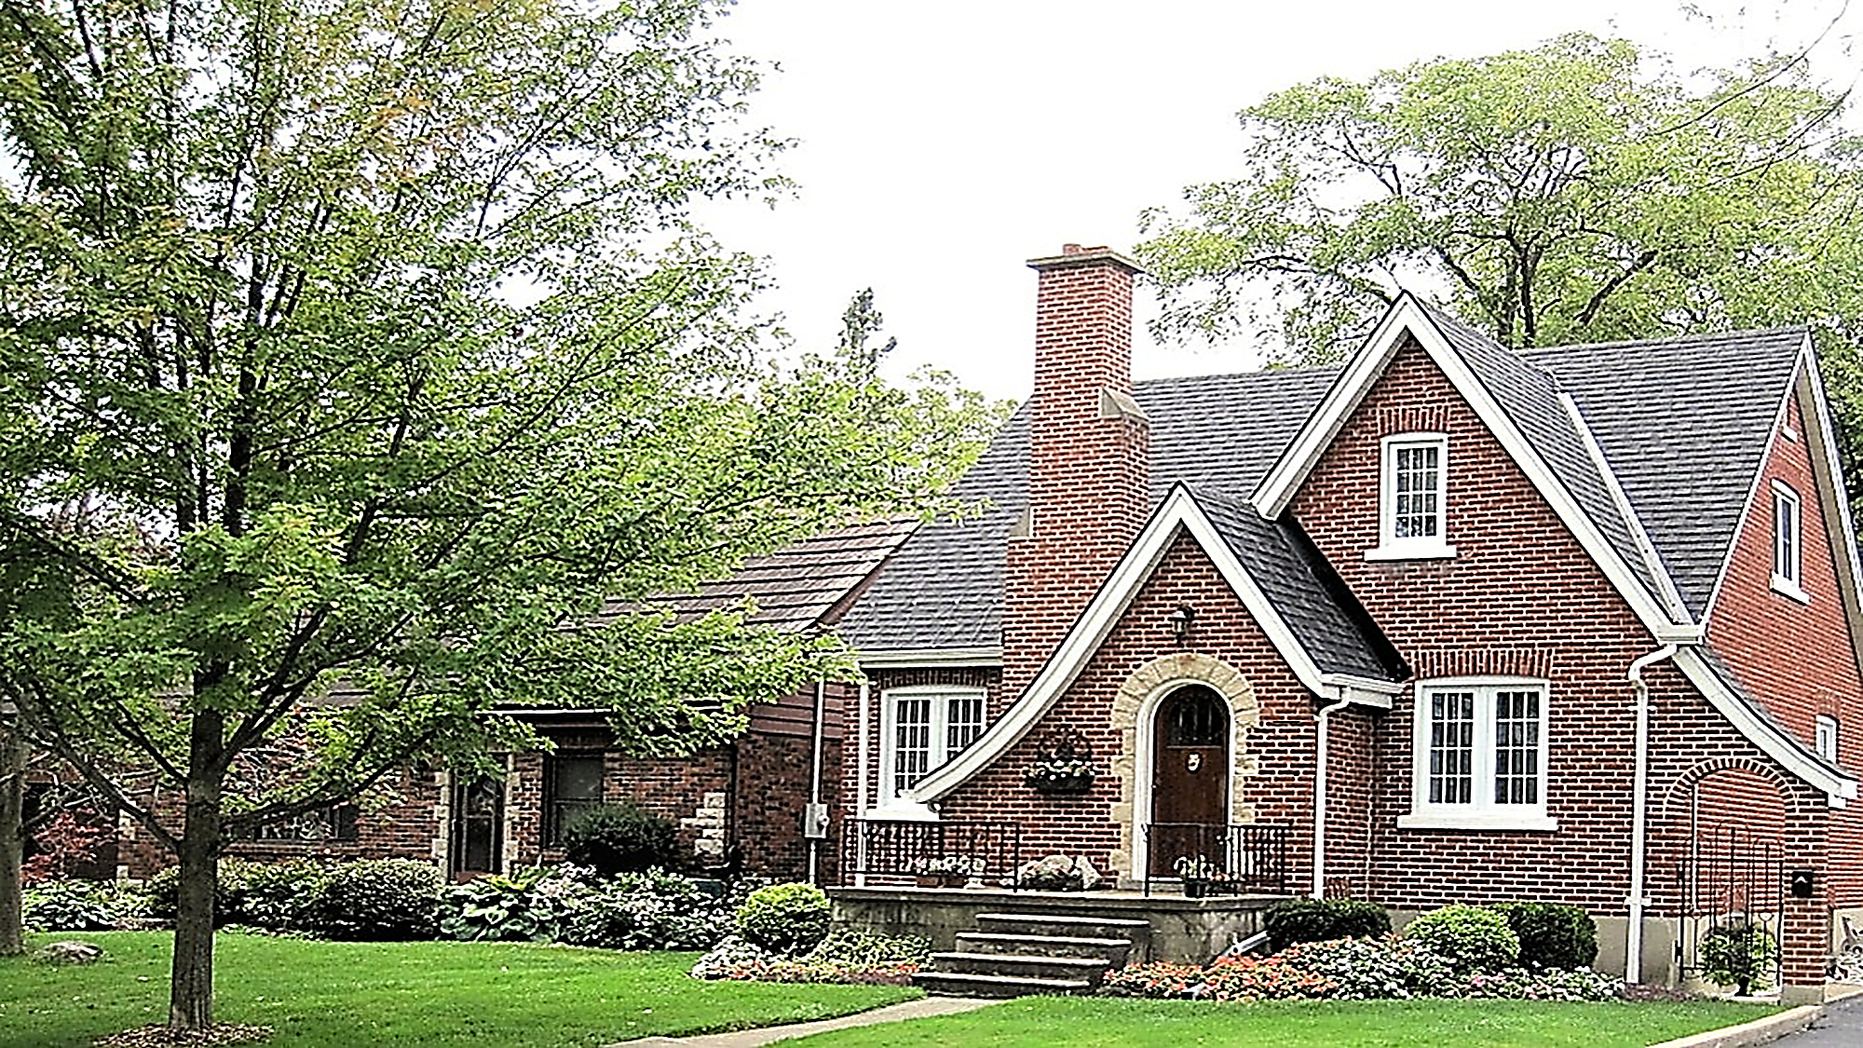
HOME

Slide 9
HAPPY PEOPLE

Slide 10
FRIENDS

Slide 11
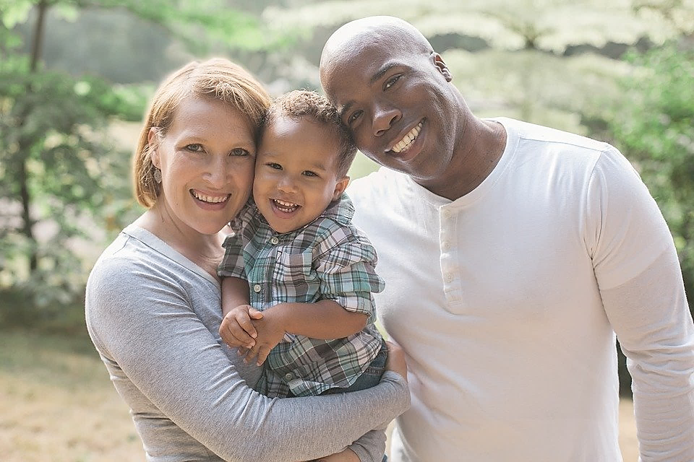
FAMILY

Slide 12
Typical contexts
INFORMATION
PEACE
SCIENCES
LOVE
ARTS
BUSINESS

Slide 13
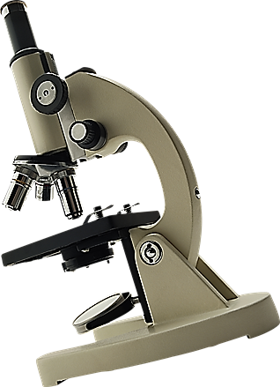
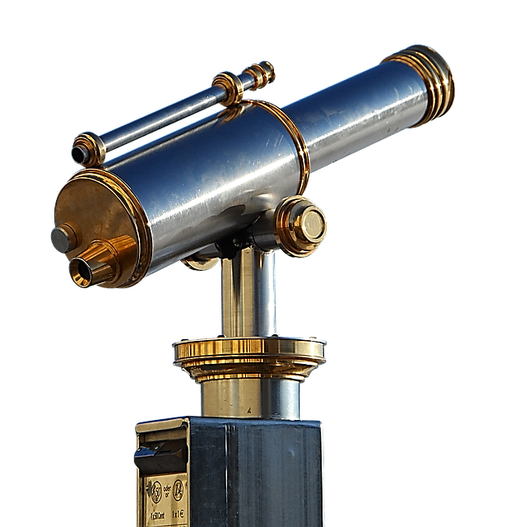
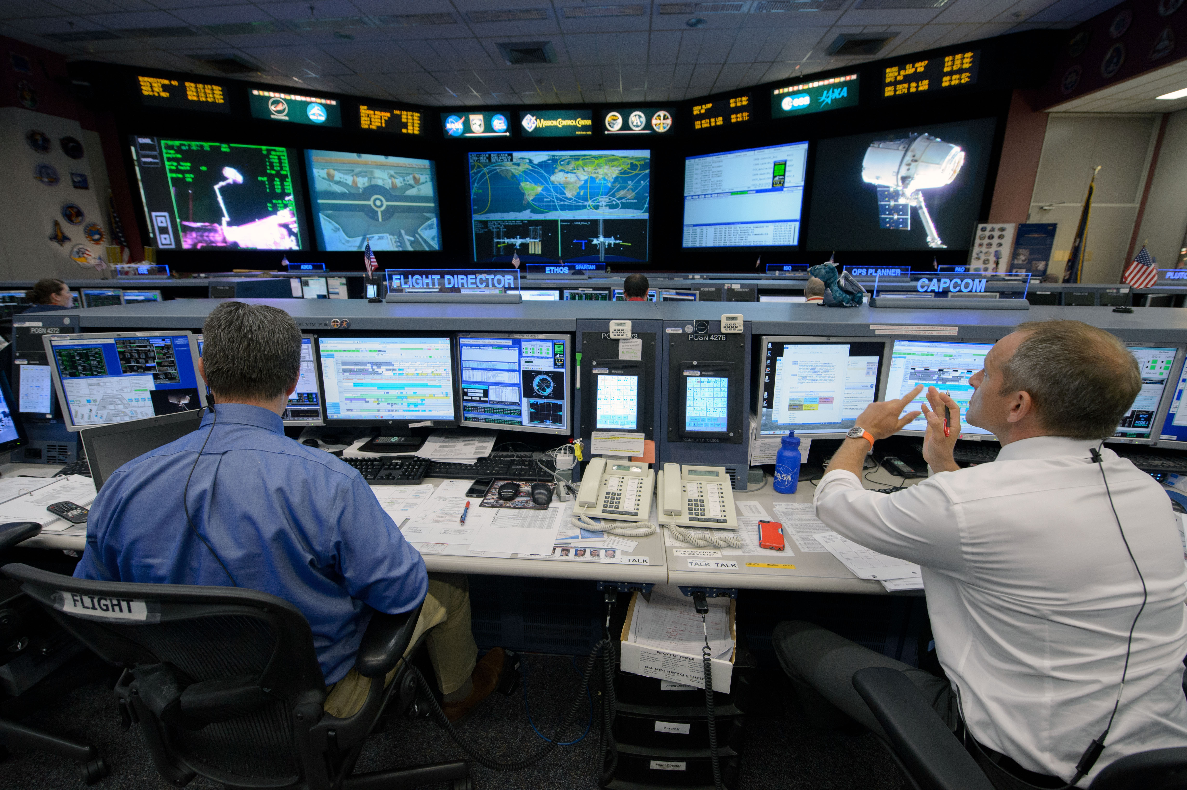
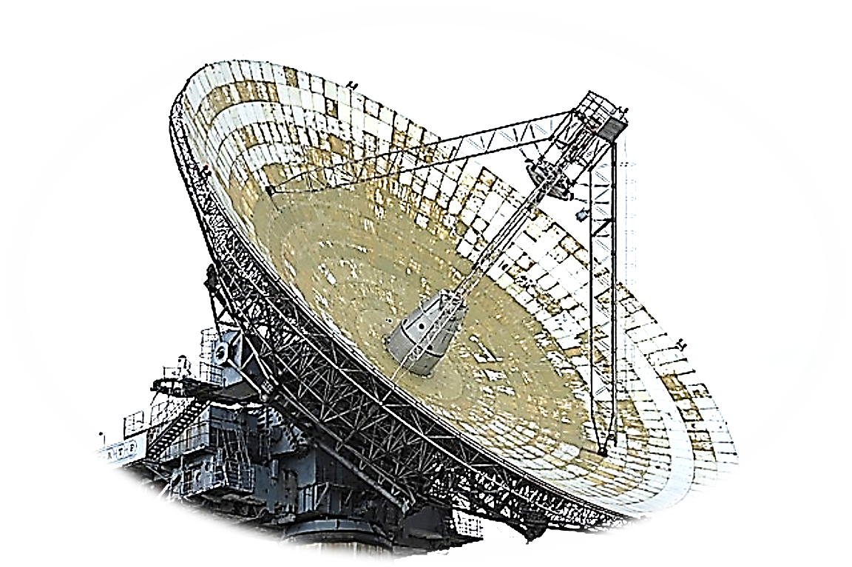
INFORMATION
INFORMATION CONTROL
CENTRE

Slide 14
SCIENCES

Slide 15
ARTS

Slide 16
PEACE

Slide 17
LOVE

Slide 18
BUSINESS

Slide 19
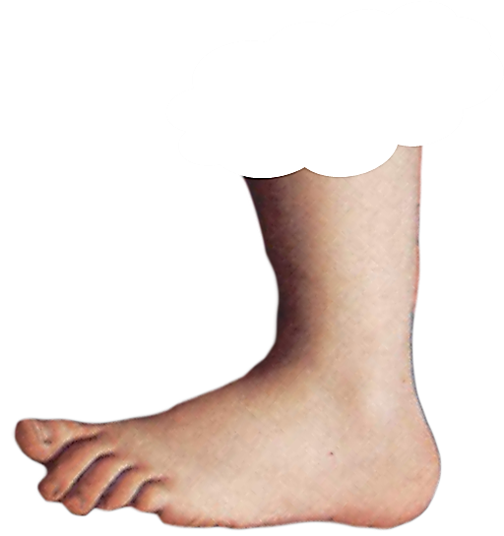
ENGLISH LANGUAGE STUDY
FOOTNOTE
FOOTNOTE

Slide 20
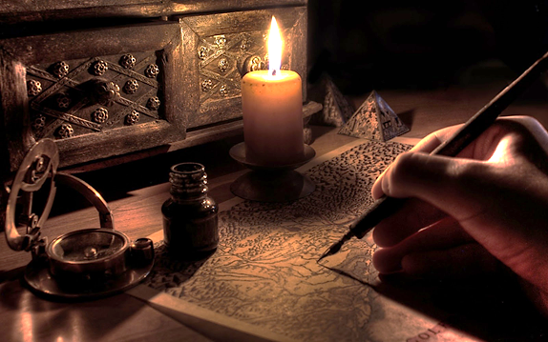
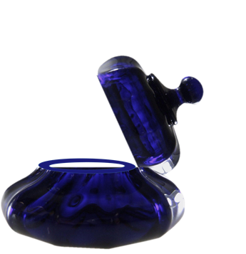

Slide 22
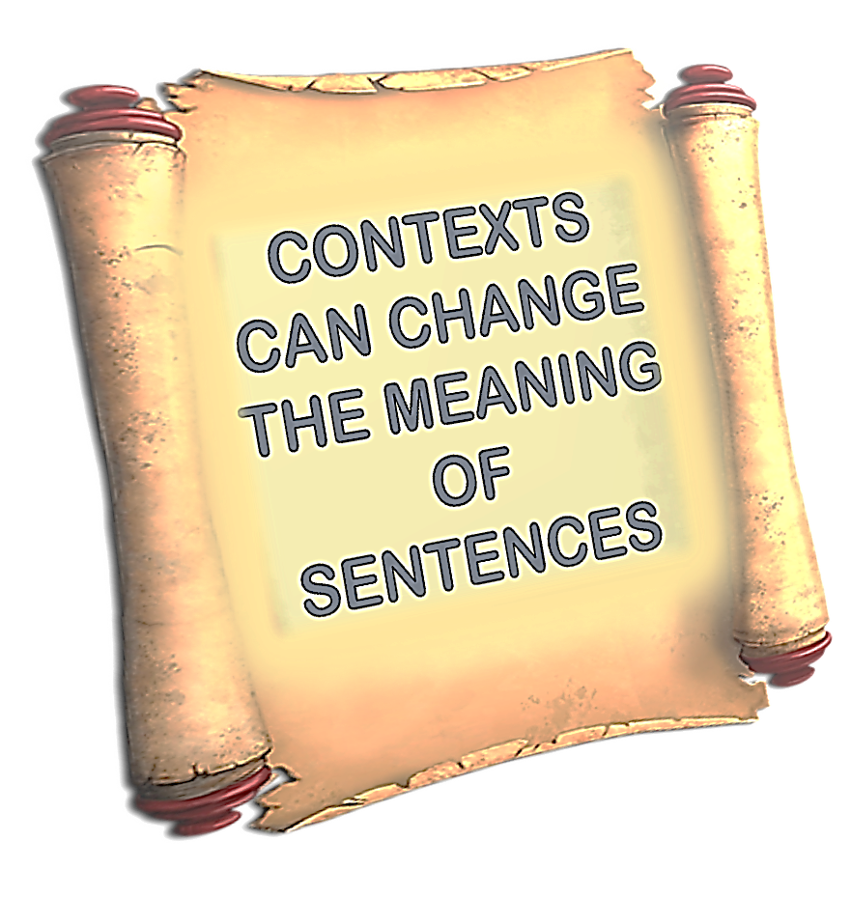

Slide 30
CONTEXTS CAN CHANGE THE MEANING OF SENTENCES

