Slide 1
1 USE OF ENGLISH PREFERENCE

Slide 4
GENERAL
I LIKE
I WOULD LIKE
I PREFER
I WOULD RATHER
I WANT
SPECIFIC
X
X
DIRECT

Slide 5
GENERAL
DO YOU LIKE..?
WOULD YOU LIKE..?
DO YOU PREFER..?
WOULD YOU RATHER..?
DO YOU WANT..?
SPECIFIC
X
X
DIRECT

Slide 6
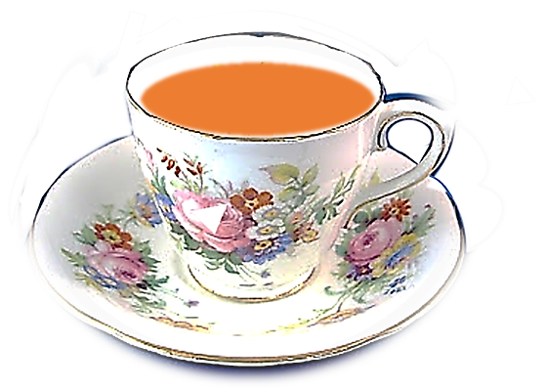
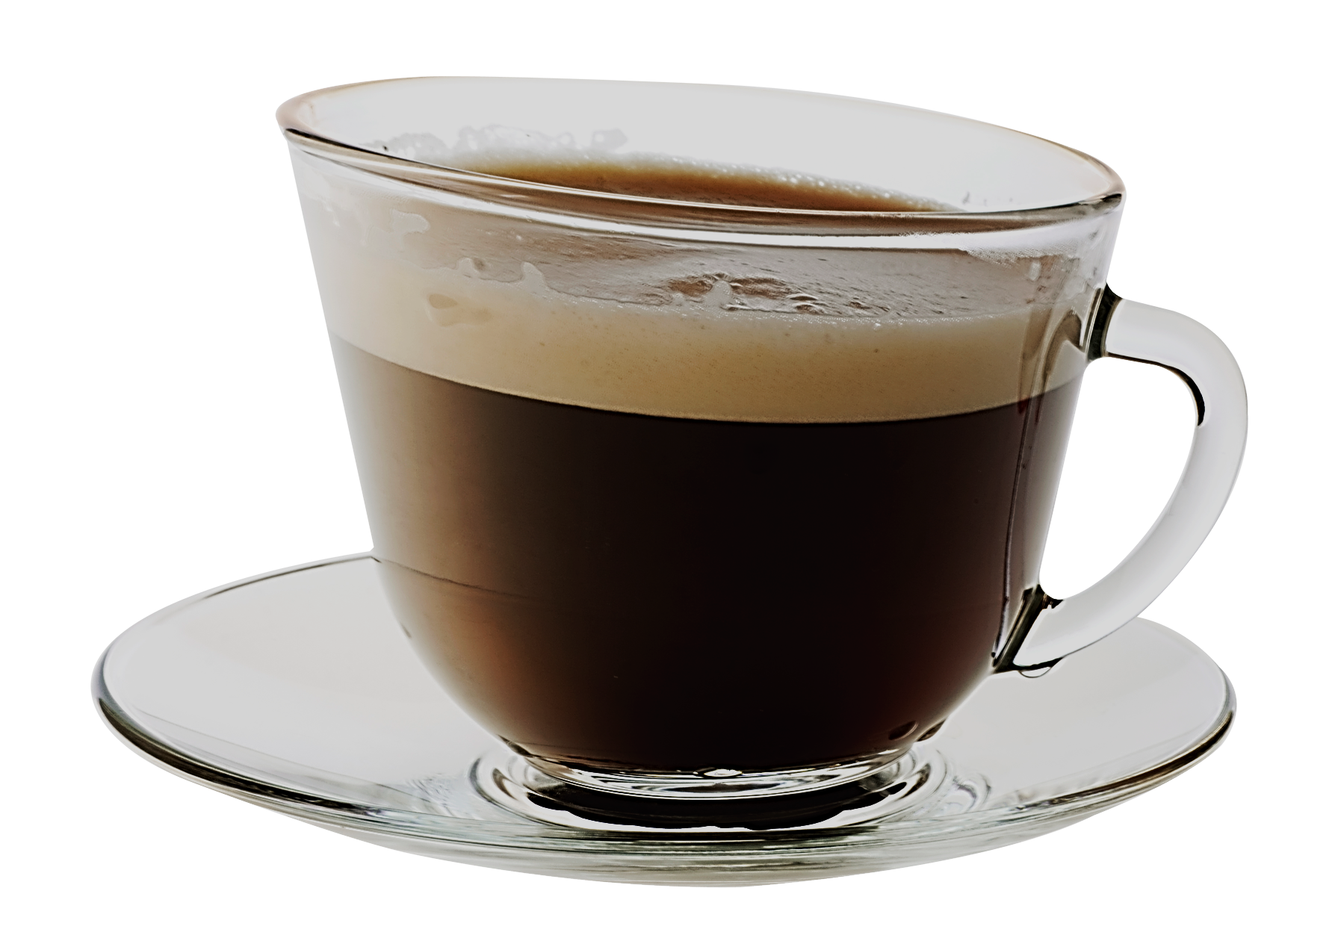
TEA
COFFEE

Slide 7
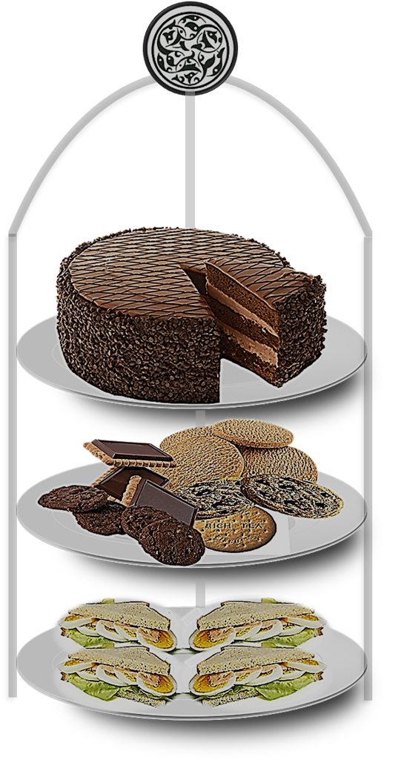
CHOCOLATE CAKE
BISCUITS
SANDWICHES

Slide 8
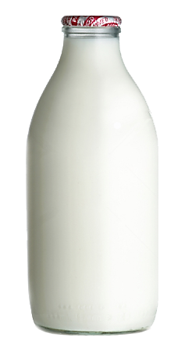

Slide 9
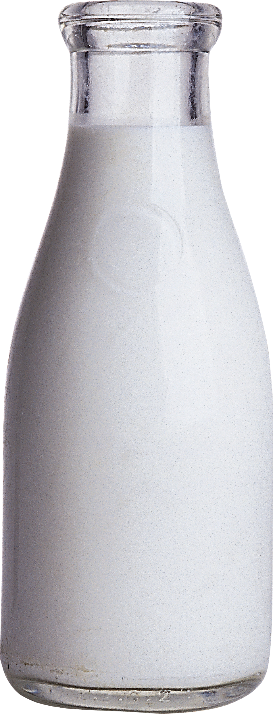
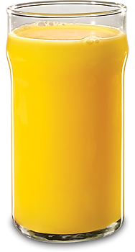
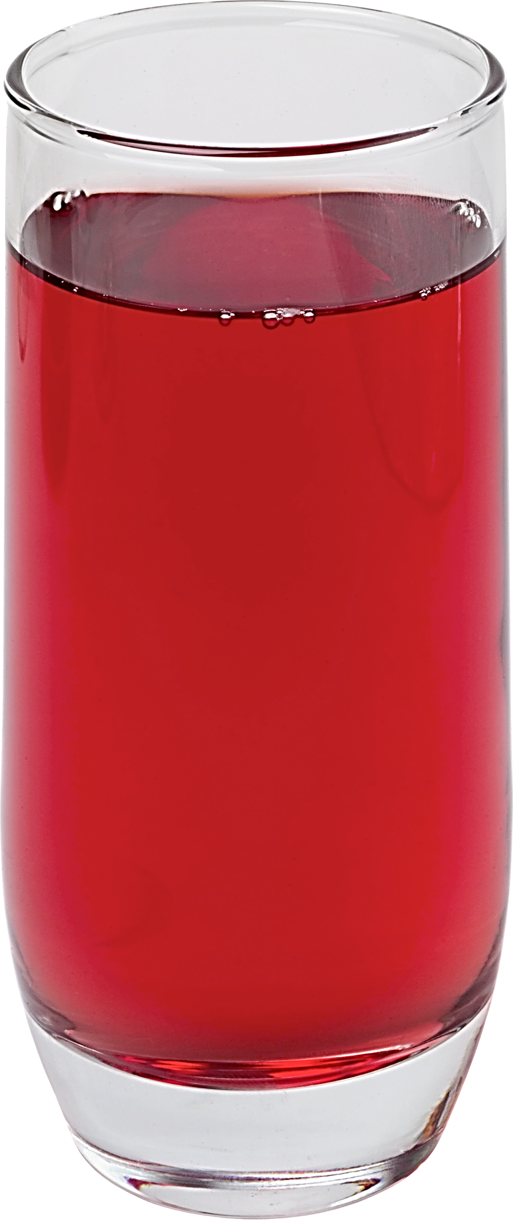

Slide 10
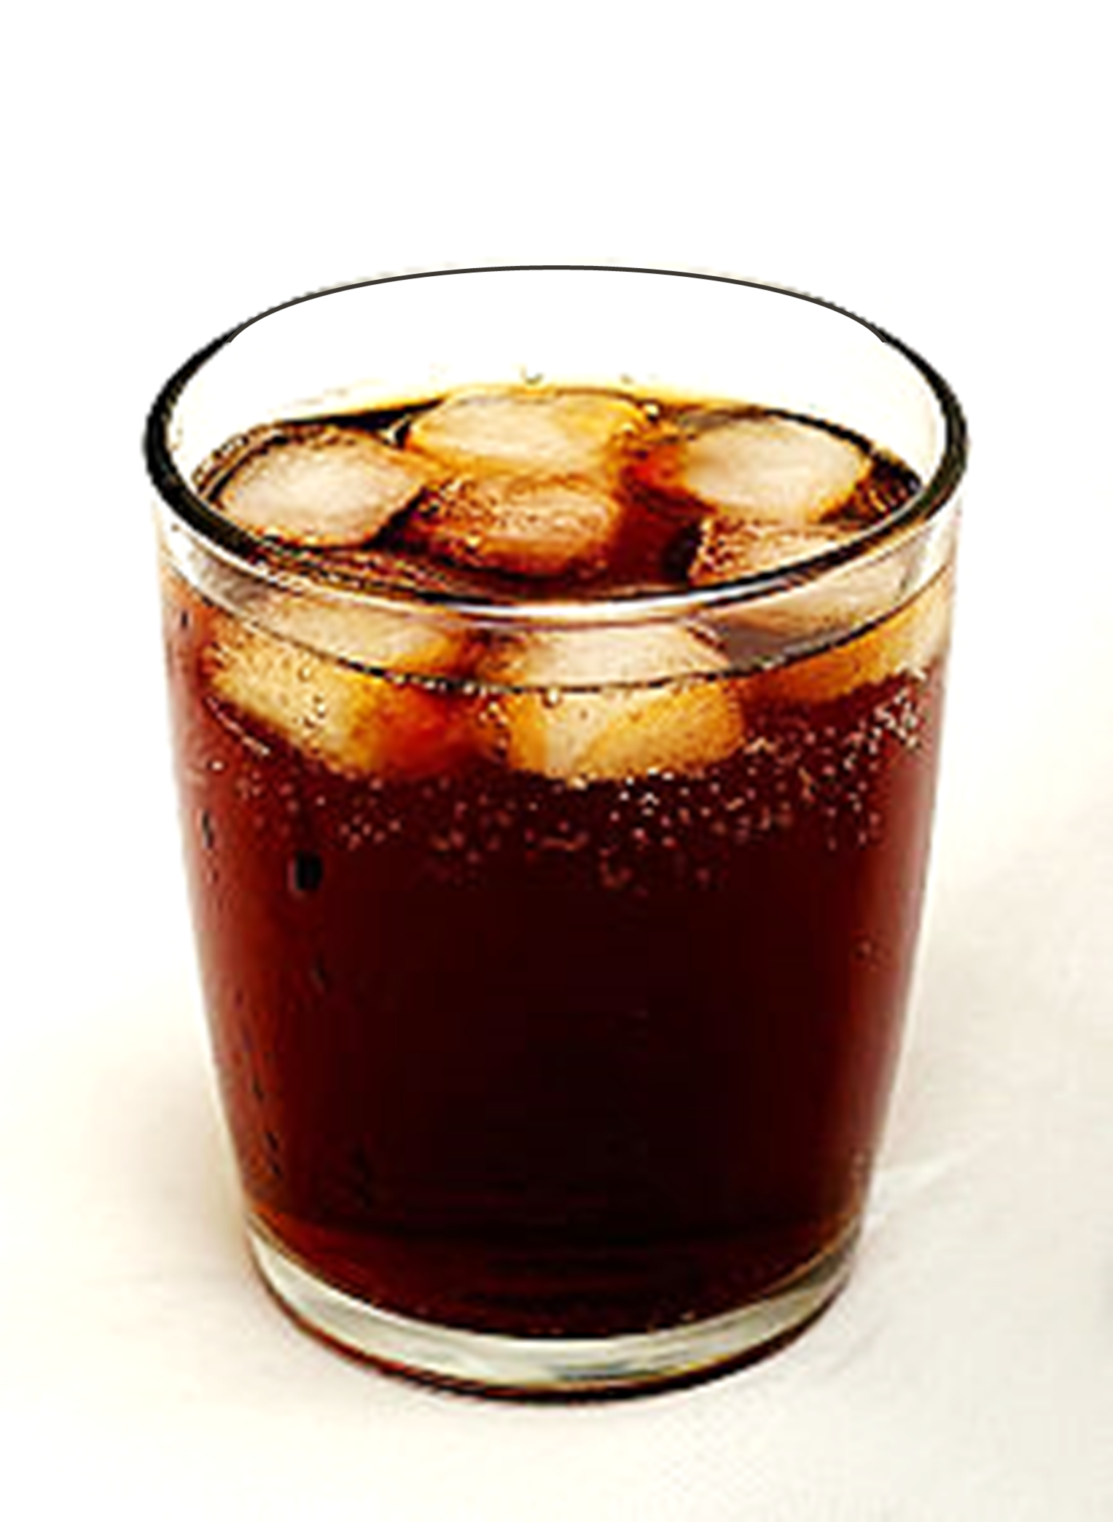

Slide 11
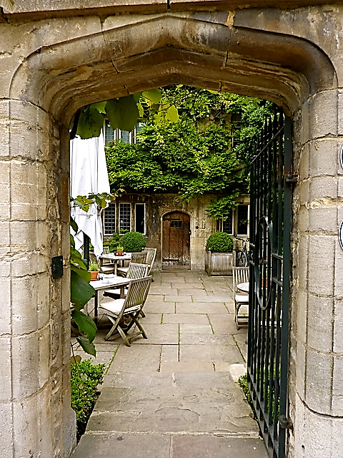
TEATIME IN OXFORD
WHAT
WOULD YOU LIKE?

Slide 12
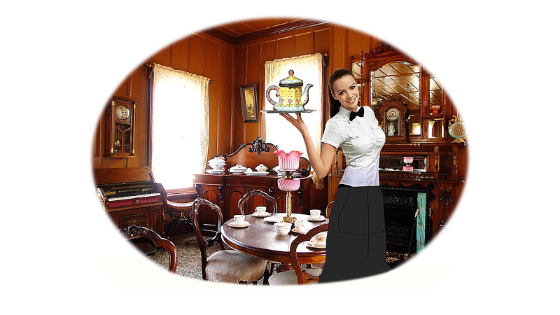
TEATIME IN OXFORD

Slide 13
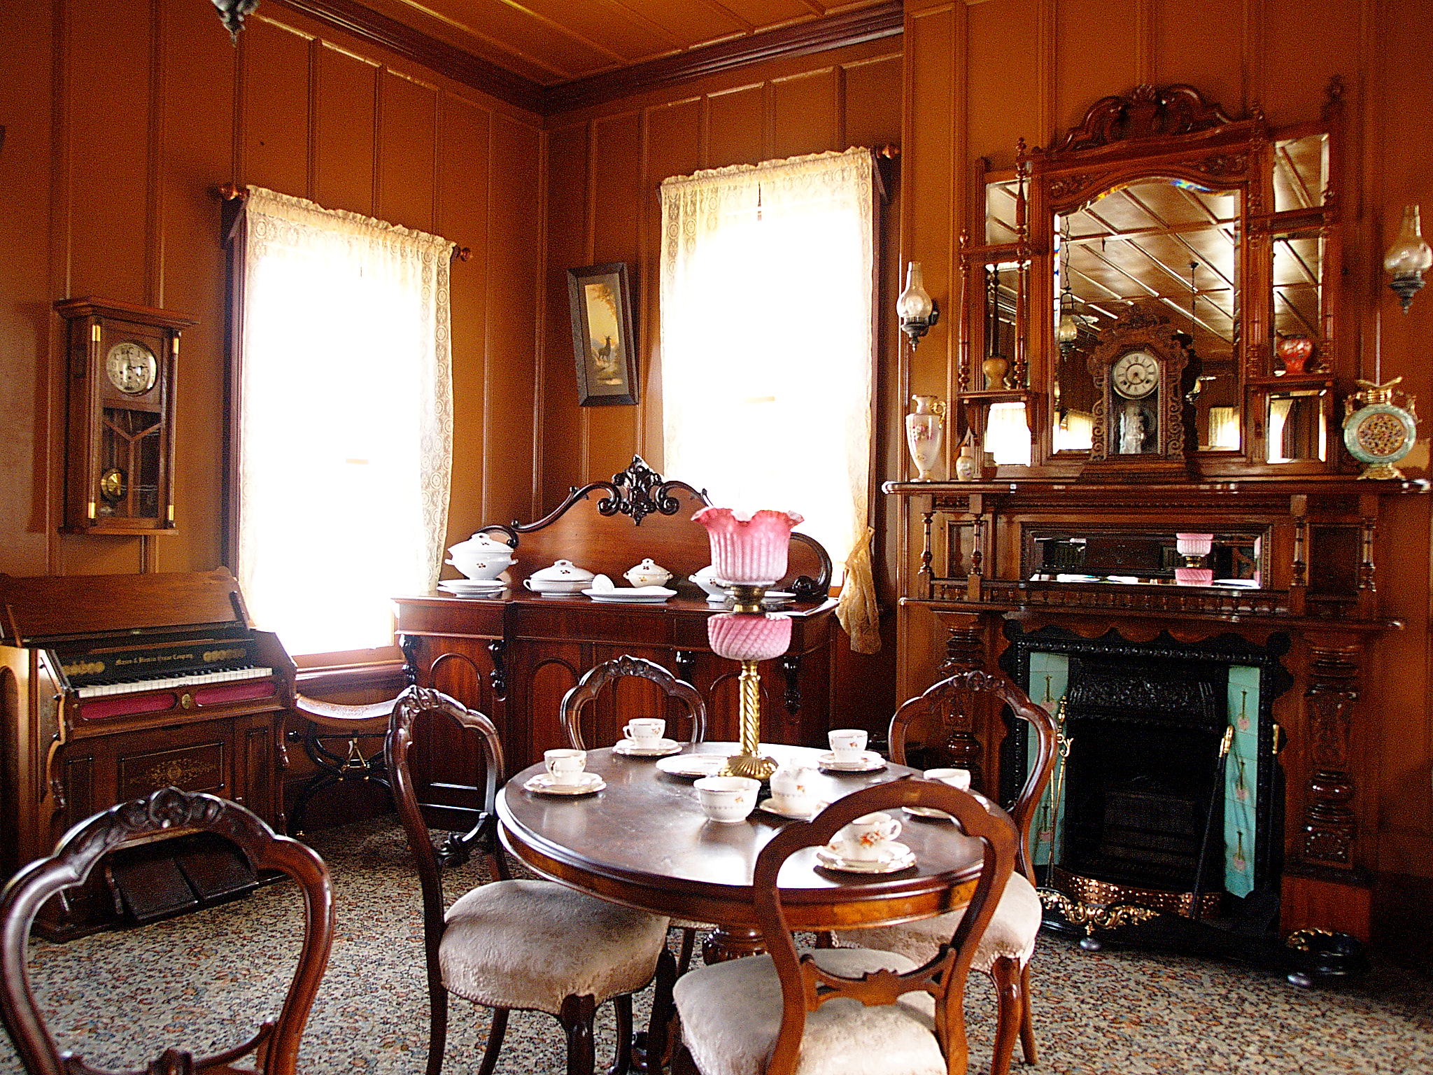

Slide 14
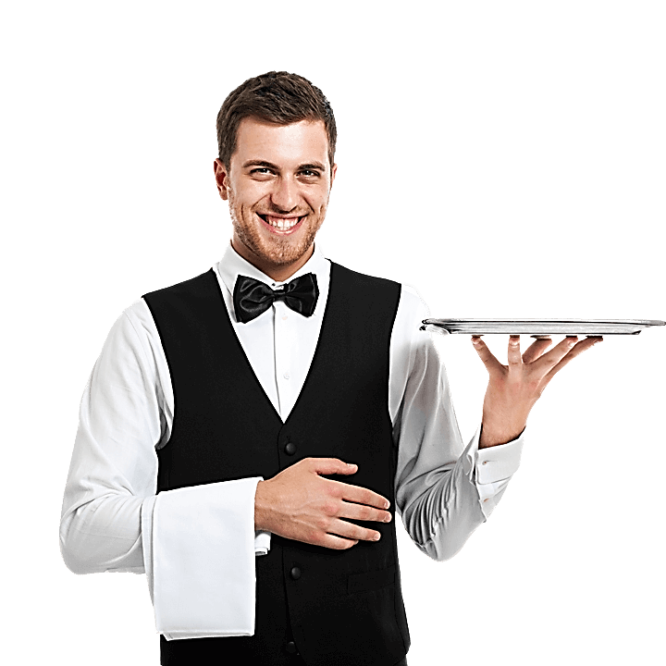
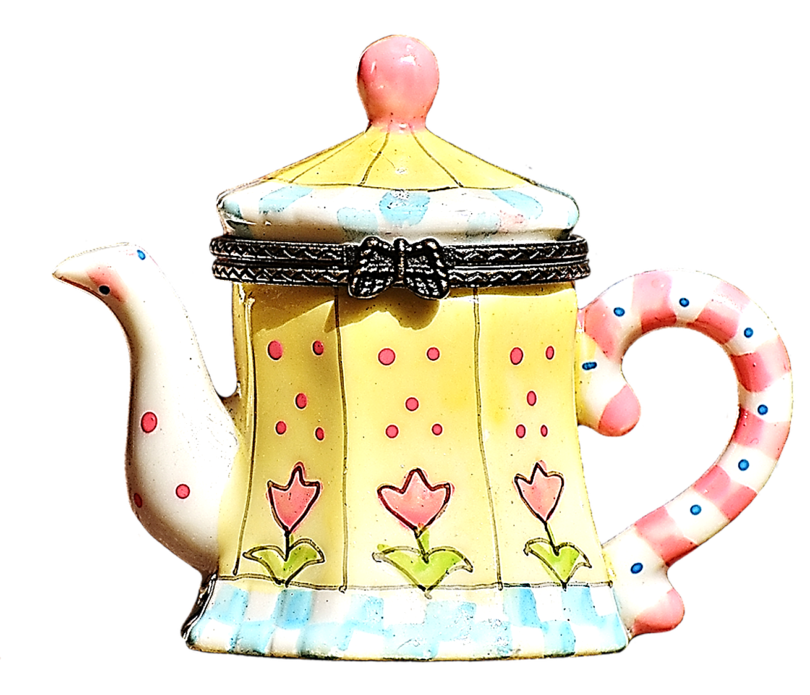

Slide 16
I LIKE
I WOULD LIKE
I PREFER
I WOULD RATHER
I WANT

Slide 17
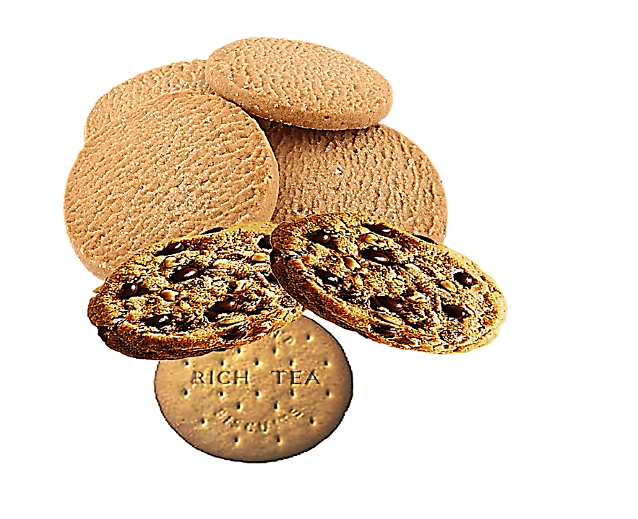
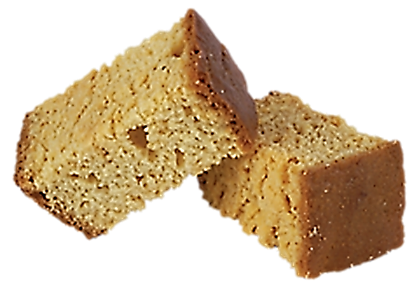
DARK CHOCOLATE DIGESTIVES

Slide 18
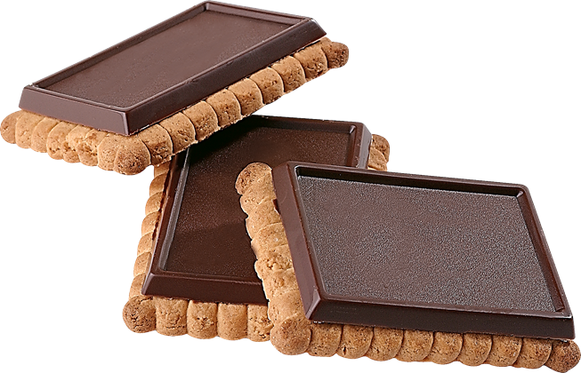
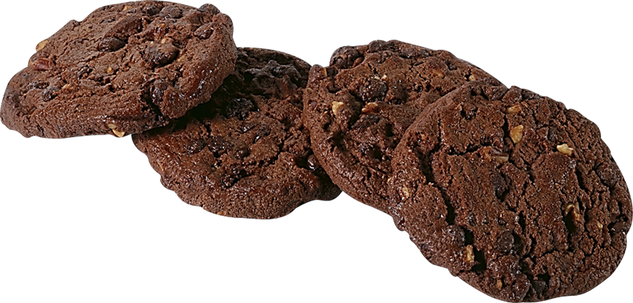

Slide 19
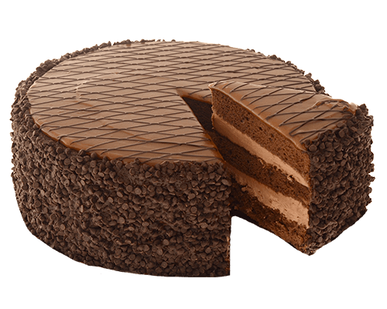

Slide 20
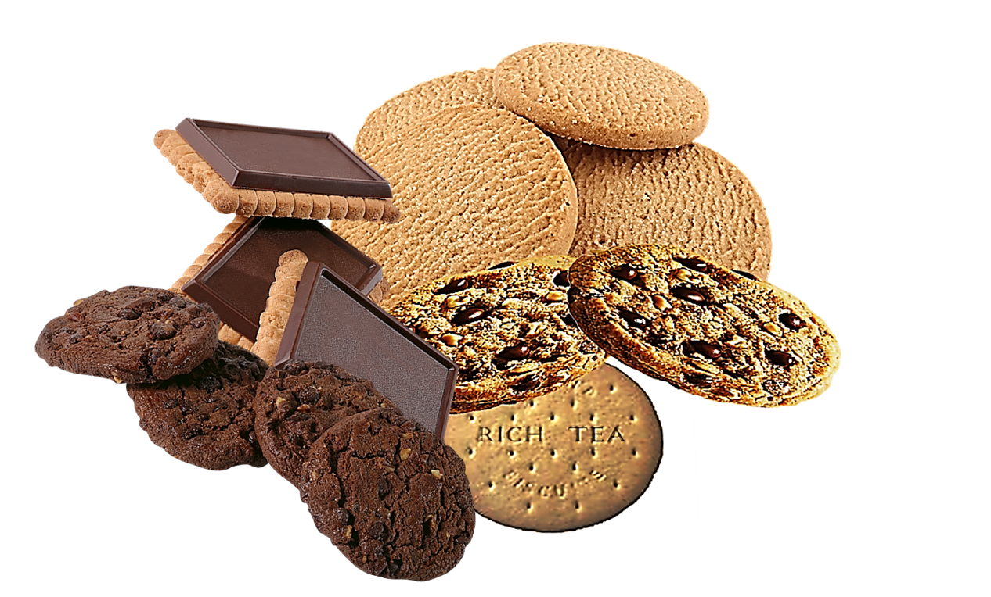

Slide 22
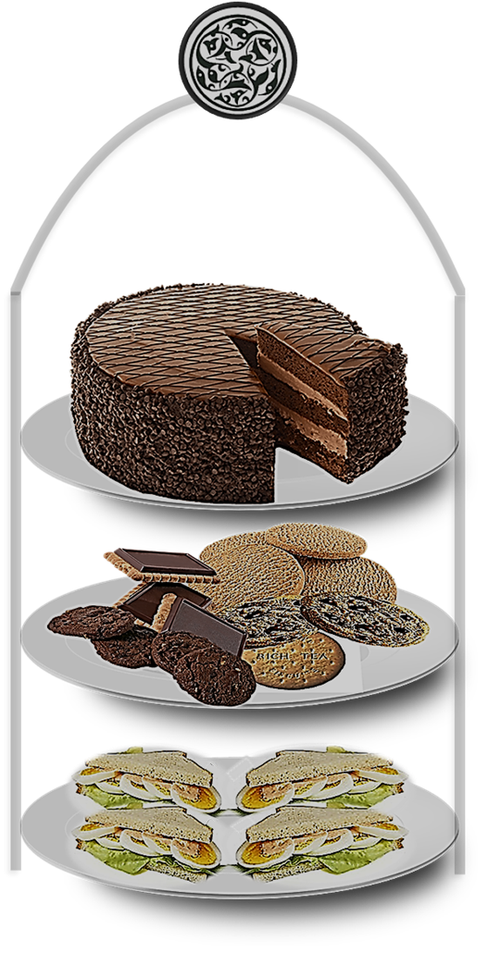

Slide 23
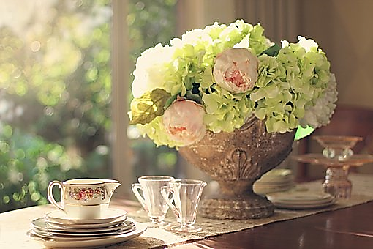

Slide 24
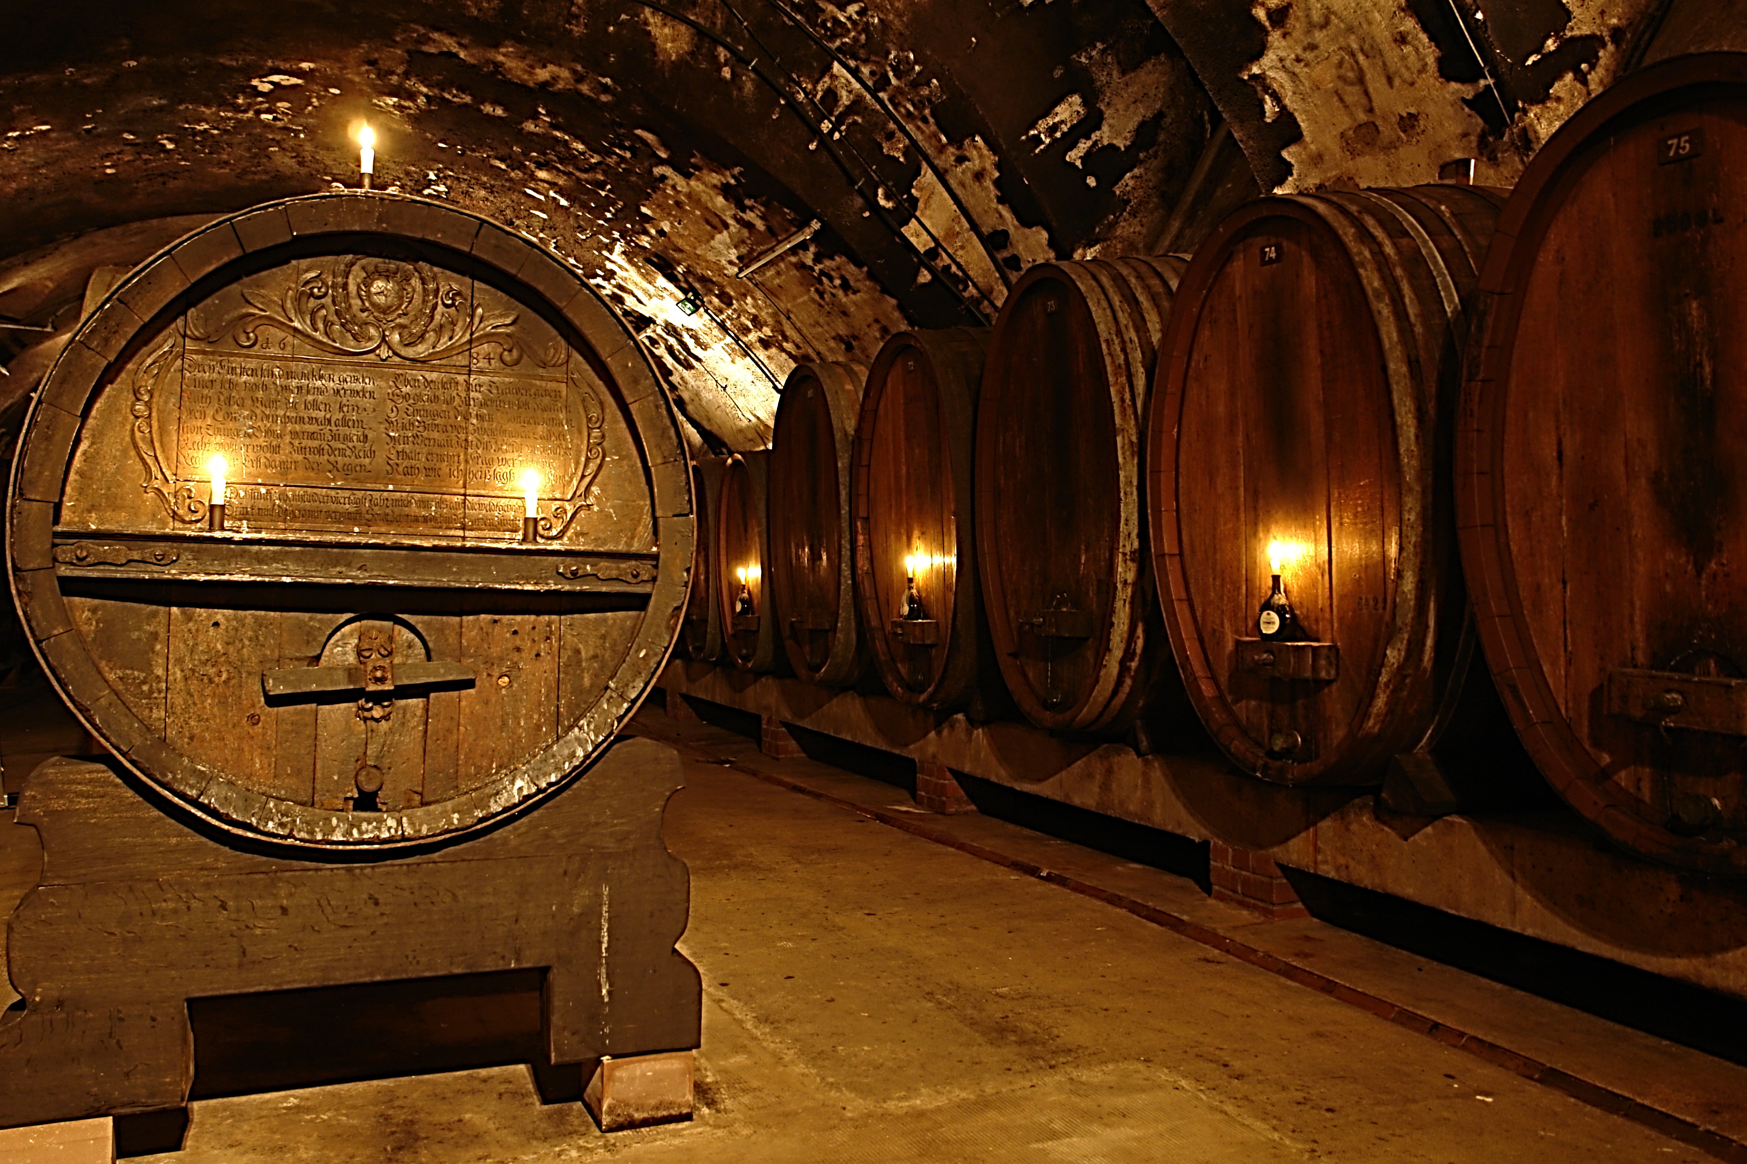

Slide 25
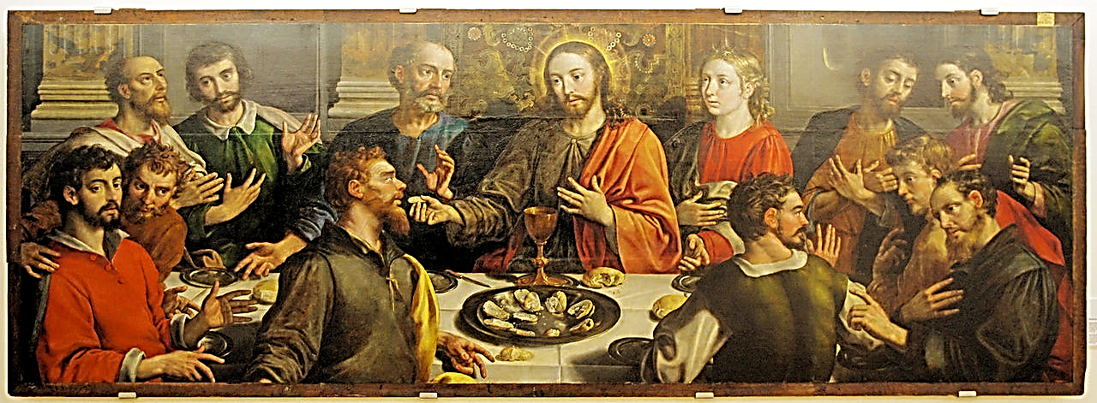

Slide 26
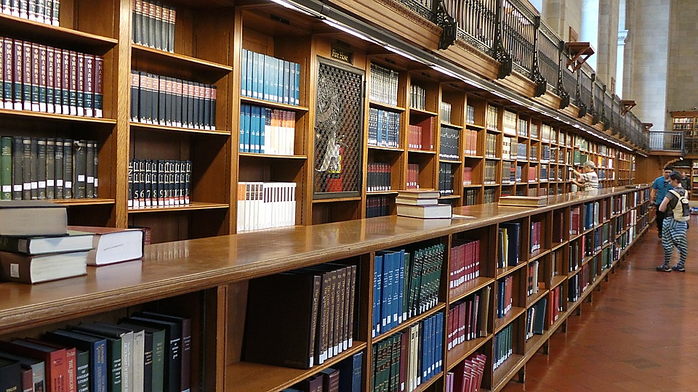

Slide 27
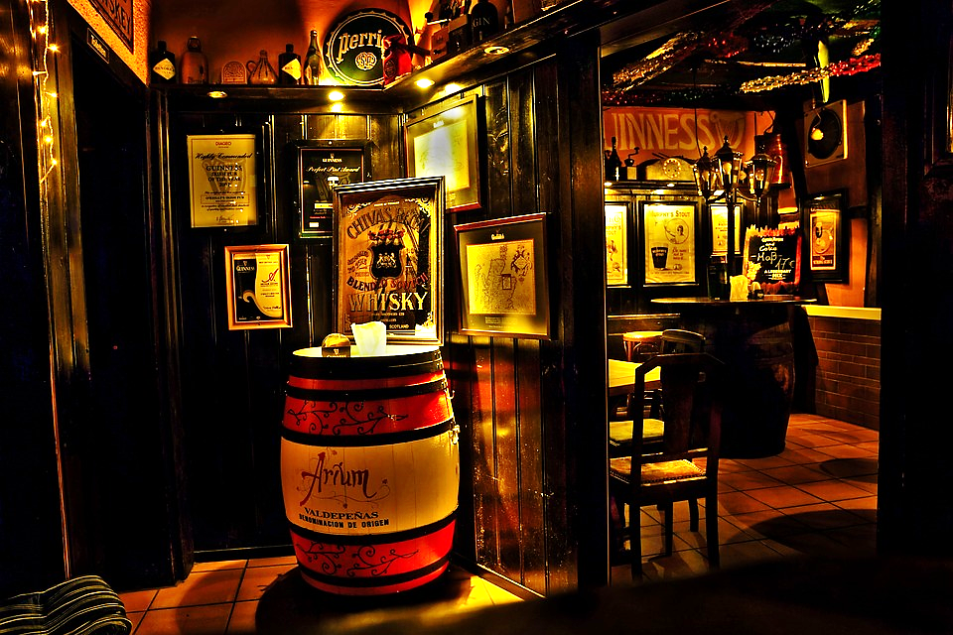

Slide 28
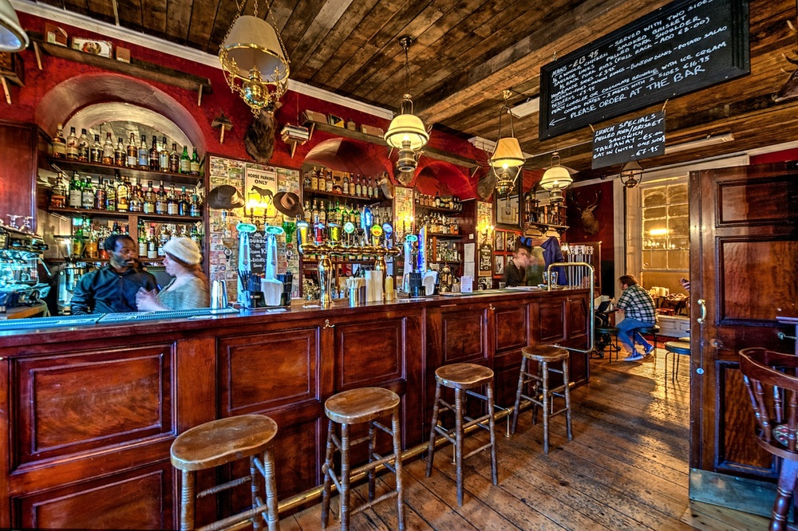

Slide 29
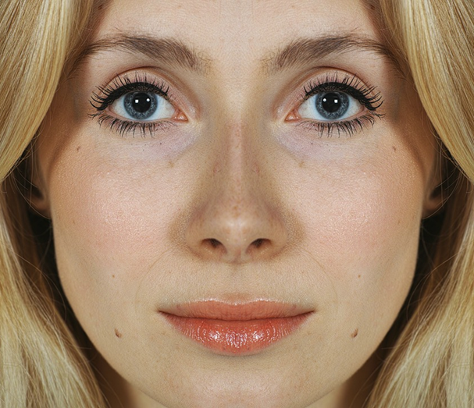

Slide 31
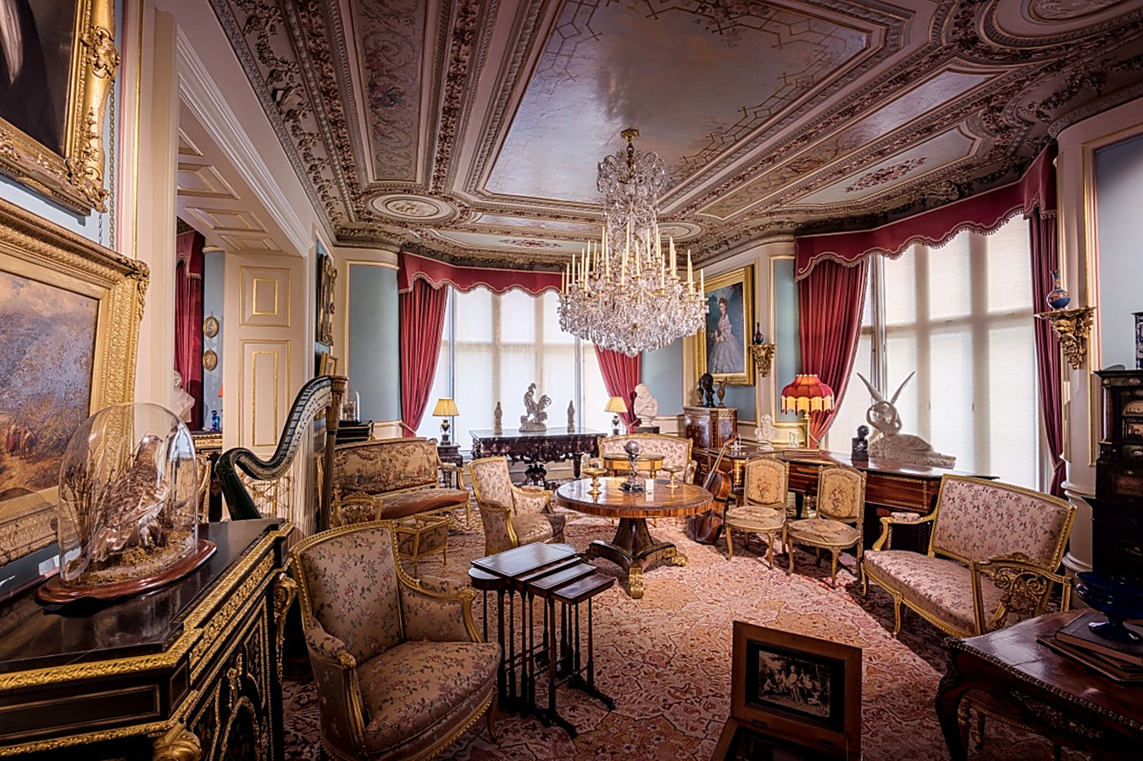

Slide 32
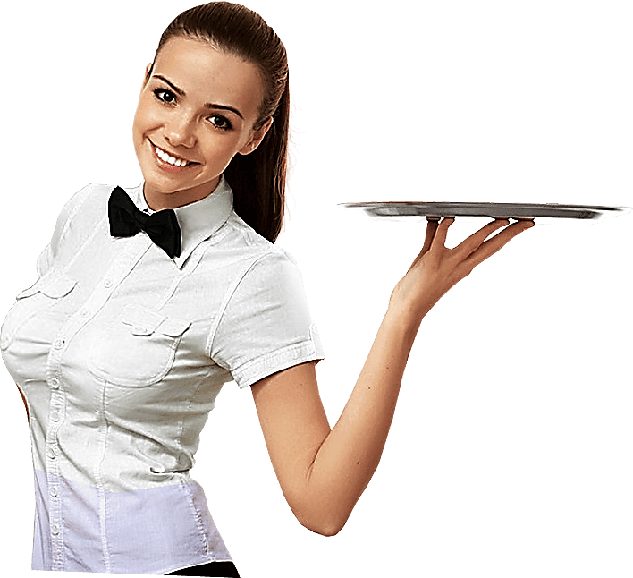
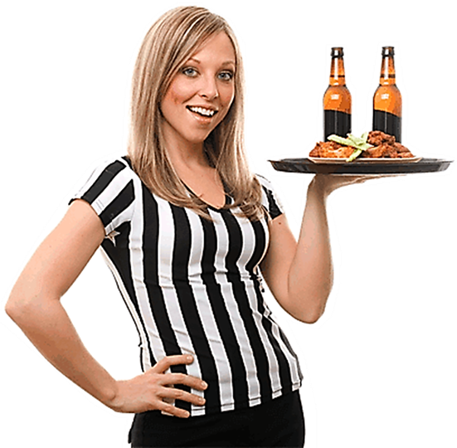

Slide 33
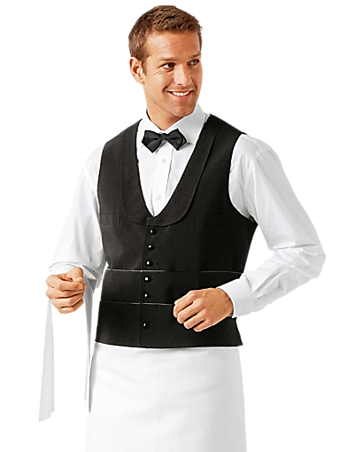
This Photo by Unknown Author is licensed under CC BY

Slide 34
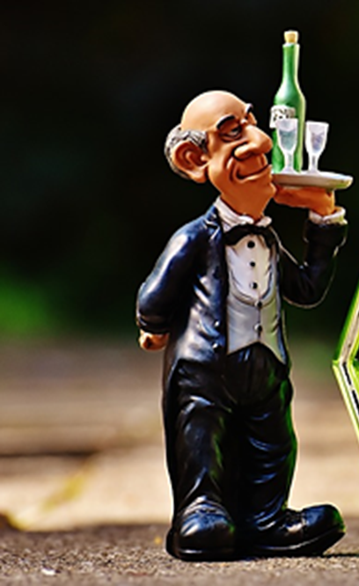
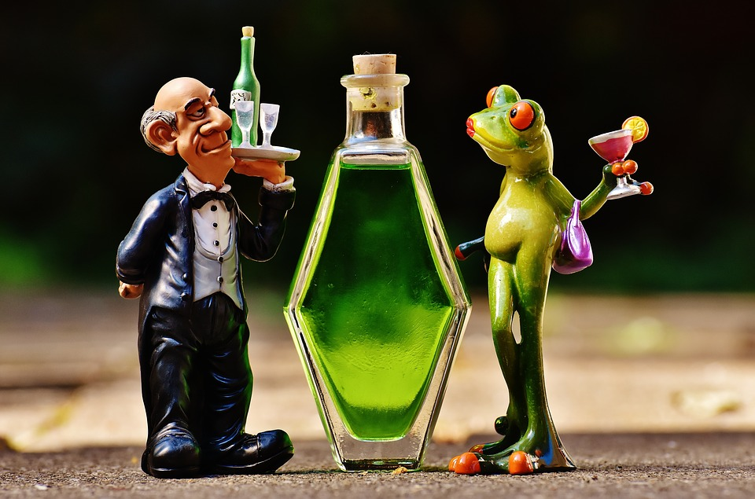

Slide 35
