Slide 1
STARTERS
SOUP OF THE DAY
FARMHOUSE PATE
MIXED SALAD
MAIN COURSES
ROAST CHICKEN
FILLET STEAK
FRESH FISH
DESSERTS
FRESH FRUIT SALAD
CHEESE BOARD

Slide 2
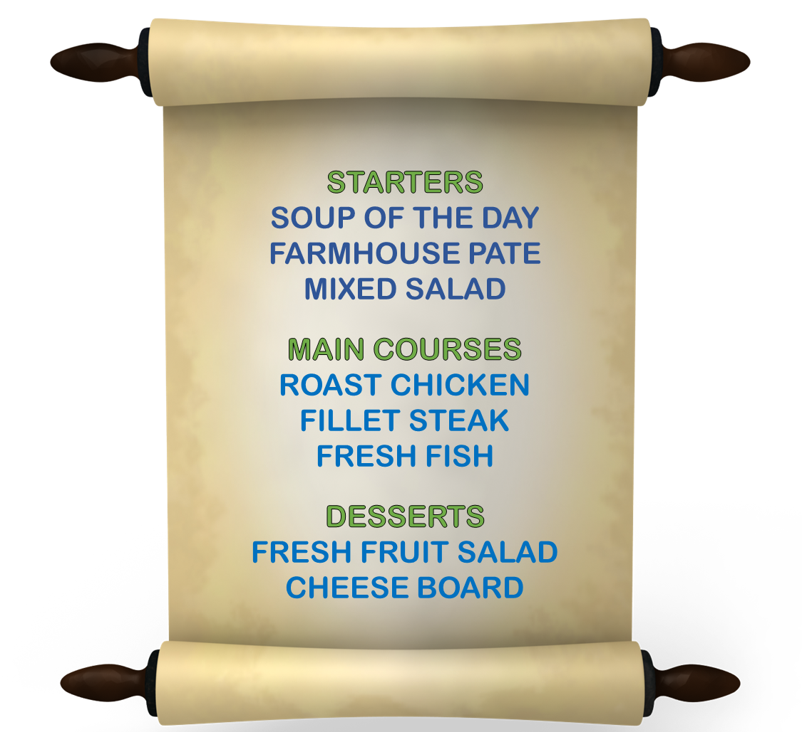
THE MENU
WOULD YOU LIKE A STARTER?
WHICH WOULD YOU LIKE
THE SOUP OR THE PATE?
THE SOUP PLEASE
FOR THE MAIN COURSE
WOULD YOU PREFER
STEAK OR FISH?
THE FISH CERTAINLY
FOR DESSERT
WOULD YOU LIKE
FRUIT SALAD?
I WOULD RATHER HAVE
THE CHEESE, PLEASE

