Slide 1
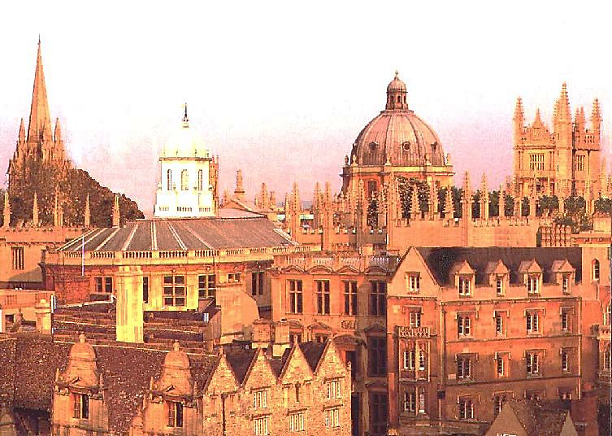

Slide 2
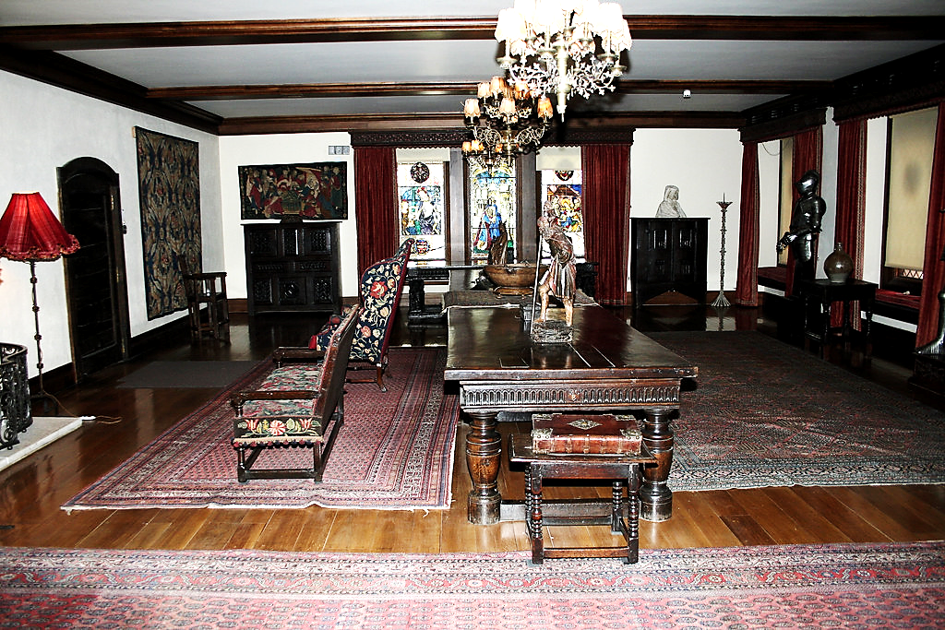
This Photo by Unknown Author is licensed under CC BY

Slide 3
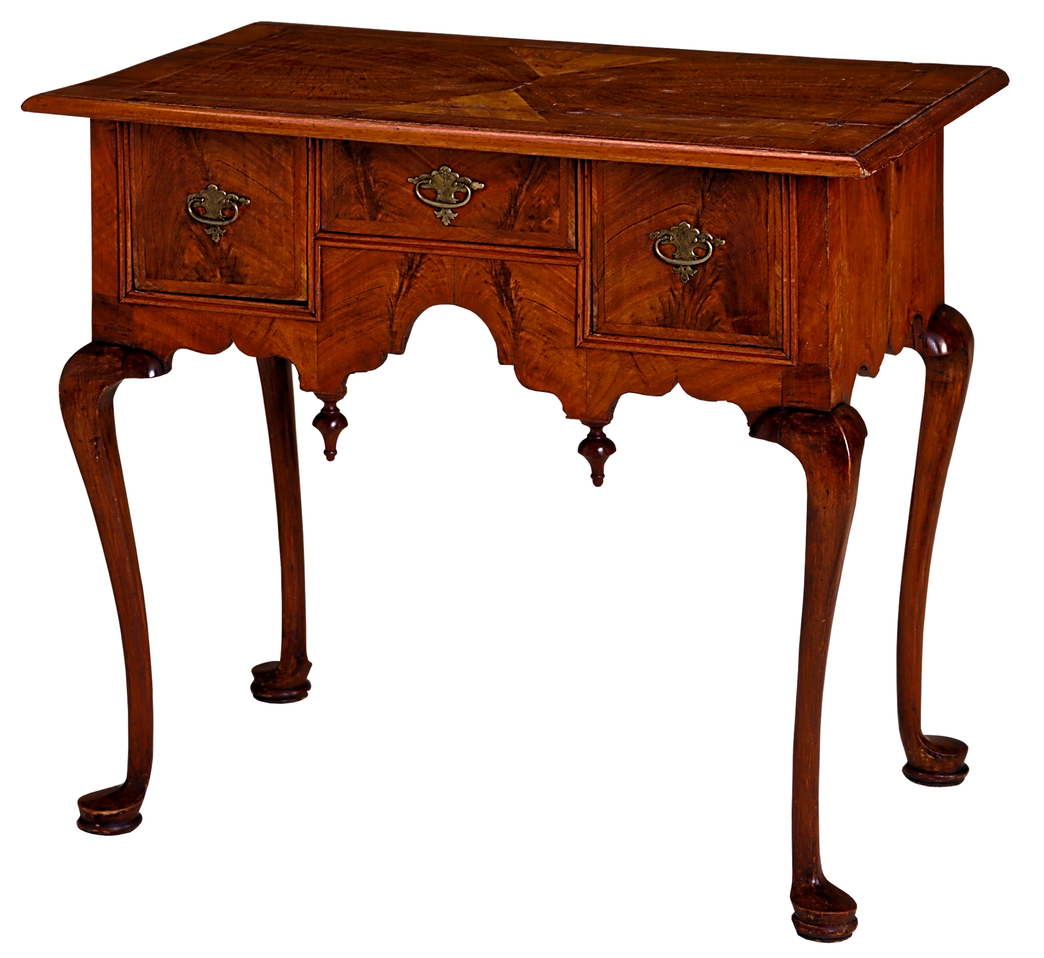

Slide 4
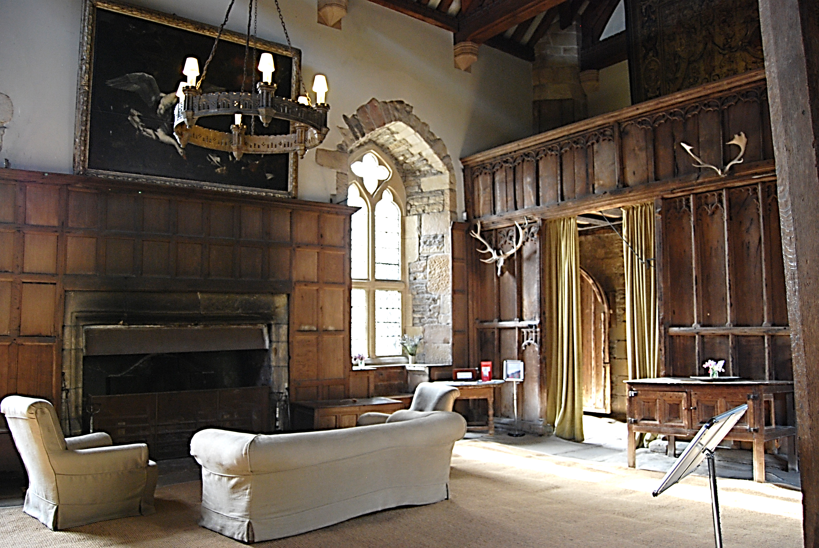
This Photo by Unknown Author is licensed under CC BY-SA-NC

Slide 5
This Photo by Unknown Author is licensed under CC BY-SA-NC

Slide 6
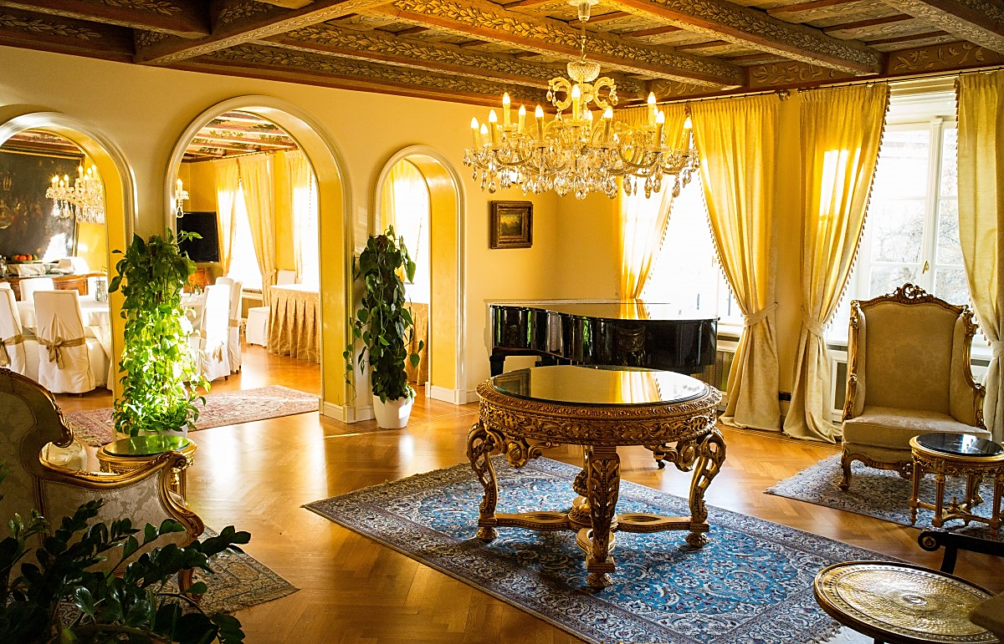

Slide 7
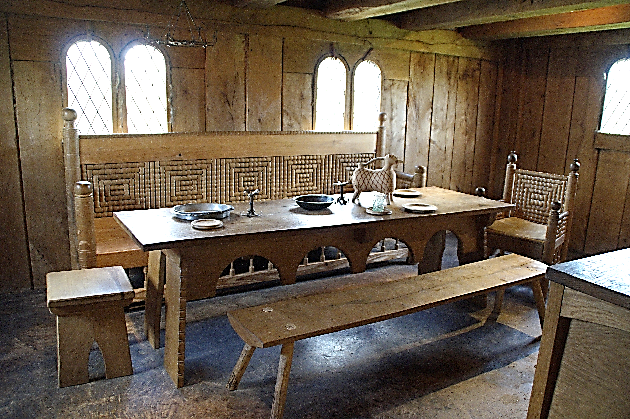

Slide 8
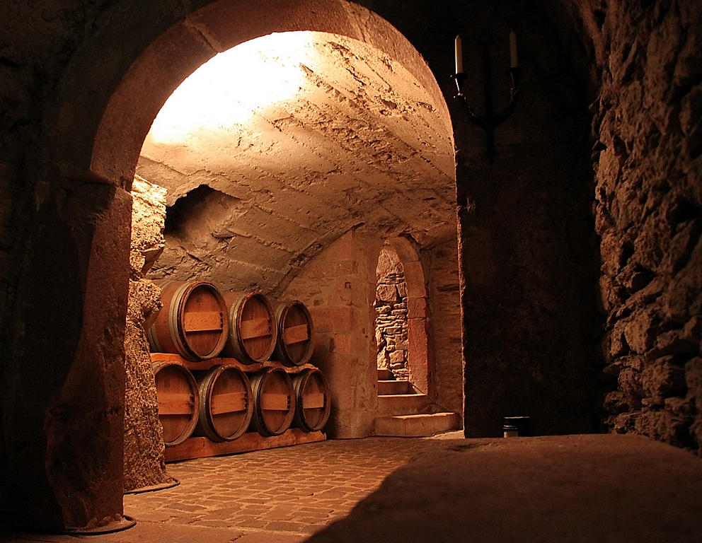
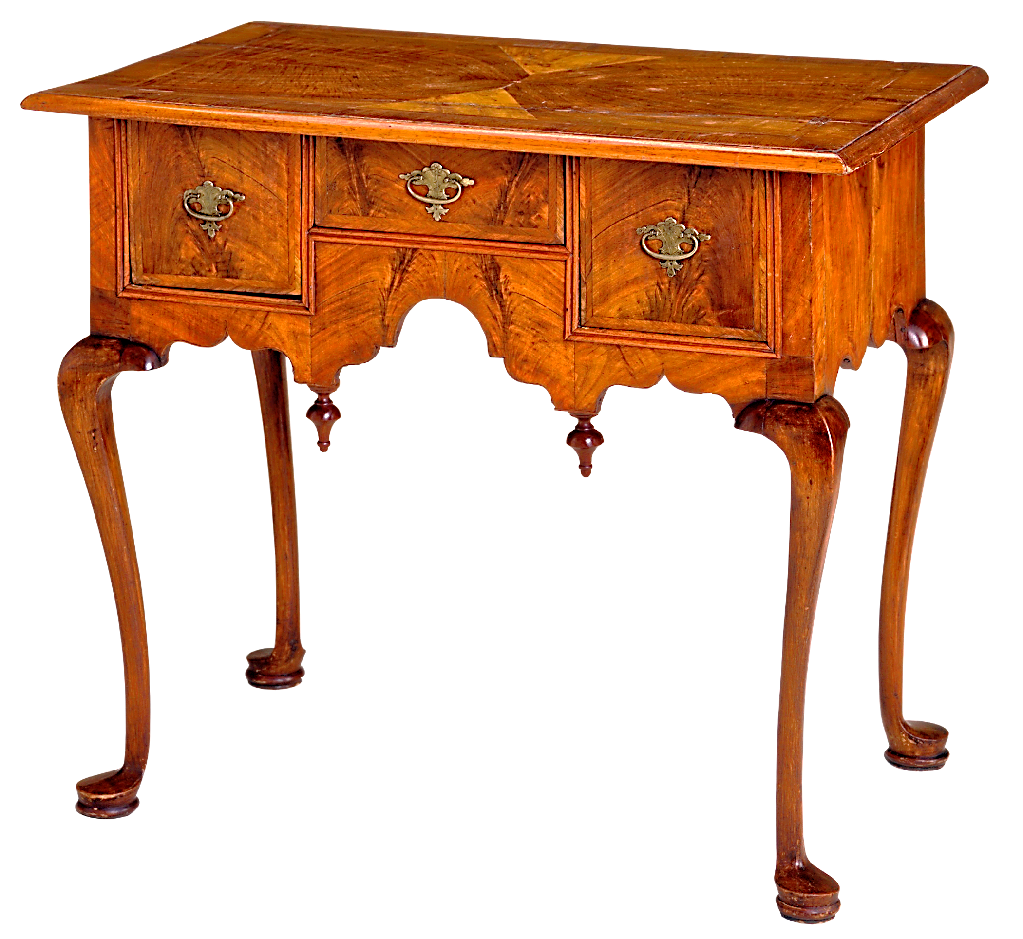
This Photo by Unknown Author is licensed under CC BY-SA

Slide 9
