Slide 1
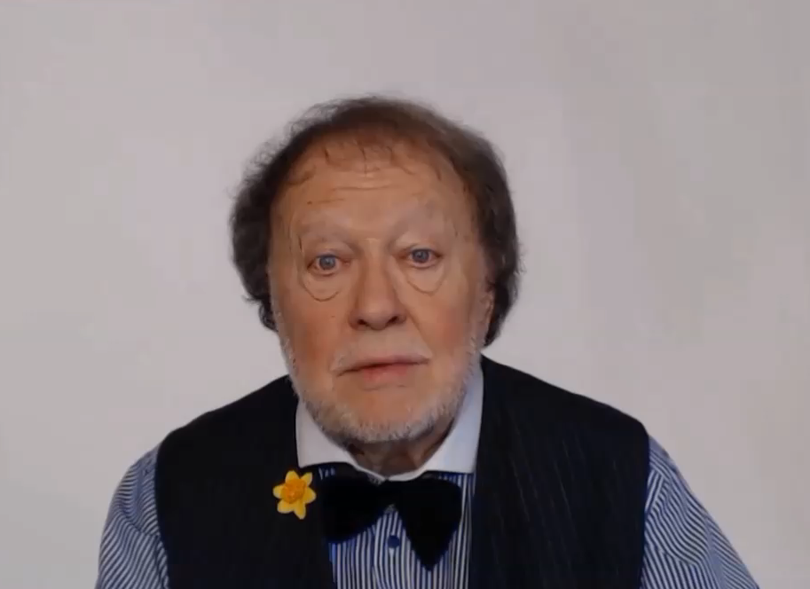
SOME ACTIVITIES ARE
SO IMPORTANT
THAT WE USE THE VERB AS A SPECIAL KIND OF NOUN

