Slide 1
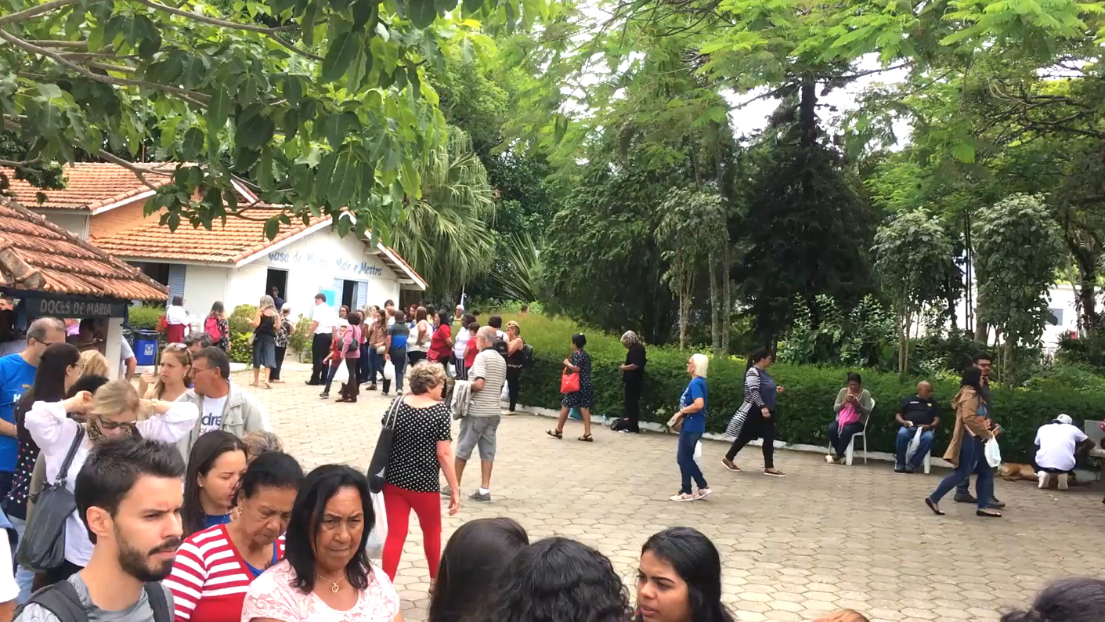


THERE ARE LOTS OF PEOPLE
THE PARK
SOME PEOPLE ARE STANDING OTHERS ARE WALKING
ABOUT
AROUND

