Slide 1
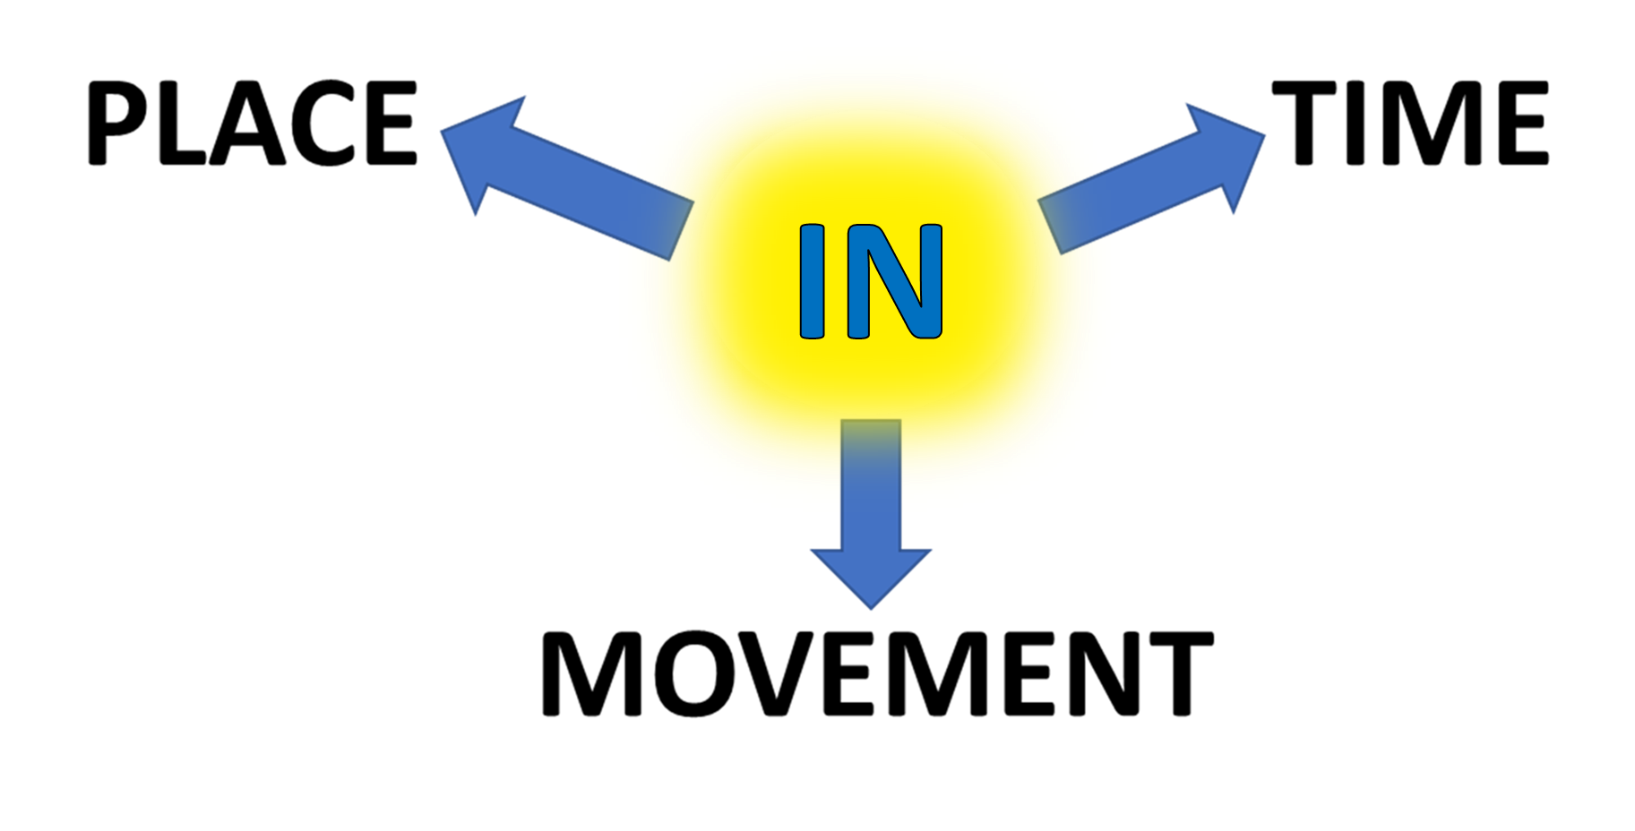
CONTAINED INSIDE LIMITS
PERIOD
DURATION
THROUGH AN AREA

