Slide 1
USING
IF
FOR UNLIKELY EVENTS

Slide 2
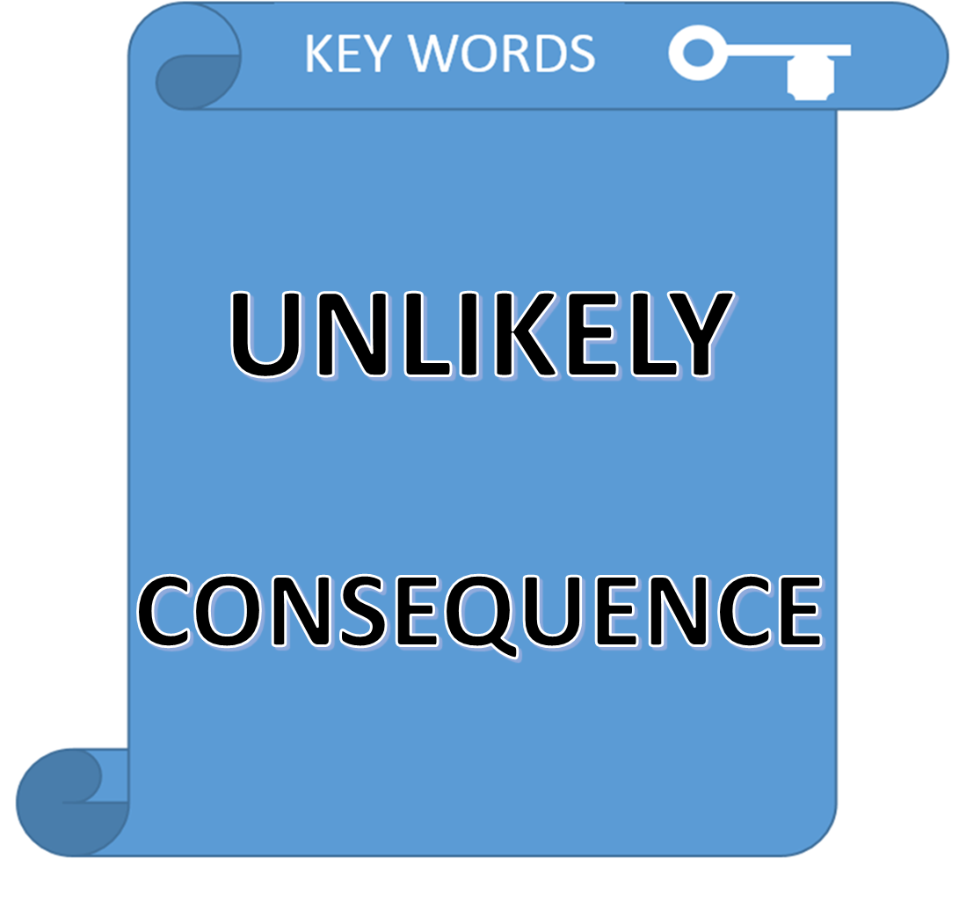


Slide 3
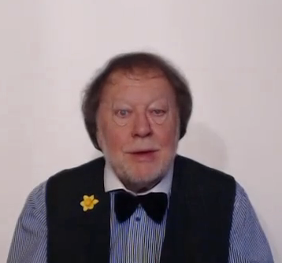
A CONSEQUENCE
OR EFFECT IS A
NECESSARY RESULT
AN
  UNLIKELY EVENT !

Slide 4
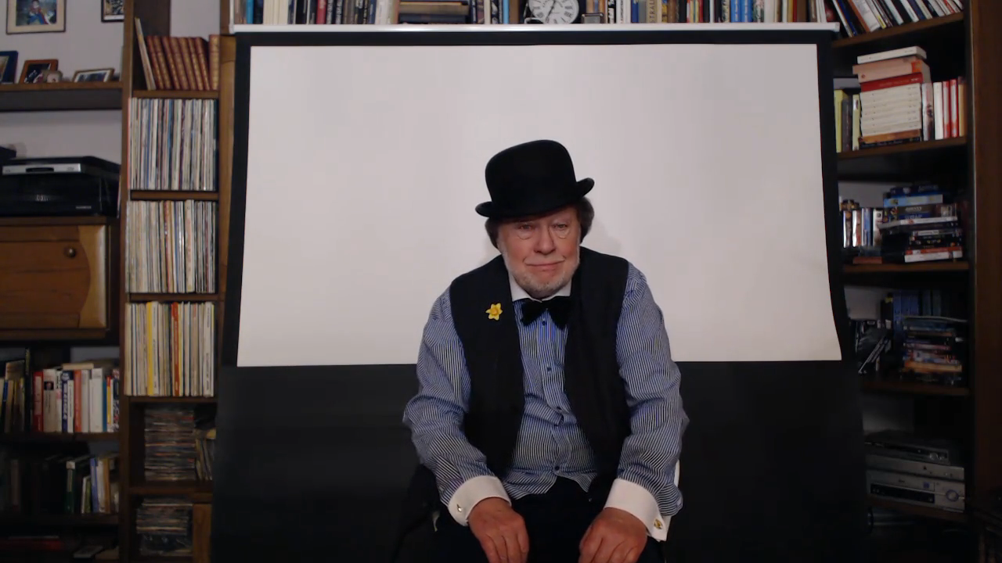
UNLIKELY EVENTS !

Slide 5
IF FOR UNLIKELY RESULTS
FANTASY !

Slide 6
IF FLYING SAUCERS
LANDED
IN YOUR GARDEN
WHAT
WOULD
YOU DO ?

Slide 7






Slide 8
IF FLYING SAUCERS
LANDED
IN YOUR GARDEN
WHAT
WOULD
YOU DO ?

Slide 9

IF FLYING SAUCERS LANDED IN YOUR GARDEN
WHAT WOULD YOU DO?
PAST FORM
THEORETICAL EVENT

Slide 10
IF PIGS HAD WINGS THEY WOULD FLY

Slide 11
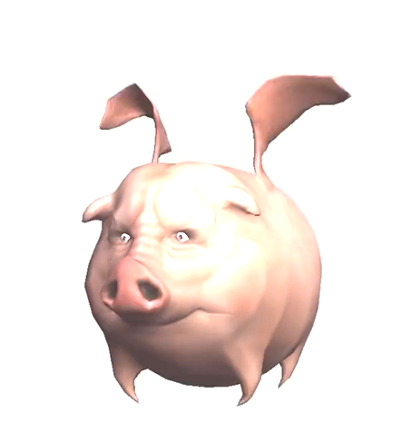
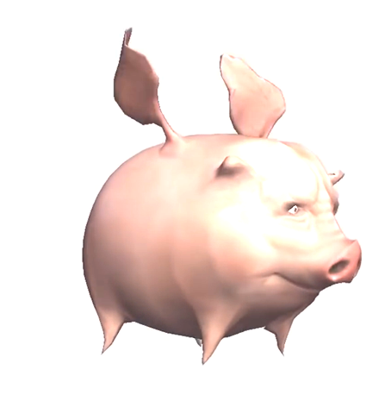
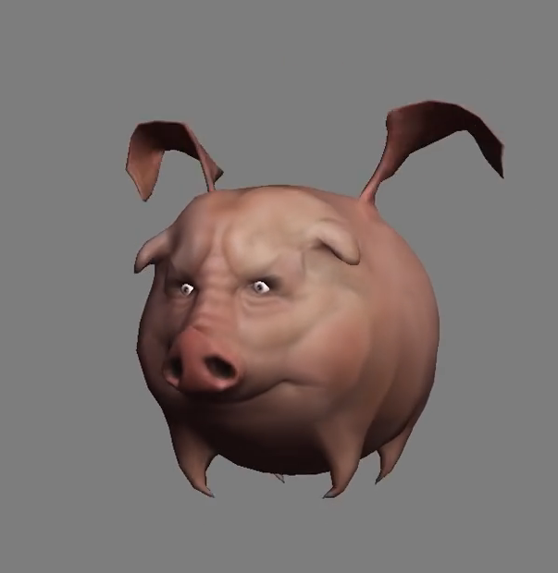
IF PIGS HAD WINGS
THEY WOULD FLY

Slide 12
IF + PAST VERB + WOULD = FANTASY
?
VERY UNLIKELY !
IF PIGS HAD WINGS
THEY WOULD FLY

Slide 13
IF + PAST VERB + WOULD = FANTASY
?
VERY UNLIKELY !
IF PIGS HAD WINGS
THEY WOULD FLY

Slide 14

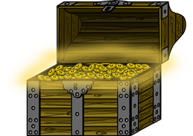
IF + PAST VERB + WOULD = FANTASY
IF YOU GOT VERY RICH IS IT SURE YOU WOULD BE HAPPIER?

Slide 15
KEY EXAMPLES
IF I WENT TO THE MOON IT WOULD BE AMAZING
IF WE MADE A MILLION WE WOULD CELEBRATE !
IF I HAD A JET I WOULD VISIT EXOTIC PLACES

Slide 16

TYPICAL DIALOGUE

Slide 17
NOTICE
REALITY IF FOR EXPECTED RESULTS
AND
FANTASY IF FOR UNLIKELY EVENTS
TYPICAL DIALOGUE

Slide 18
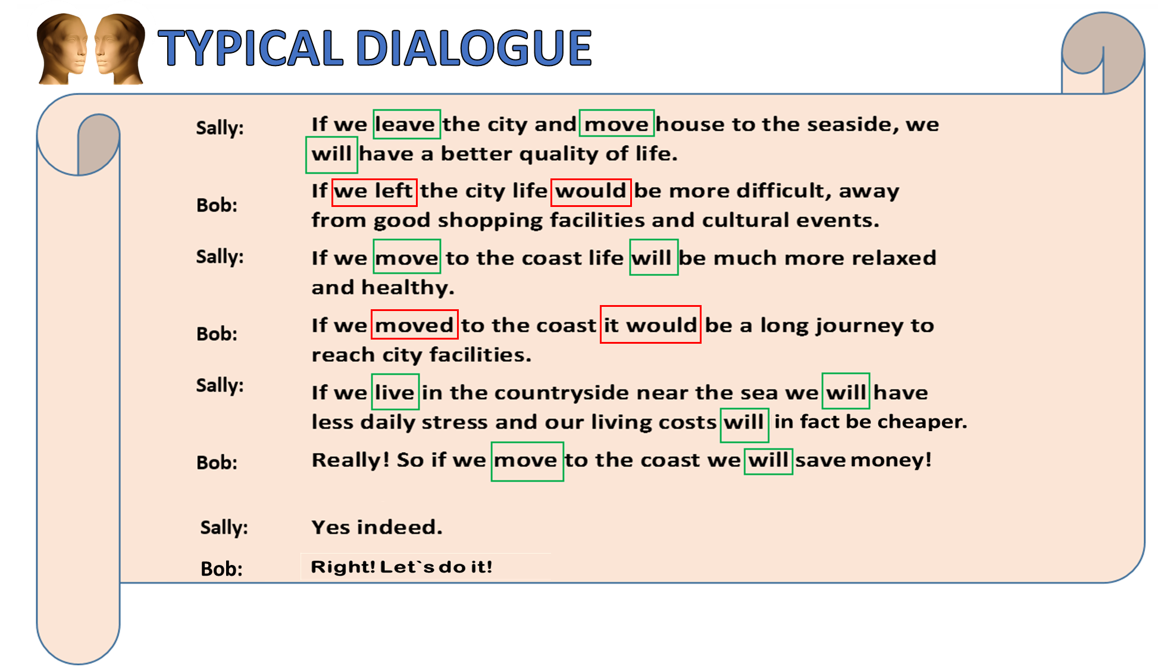

Slide 19


TYPICAL DIALOGUE
JUST LISTEN.......

Slide 21
POSITION OF
IF
IN THE TIME FIELD

Slide 22

POSITION OF IF IN THE TIME FIELD
WE SPEAK NOW
ABOUT LATER
IF EXPRESSES THE CAUSE AND EFFECT
CONNECTION OF THE PRESENT TO THE FUTURE
PAST
PRESENT
FUTURE

Slide 23


POSITION OF IF IN THE TIME FIELD
PRESENT VERB
FUTURE VERB
PAST
PRESENT
FUTURE
IF I THROW MY HAT UP IT WILL FALL
EXPECTED RESULT
IF FLYING SAUCERS LANDED IN YOUR GARDEN
WHAT WOULD YOU DO?

Slide 24
NOTICE THE TIMELESS UNLIKELY EVENT !
PAST
PRESENT
FUTURE
IF FLYING SAUCERS LANDED IN YOUR GARDEN
WHAT WOULD YOU DO?
THEORETICAL RESULT
TIMELESS PAST FORM

Slide 25
THIS PAST VERB HAS NO TIME FUNCTION !
PAST
PRESENT
FUTURE
LANDED
IF FLYING SAUCERS LANDED IN YOUR GARDEN
WHAT WOULD YOU DO?
THEORETICAL RESULT
TIMELESS PAST FORM

Slide 26

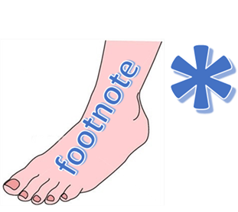
SUMMARY
IF WE WORK HARD WE WILL GET TIRED
IF I RAN A MARATHON I WOULD WIN
REMEMBER: BOTH THESE IF SENTENCES ARE IN THE FUTURE

Slide 27
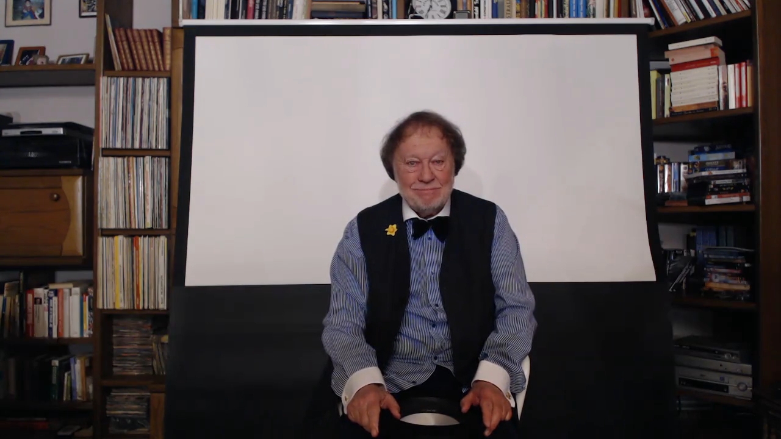
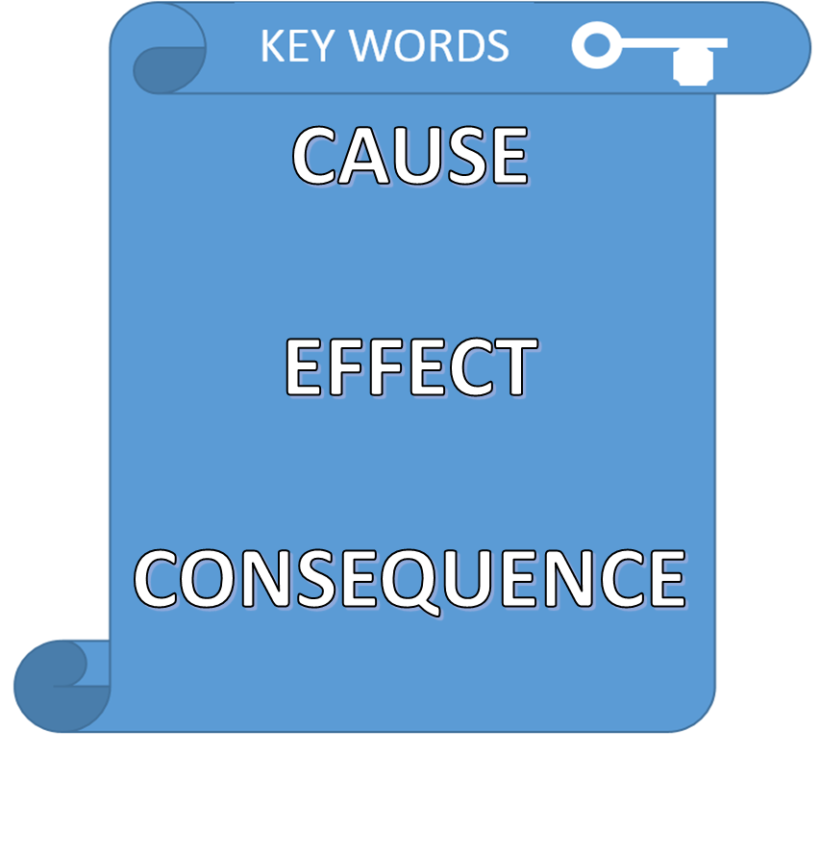

IF OVERVIEW

Slide 28

SUMMARY
REALITY
FANTASY
IF WE VISIT
LONDON
WE WILL SPEAK
ENGLISH
IF YOU WON THE
LOTTERY
YOU WOULD BE
RICH

Slide 29
OVERVIEW: IF FOR UNLIKELY EVENTS
IF FLYING SAUCERS LANDED IN YOUR GARDEN
WHAT WOULD YOU DO?
PAST FORM
THEORETICAL EVENT

Slide 30

SUMMARY
WE SPEAK NOW
ABOUT LATER
IF IS THE CAUSE AND EFFECT
CONNECTION OF THE PRESENT TO THE FUTURE
PAST
PRESENT
FUTURE

Slide 31


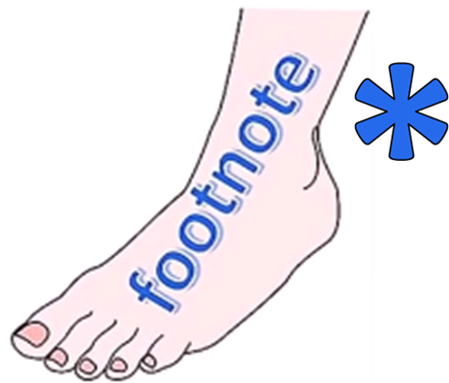
ENGLISH LANGUAGE STUDY
THE
IF
DIFFERENCE !

Slide 32
ENGLISH LANGUAGE STUDY
THE
IF
DIFFERENCE !

Slide 33

IF I WORK HARD I WILL BE SUCESSFUL
REALITY
IF I RAN A MARATHON I WOULD WIN !

