Slide 1
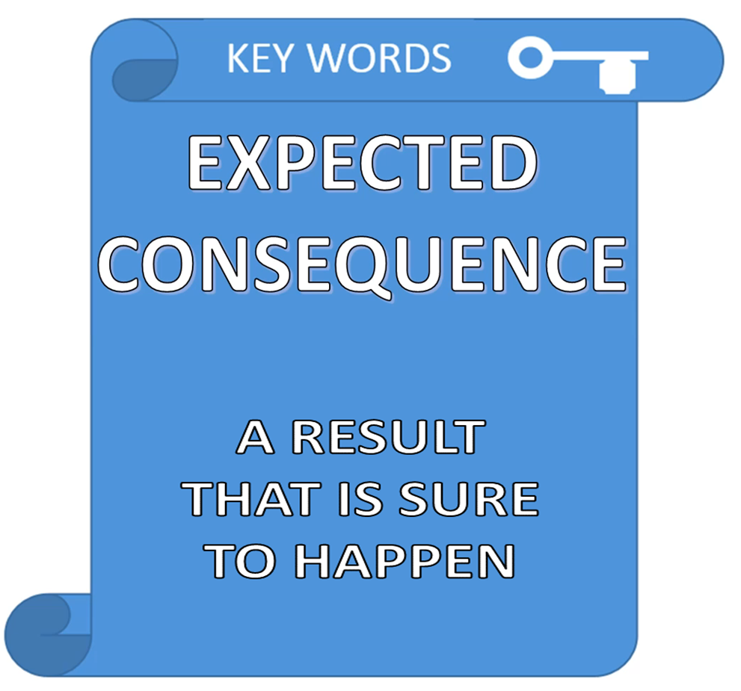

Slide 2


KEY EXAMPLES
IF WE HAVE GOOD LUCK WE WILL BE HAPPY
IF IT RAINS ALL SUMMER WE WILL BE SAD
CREATES
CAUSE
EFFECT

Slide 3


AN EXPECTED
OR NECESSARY RESULT
IF I SPEAK TO MY FRIENDS WE WILL FIX A DATE

Slide 4
MORE EXPECTED AND NECESSARY RESULTS
IF I REMEMBER CORRECTLY I WILL FIND THE WAY
IF YOU WALK ON THE BEACH YOU WILL BE REFRESHED
IF WE MEET FRIENDS WE WILL ENJOY THE TIME

Slide 5
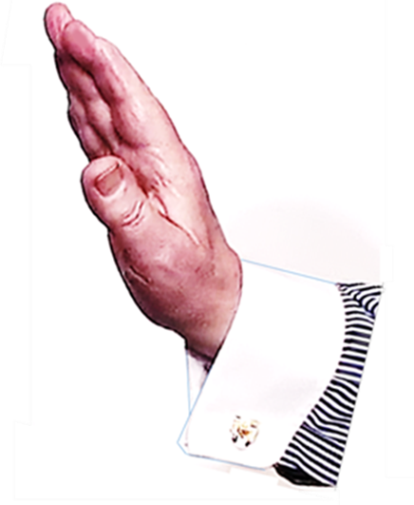


HERE IS A SIMPLE CAUSE WITH A FOLLOWING EFFECT
THIS IS
A DIRECTLY EXPECTED
CONSEQUENCE
CAUSE
EFFECT

Slide 6
KEY EXAMPLES
IF I PUSH THE BALL IT WILL FALL
PRESENT VERB
FUTURE VERB
THIS IS OUR REALITY !

Slide 7
A
CAUSE
IS AN EVENT WHICH CREATES
A CONSEQUENCE
A
CONSEQUENCE
EFFECT
IS A NECESSARY

Slide 8
KEY EXAMPLES
IF I BUY A BOOK I WILL READ IT
IF YOU WORK HARD YOU WILL
GET TIRED
IF WE RELAX WE WILL ENJOY IT

Slide 9

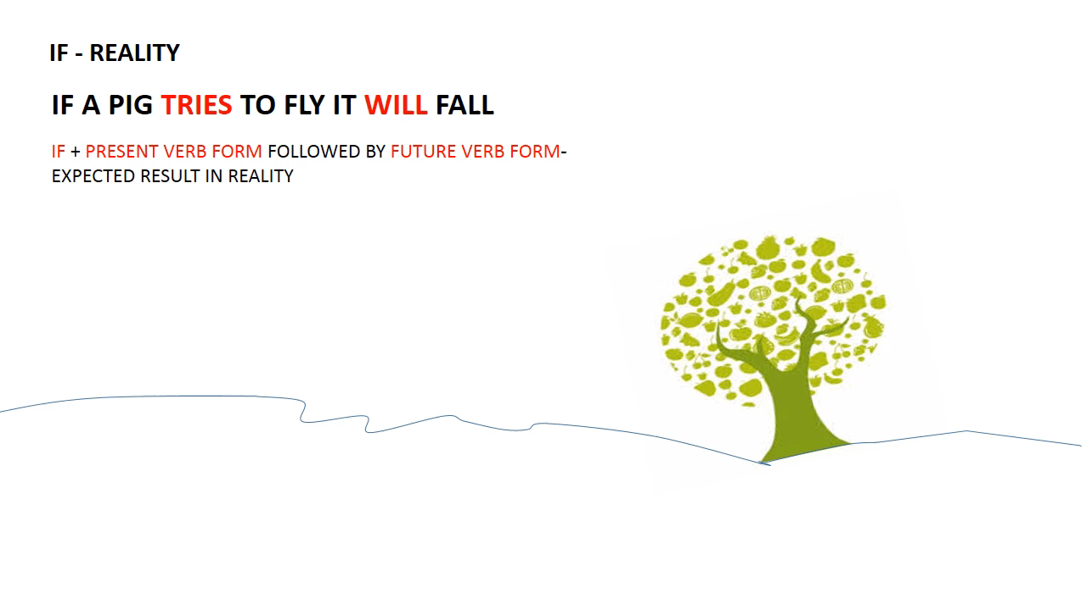

REALITY !
IF + PRESENT VERB FOLLOWED BY FUTURE VERB
= EXPECTED REALITY
PRESENT
FUTURE

Slide 10
SUMMARY
IF FOR EXPECTED RESULTS
REALITY
REALITY
REALITY

Slide 11
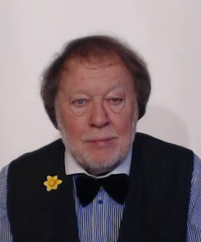
SUMMARY
IN OUR EVERYDAY LIVES
WE TALK ABOUT
EXPECTED
CONSEQUENCES

Slide 12


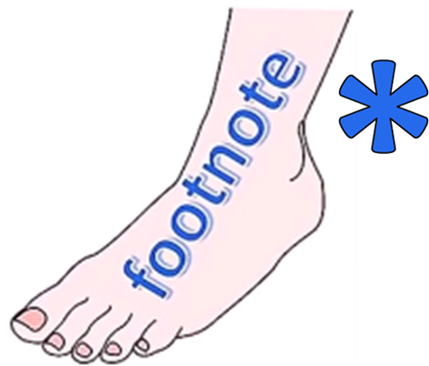
ENGLISH LANGUAGE STUDY
TYPICAL
IF
QUESTION

Slide 13



?
WHAT IF I TAKE THAT WAY ?
WHAT IF I TAKE THIS WAY ?
IF I CHOOSE CORRECTLY MAYBE I WILL HAVE AN ADVENTURE !

