Slide 1
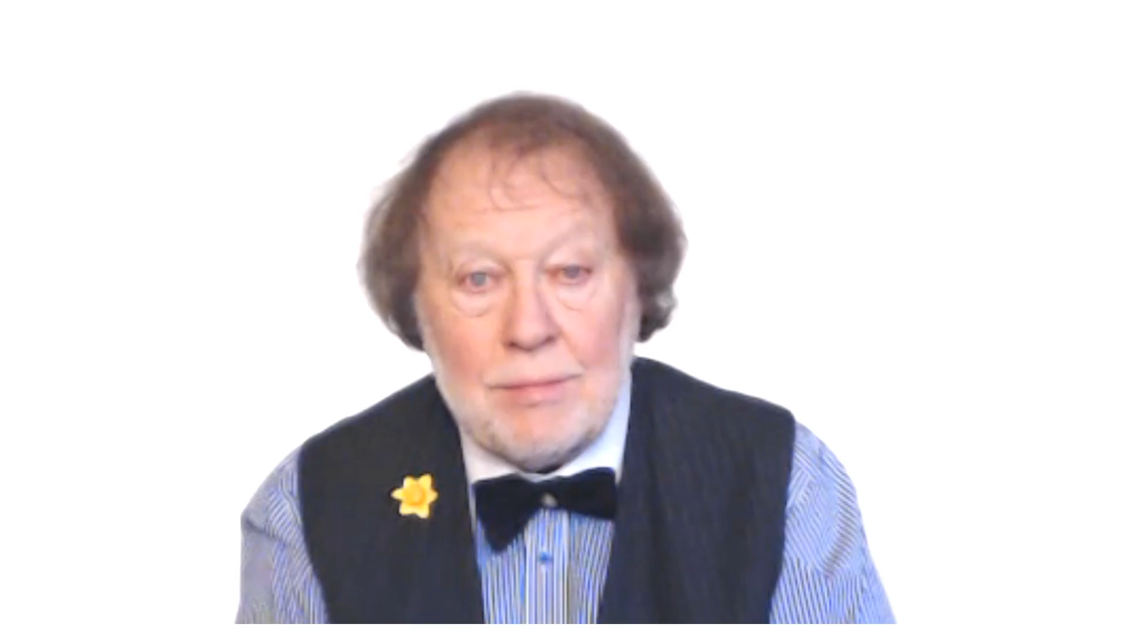
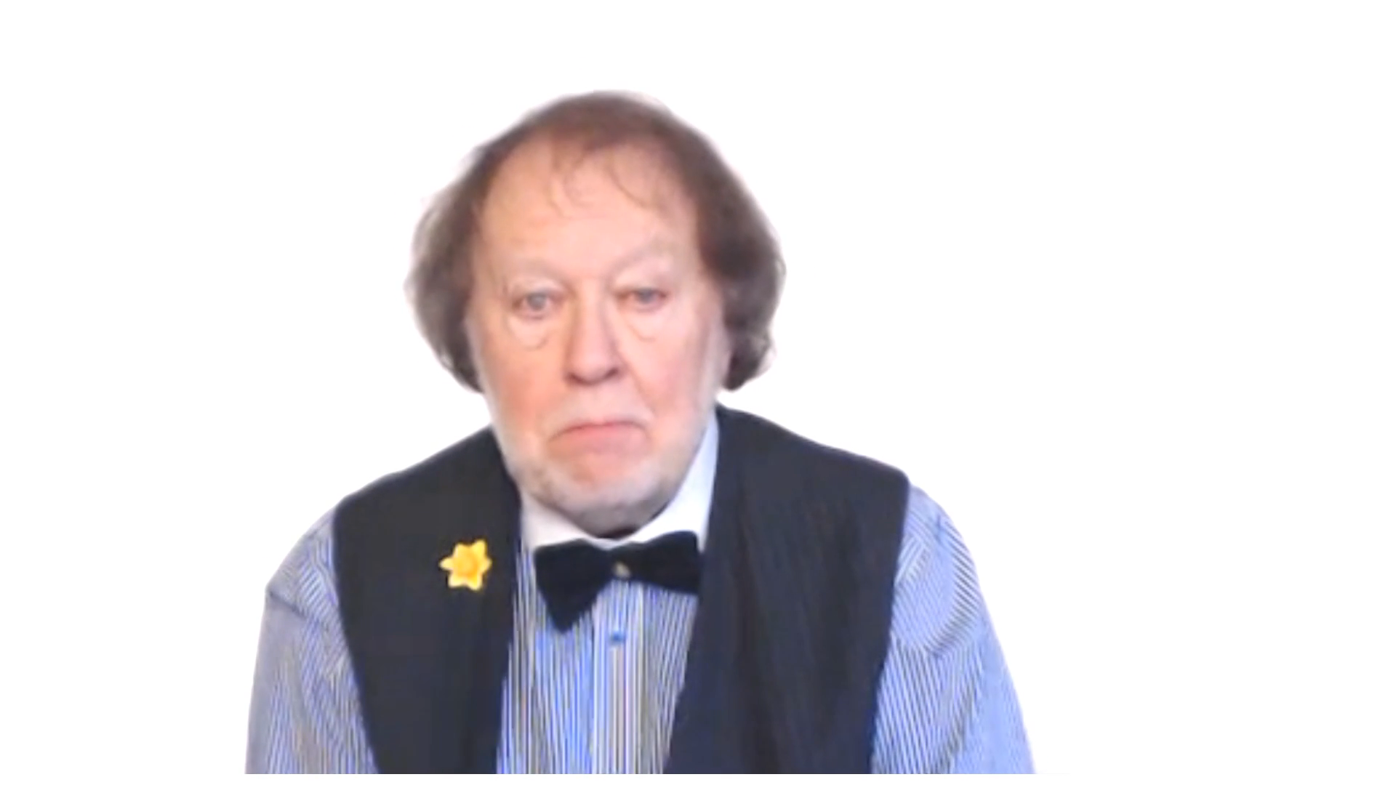
THE LANGUAGE WE USE
FOR OBLIGATION

Slide 2



KEY IDEA

Slide 3
OBLIGATION
IS A PROMISE OR A CONTRACT
DUTY
IS AN OFFICIAL OR VERY PERSONAL OBLIGATION

Slide 4

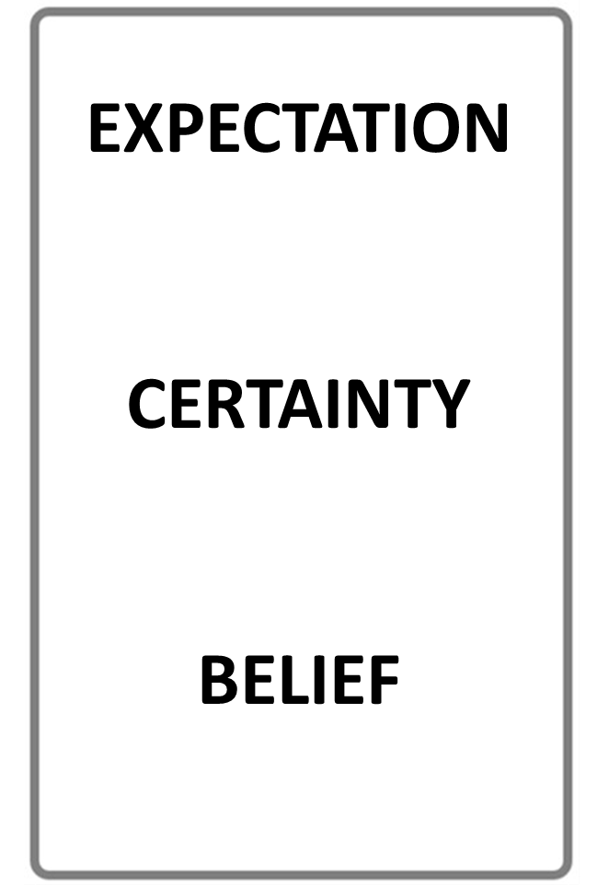


MUST
HAVE TO
SHOULD
NEEDN’T
PERSONAL OBLIGATION
EXTERNAL OBLIGATION
MORAL OBLIGATION
DUTY
NO OBLIGATION!
STOP THE VIDEO WHILE YOU CHECK

Slide 5
MUST
HAVE TO
SHOULD
NEEDN’T
PERSONAL OBLIGATION
EXTERNAL OBLIGATION
MORAL OBLIGATION
DUTY
NO OBLIGATION!
STOP THE VIDEO WHILE YOU CHECK

Slide 6
HERE ARE THE OBLIGATION AUXILIARIES IN ACTION
SHOULD
NEEDN’T
MUST
WE WORK HARD
HAVE TO

Slide 7
THE OBLIGATION AUXILIARIES OVERVIEW
PERSONAL OBLIGATION
MUST
WE WORK HARD
HAVE TO
SHOULD
EXTERNAL OBLIGATION
MORAL OBLIGATION
DUTY
NEEDN’T
NO OBLIGATION!

Slide 8
KEY EXAMPLES
WE MUST BE KIND TO CHILDREN
YOU HAVE TO RESPECT THE LAW
HE SHOULD VISIT HIS OLD FRIENDS
I NEEDN’T WORK ON SUNDAYS

Slide 9
KEY CONTEXTS
WE MUST BE KIND TO CHILDREN
HUMANITARIAN
NEED
YOU HAVE TO RESPECT THE LAW
IT’S OFFICIAL
HE SHOULD VISIT HIS OLD FRIENDS
SOCIAL
NECESSITY
NO STRESS
I NEEDN’T WORK ON SUNDAYS

Slide 10
THE PAST FORM OF
MUST AND HAVE TO
IS
HAD TO

Slide 11
KEY EXAMPLE
I MUST SEE PETER BECAUSE
I HAVE TO PAY HIM
I HAD TO SEE PETER BECAUSE I HAD TO PAY HIM

Slide 12
STORY BOARD
ENJOY IT !

Slide 13


STORY BOARD
READ
LISTEN
READ AGAIN!

Slide 14

I must get some flowers for my mother’s birthday.
I have to go to the bank first, as I don’t have any cash.
I should see her more but she lives so far away.
She tells me that I needn’t visit her very often but telephoning more would be nice.
My sister has to work four days per week only, so
she can easily visit at weekends. We needn’t support our parents as they have their own shop.
Maybe we should help in the shop. Perhaps one day we must run it!

Slide 15


STORY BOARD

Slide 16
I must get some flowers for my mother’s birthday.
I have to go to the bank first, as I don’t have any cash.
I should see her more but she lives so far away.
She tells me that I needn’t visit her very often but telephoning more would be nice.
My sister has to work four days per week only, so
she can easily visit at weekends. We needn’t support our parents as they have their own shop.
Maybe we should help in the shop. Perhaps one day we must run it!

Slide 17
MORE KEY EXAMPLES
I MUST REMEMBER YOUR BIRTHDAY!
WE HAVE TO GO TO SCHOOL
SHE SHOULD BE MORE FRIENDLY
YOU NEEDN’T TEXT ME I’LL CALL YOU

Slide 18

TYPICAL DIALOGUE

Slide 19

Mike: Do we have to tell people about our plans?
Fiona: Our plans can be private but we must tell the children.
Mike: When should we tell them? Soon, do you think?
Fiona: We needn’t say anything until they seem ready.
Mike: We should help them understand. They must live with us too!
It isn’t everyday their mother gets remarried!
Fiona: We must listen to their feelings, that would be fair!
Mike: Maybe we will have to persuade them everything will be fine.
Fiona: We needn’t worry, they know and like you.
They’ll have to accept it.
Mike: I do hope so...

Slide 20


Slide 21
Mike: Do we have to tell people about our plans?
Fiona: Our plans can be private but we must tell the children.
Mike: When should we tell them? Soon, do you think?
Fiona: We needn’t say anything until they seem ready.
Mike: We should help them understand. They must live with us too!
It isn’t everyday their mother gets remarried!
Fiona: We must listen to their feelings, that would be fair!
Mike: Maybe we will have to persuade them everything will be fine.
Fiona: We needn’t worry, they know and like you.
They’ll have to accept it.
Mike: I do hope so...

Slide 22
SUMMARY
KEY IDEA

Slide 23
OBLIGATION
IS A PROMISE OR A CONTRACT
DUTY
IS AN OFFICIAL OR VERY PERSONAL OBLIGATION

Slide 24
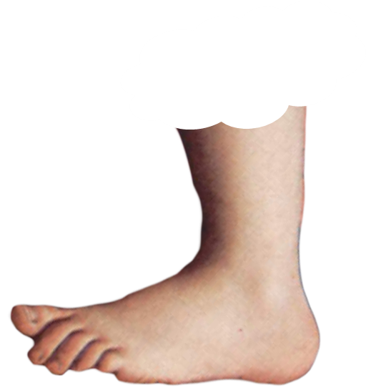
FOOTNOTE
FOOTNOTE

Slide 25


THE MUST OF LOGIC
IS A DIFFERENT FUNCTION
‘HE ISN’T HERE SO HE MUST BE SOMEWHERE ELSE !’
FOOTNOTE

Slide 26
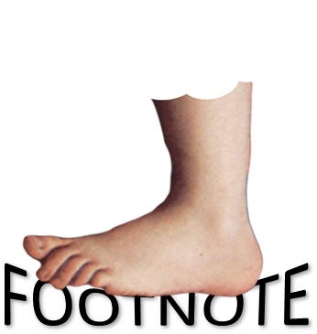
MUST HAVE TO SHOULD NEEDN’T
THESE WORDS HAVE OTHER CONTEXTS
SEE AUXILIARIES LESSON

