Slide 1
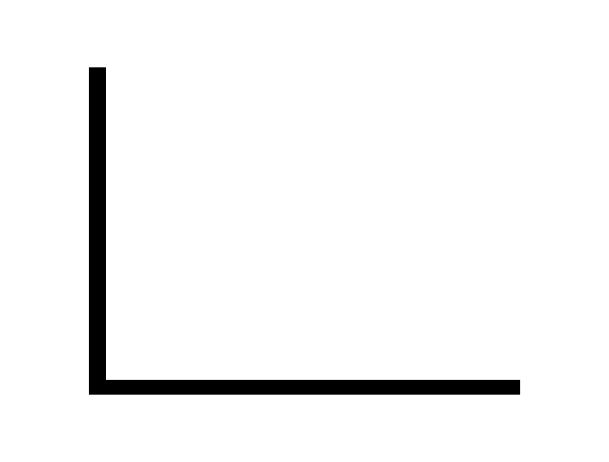
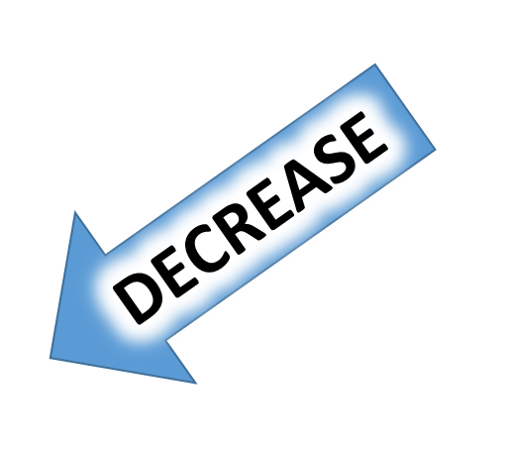

GETTING
LARGER
MORE
GETTING
SMALLER
INCREASE
LESS

