Slide 1
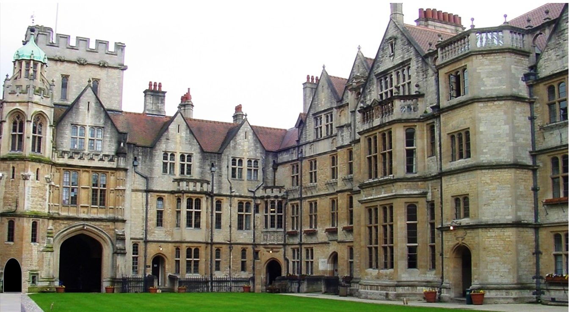

Slide 4


Slide 5
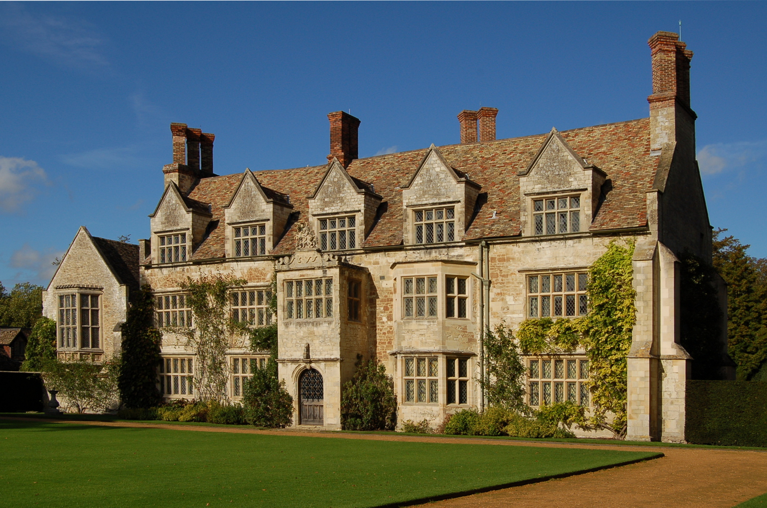
This Photo by Unknown Author is licensed under CC BY-SA

Slide 6
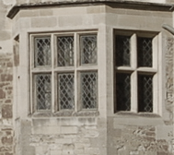
SCHOLA GRAMMATICA ET HISTOR

Slide 7
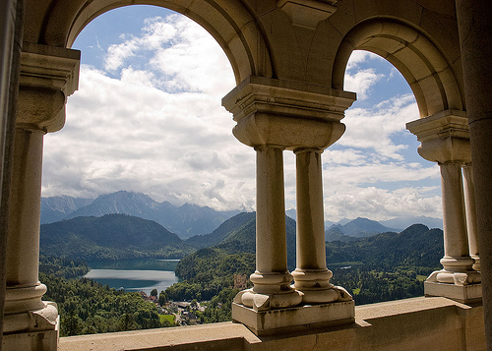
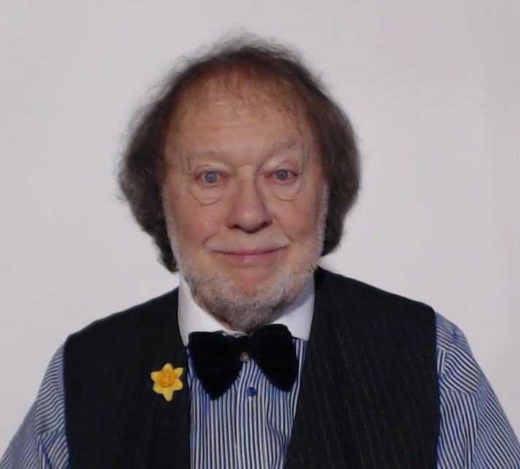

Slide 8
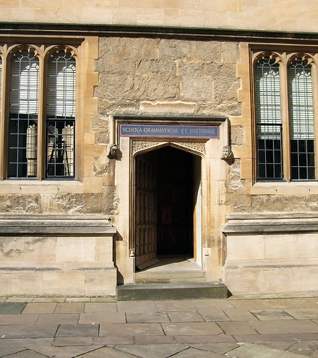
This Photo by Unknown Author is licensed under CC BY

Slide 9

THE GRAMMAR ZONE
WHAT IS GRAMMAR ?
GRAMMAR IS THE WAY WE USE WORDS TO MAKE SENTENCES

Slide 10
WHAT IS GRAMMAR ?
GRAMMAR IS THE WAY WE USE WORDS TO MAKE SENTENCES

Slide 11


Slide 12
