Slide 1


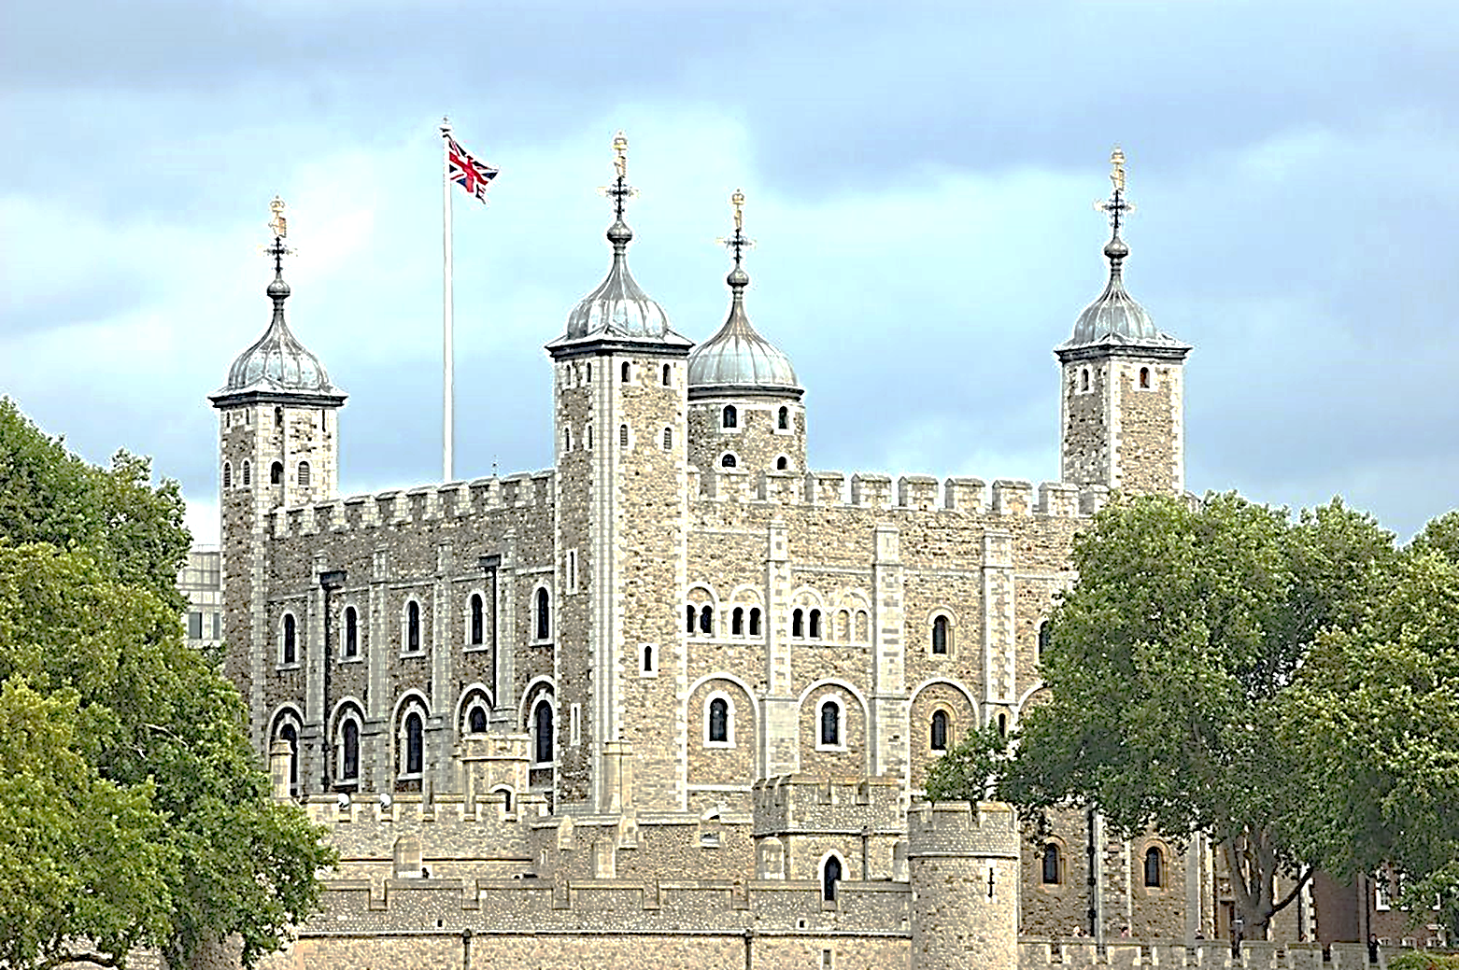
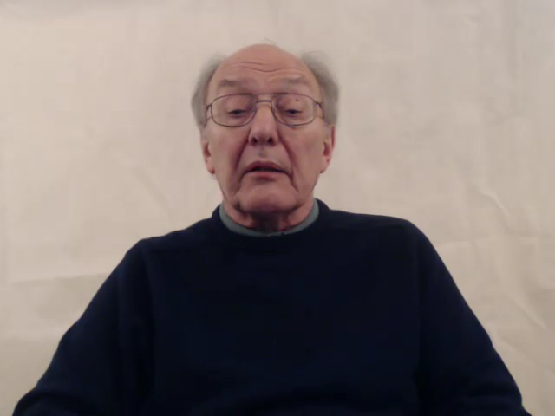

Slide 2


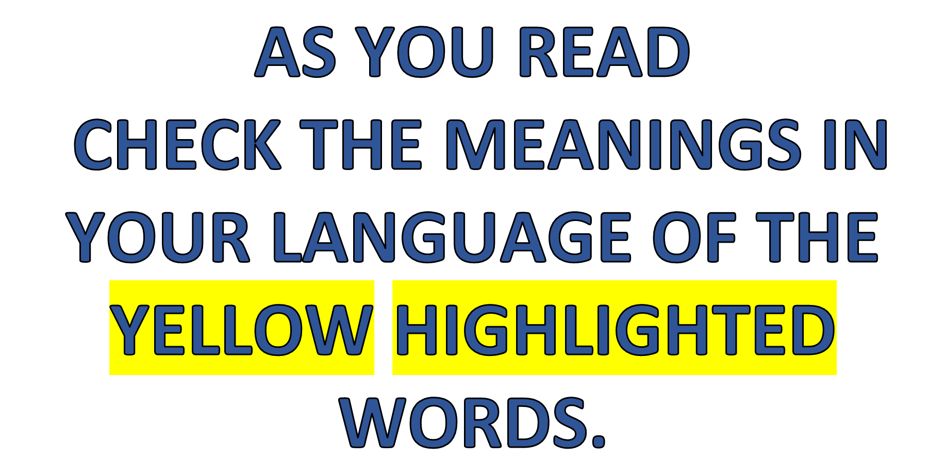
ENGLISH LANGUAGE STUDY

Slide 3
The Tower of London is called simply “the Tower” by Londoners, because it was the biggest landmark in the city for hundreds of years. This great castle does not dominate the sky line as it used to in the Middle Ages and does not play a central role in English politics anymore, but nobody has forgotten it is there. Its long, dark history is too well known for that. This was the place where traitors to the Kings and Queens of England were brought by river, through Traitors’ Gate, to be executed by the axe or secretly murdered. One story tells how a duke was drowned in a barrel of wine, but the worst tale is that of the two, little princes, who were smothered while they were sleeping. Tales like these are long remembered and have been handed down by the generations of Londoners who have lived in the Tower’s shadow.

Slide 4
Do not suppose that what you see today is the original Tower. The square at the centre of the castle was built by the Normans, soon after they had conquered England in 1066. Over the centuries since, however, new walls, towers and buildings have been added and even demolished. There was once a splendid, great hall, where Henry the Eighth married Anne Boleyn, but that did not survive her long after she was executed on Tower Green. Today, the main attractions are the Crown Jewels, to which thousands of visitors are attracted each year, and the yeomen warders, the “beefeaters”, who are photographed countless times in their colourful, period uniforms.
One of the best stories of the Tower is that of Captain Blood, an Irish soldier who was caught trying to steal the Crown Jewels. He beat them out of shape with a hammer to hide them under his cloak, but he didn’t lose his head for this. The king, Charles 11, was amused by him and his courage and gave him a pension to live on instead! So don’t leave London without visiting The Tower. You will be amazed by its history.

Slide 5
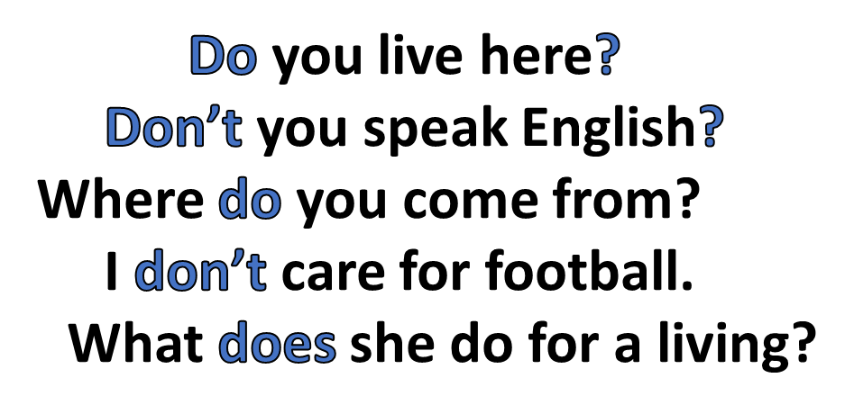
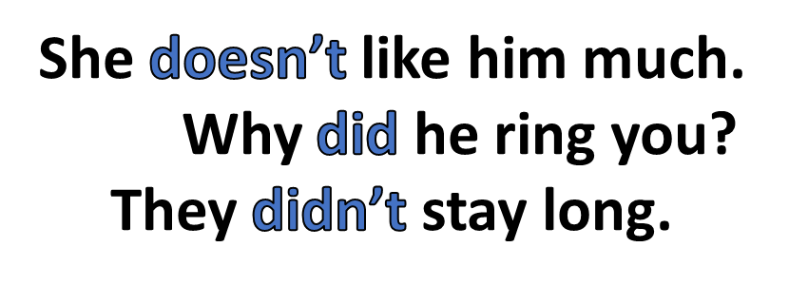
Do
There are various uses for the auxiliary verbs do, be and have;
to make negatives and questions and to form tenses.
Do, does and did are used to form questions and negatives in the
Present Simple and the Past Simple.

Slide 6
Be
Be is used either with the -ing or past participle forms
of a verb to give its continuous and passive forms.
He is making a phone call.
The lion is found in Africa.
What were they making for supper?
He was accused of stealing.
She has been living here for years.
My coat has been lost.

Slide 7
Have
Have is used to make Perfect forms of verbs.
Have you ever visited my country?
She has never seen an elephant.
We have been queuing for hours!

Slide 8
ENGLISH LANGUAGE STUDY

