Slide 1

THE SOUNDS OF SPEECH
THE
SOUND
HOW TO SAY IT

Slide 2

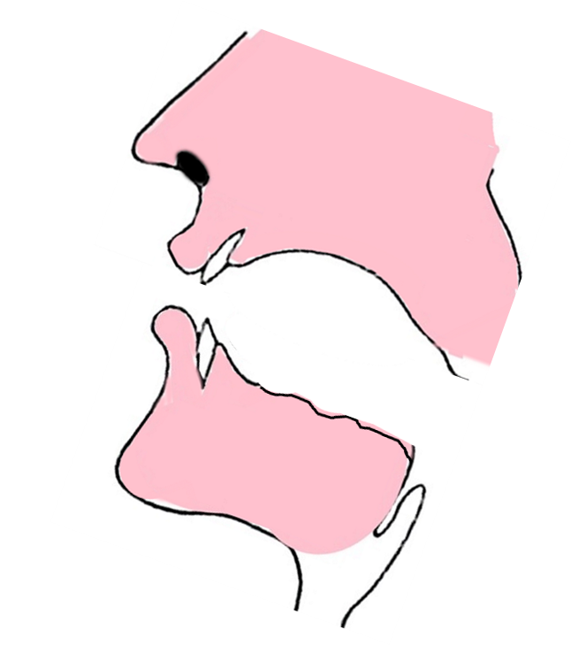


AIR

Slide 3
AIR MUST BLOW THROUGH THE GAP
AIR
AIR

Slide 4
MUST TOUCH THE BACK OF YOUR TOP TEETH
AIR
YOUR TONGUE

Slide 5
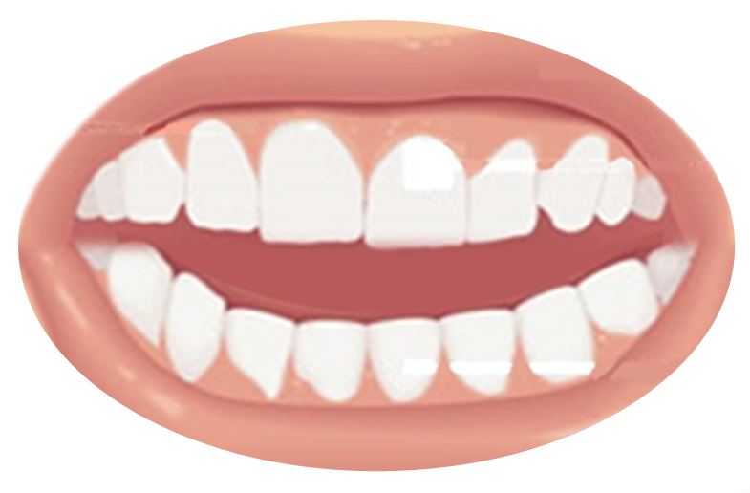



AIR ONLY
THE VOICELESS
th

Slide 6
MUST TOUCH THE BACK OF YOUR TOP TEETH
AIR ONLY
YOUR TONGUE
THE VOICELESS
th

Slide 7

THANKS FOR THERAPY! I THINK IT WAS HELPFUL

Slide 8

th
VOICELESS
THANKS VERY MUCH FOR YOUR KIND THOUGHTS
AFTER THREE THUNDERCLAPS
EVERYTHING WAS CANCELLED EVEN OUR MARATHON
THINKING SOMETHING THROUGH THOUGHTFULLY
CAN BE HEALTHY!

Slide 9


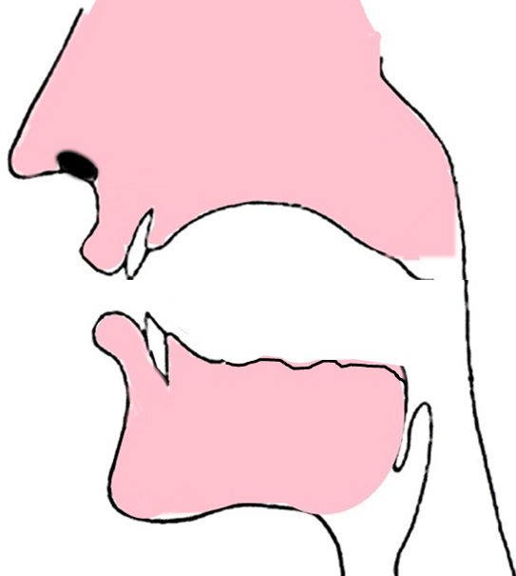
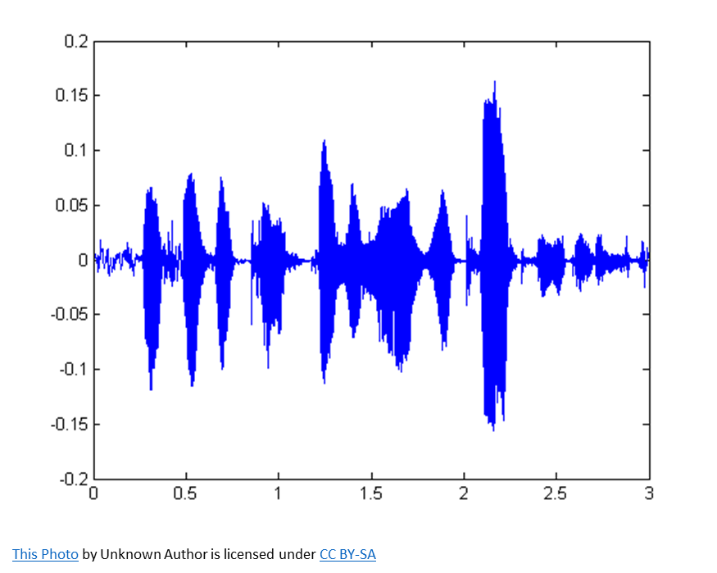
LISTEN AGAIN
AIR

Slide 10
AIR

Slide 11

AIR
AND
AIR
VOICE

Slide 12
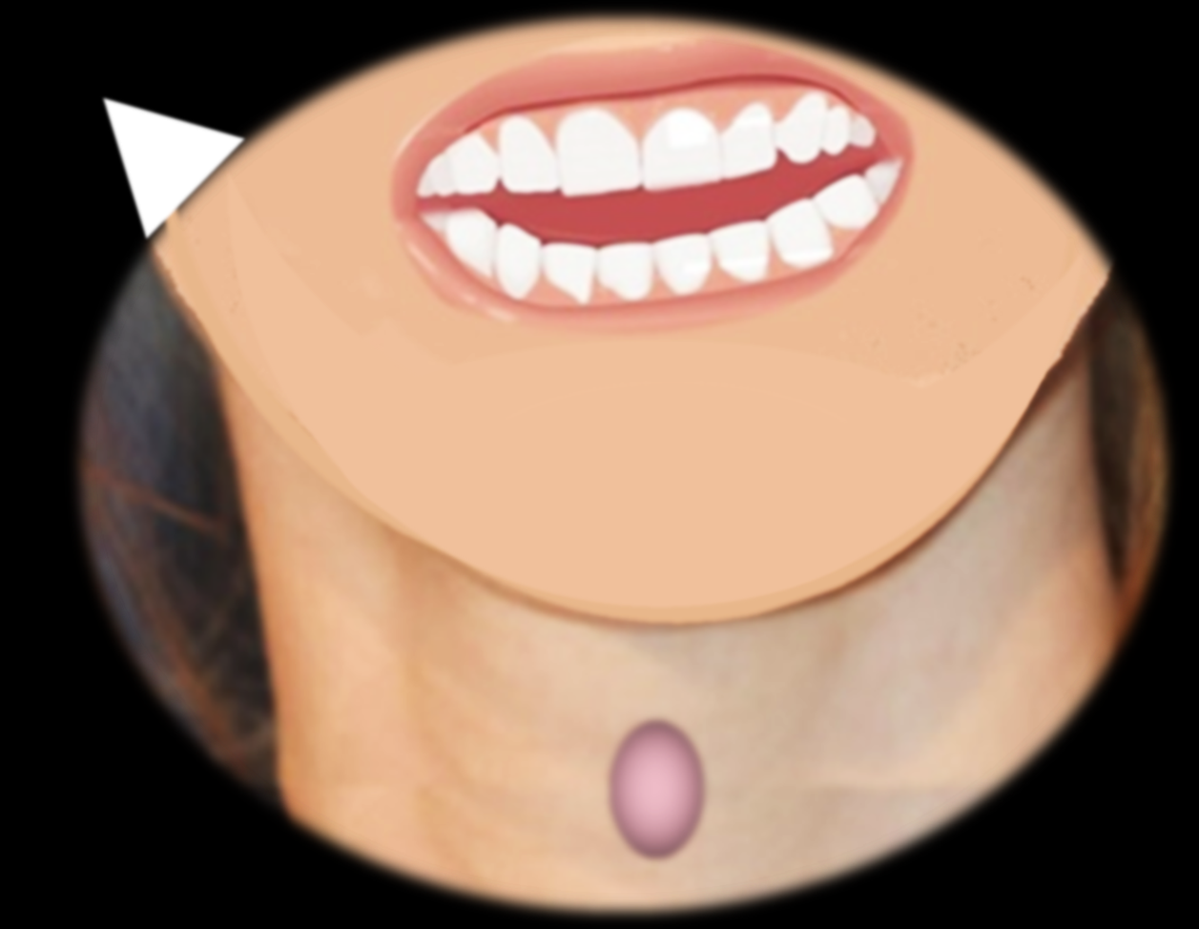
WATCH THE TONGUE !
HEAR THE AIR !
HEAR THE VIBRATION !

Slide 13
WATCH THE TONGUE !
HEAR THE AIR !
HEAR THE VIBRATION !

Slide 14
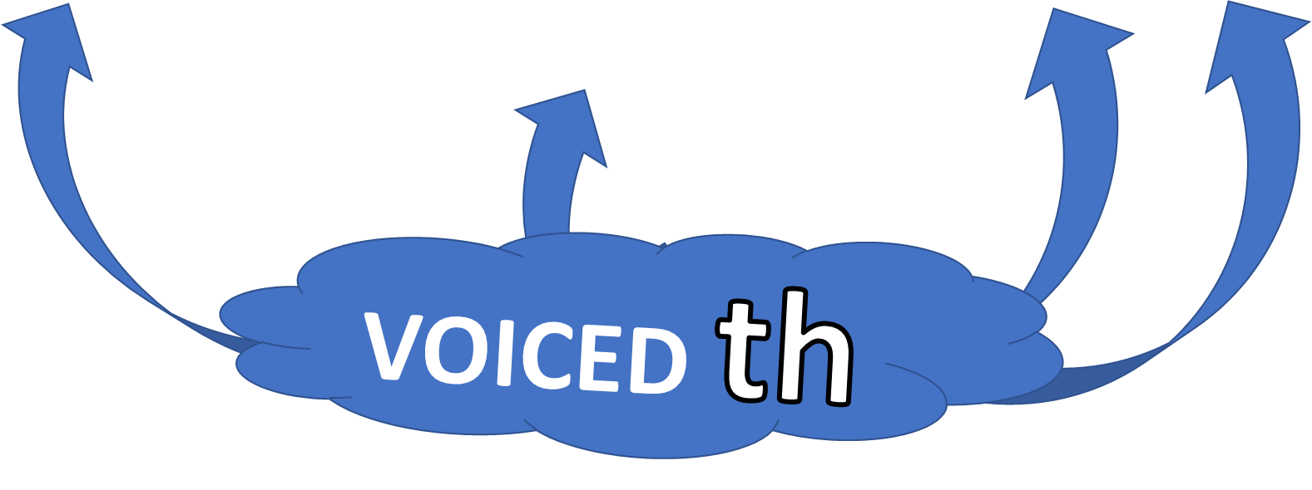
THIS BOOK IS MORE INTERESTING THAN THAT OTHER ONE

Slide 15
th
VOICED
MY BROTHER IS A WEATHER MAN
AND WORKS FOR THE BBC
MY FATHER HAS ANOTHER JOB HE WORKS IN THE LEATHER INDUSTRY
THESE CLOTHES ARE AS LIGHT AS A FEATHER!

Slide 16
IMPORTANT VOICELESS AND VOICED th WORDS

Slide 17


ENGLISH LANGUAGE STUDY
REMEMBER-USE YOUR TONGUE!
NATIVE SPEAKERS
DO THIS EVERY TIME

