Slide 1

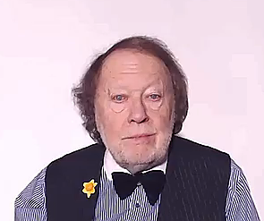
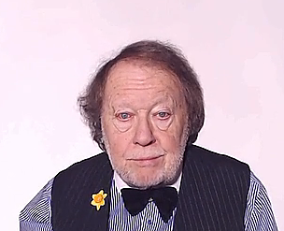
CONTEXTS
All the aspects which define something
are the
CONTEXT

