Slide 2
FULL OF ENERGY AND HOPE
CHECK THESE WORDS
ENTHUSIASTICALLY
WITH ACTION AND CERTAINTY
DYNAMICALLY
REALISTICALLY
SPEAKING FROM EXPERIENCE

Slide 3
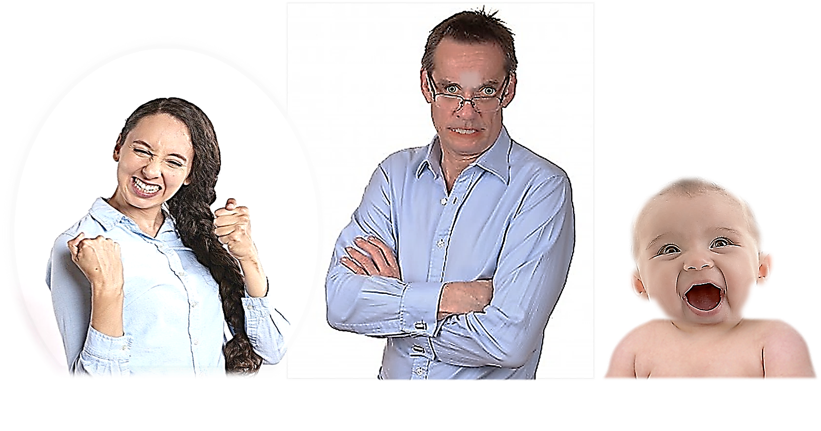
JOE
MELLY
BABY

Slide 6
THE RED WORDS

Slide 7
WHAT DOES THIS MEAN?
THESE WORDS

Slide 8
CHECK THE GREEN WORDS

Slide 10
HERE ARE SOME
KEY WORDS
TO KNOW

Slide 11
XXXX
XXXX
XXXX
XXXX
XXXX
XXXX
XXXX
XXXX

Slide 13
CONTENT
EVENT
SITUATION
FEELING
ATMOSPHERE
MELODY
FACTS

Slide 15
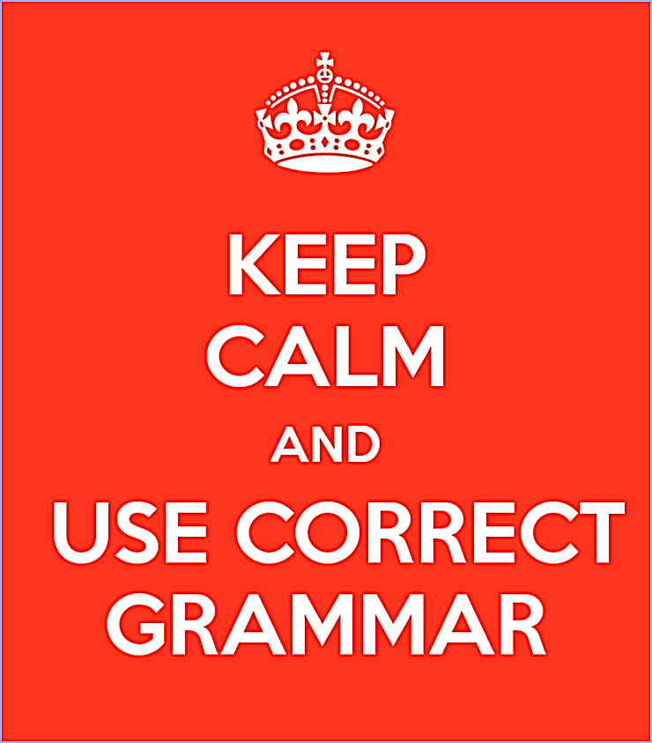

Slide 17
HERE ARE MORE OPTIONS !
SHOULD
WOULD
ADVICE
DUTY
PREFERENCE
ETC…

Slide 18
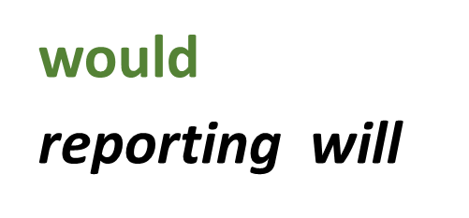
I DO DO IT
I DID DO IT
I WAS DOING IT
I WAS BEING
I AM DOING IT
I DO HAVE IT
I HAVE HAD IT
I HAVE BEEN DOING IT
I WAS HAVING IT

Slide 19
PEOPLE TALKING
OETV

Slide 20
PEOPLE TALKING
OETV

Slide 21
PEOPLE TALKING
OETV

Slide 22
PEOPLE TALKING
OETV

Slide 23
STUDIO ONE
OETV

Slide 24
STUDIO ONE
OETV

Slide 25
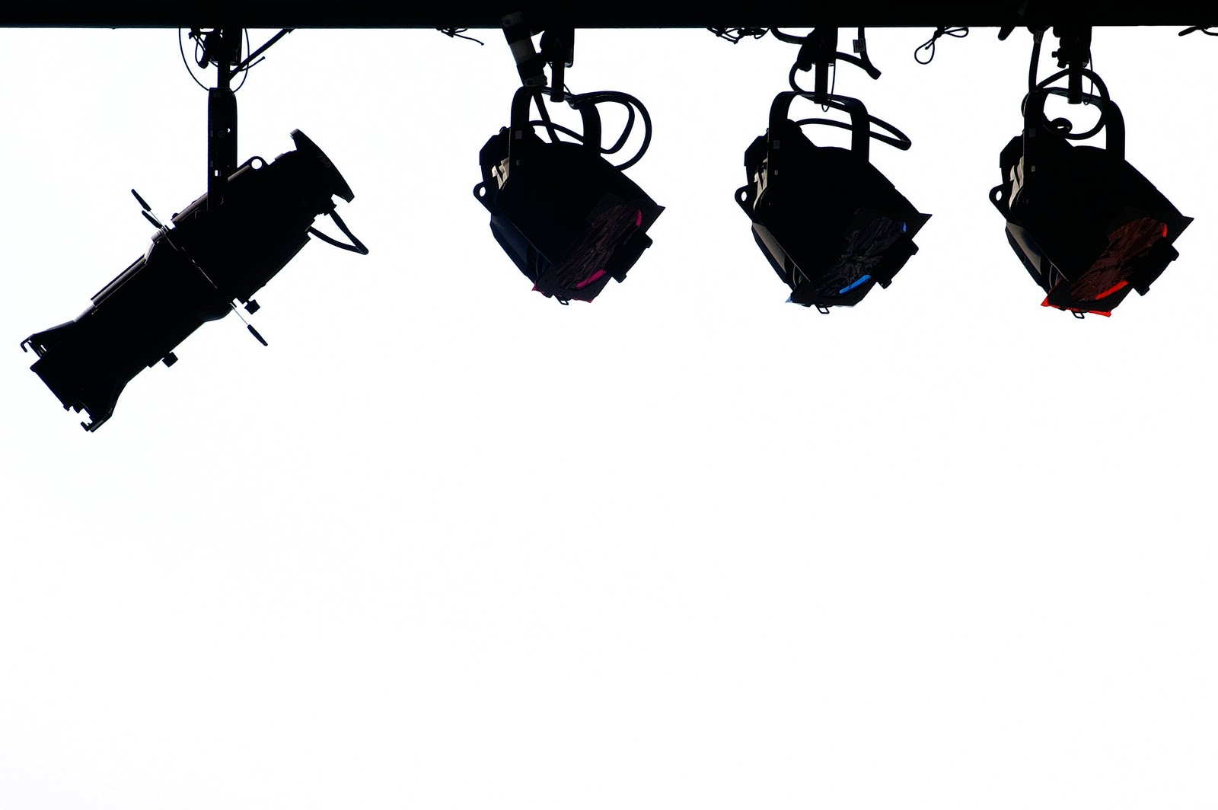
OETV
This Photo by Unknown Author is licensed under CC BY-NC-ND

Slide 26
NEWS
OETV

Slide 27
OETV
This Photo by Unknown Author is licensed under CC BY-NC-ND

Slide 28
OETV
OXFORD ENGLISH TELEVISION

Slide 29
WELCOME TO OXFORD

Slide 31
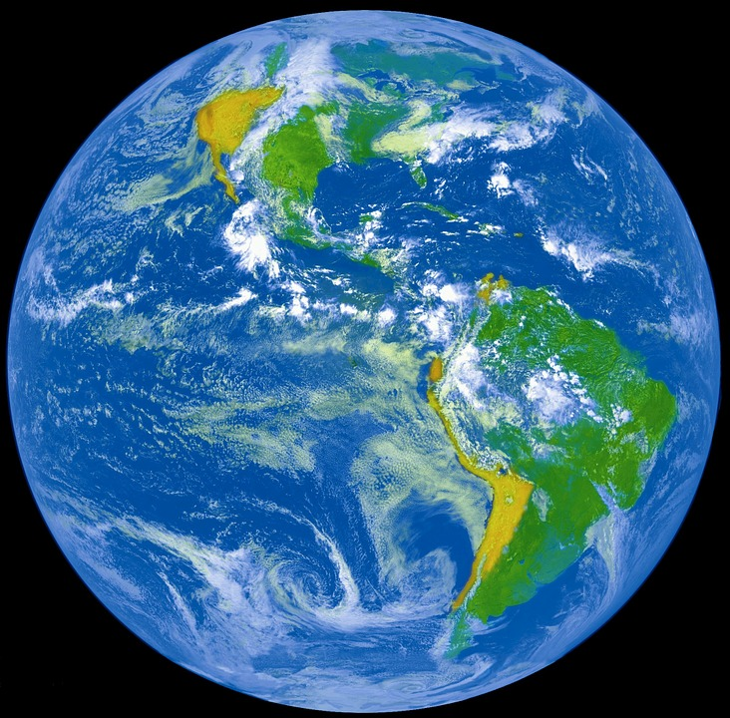
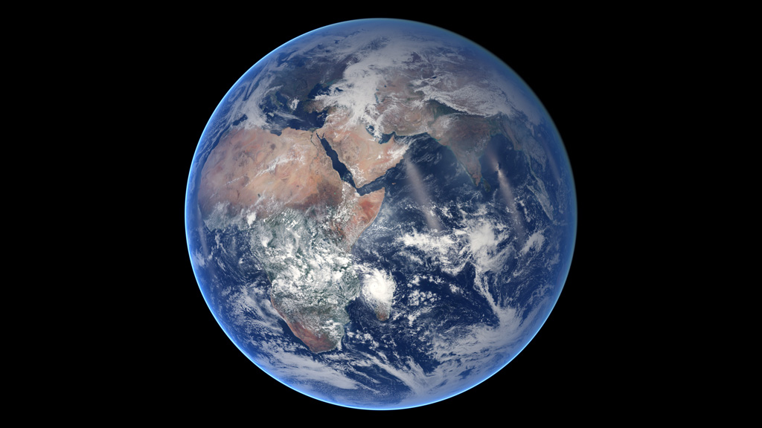
This Photo by Unknown Author is licensed under CC BY-SA

Slide 35
OBLIGATION BEGINS
WE WEAR CYCLE HELMETS
HERE !

Slide 36
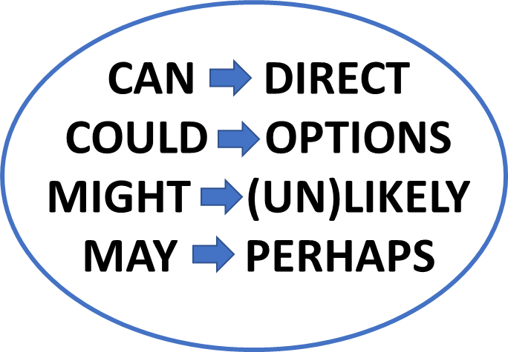
KEY POSSIBILITY EXAMPLES
CAN
COULD
MAY
MIGHT
WE VISIT THE DOCTOR

Slide 37
KEY FUTURE EXAMPLES
WE VISIT THE DOCTOR
SHALL
WILL

Slide 38
KEY FUTURE EXAMPLES
WE VISIT THE DOCTOR
SHALL
WILL

Slide 41
LISTENING
UNDERSTANDING
SPEAKING

Slide 42
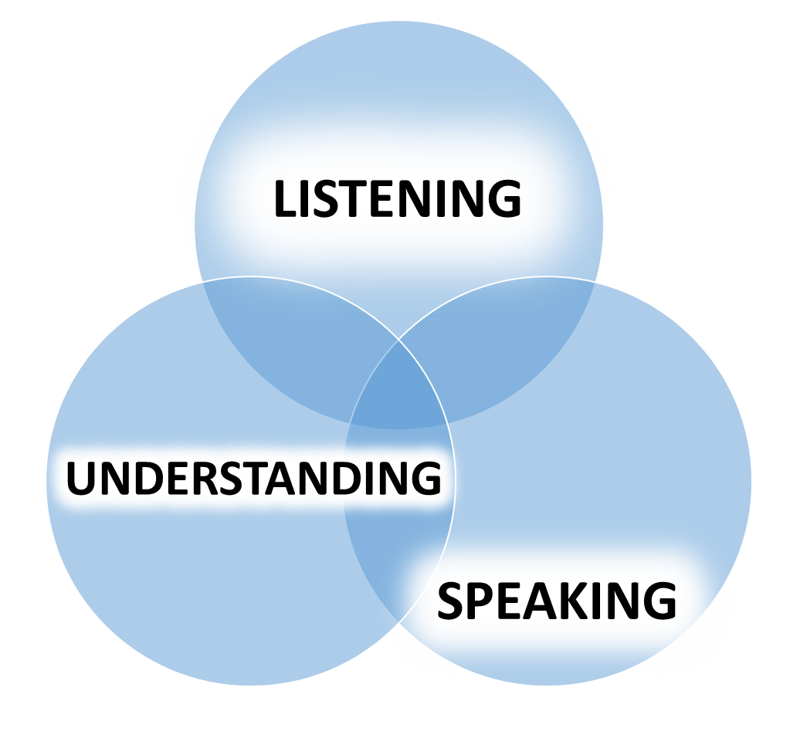

Slide 43
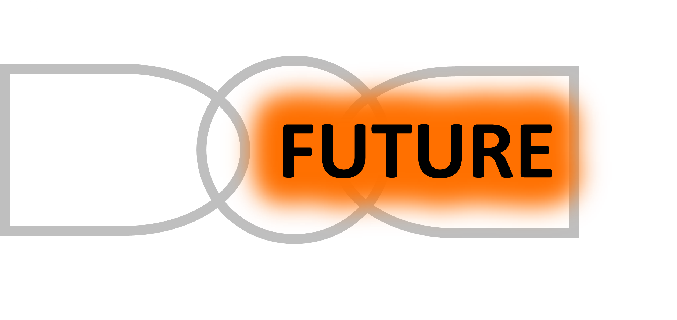
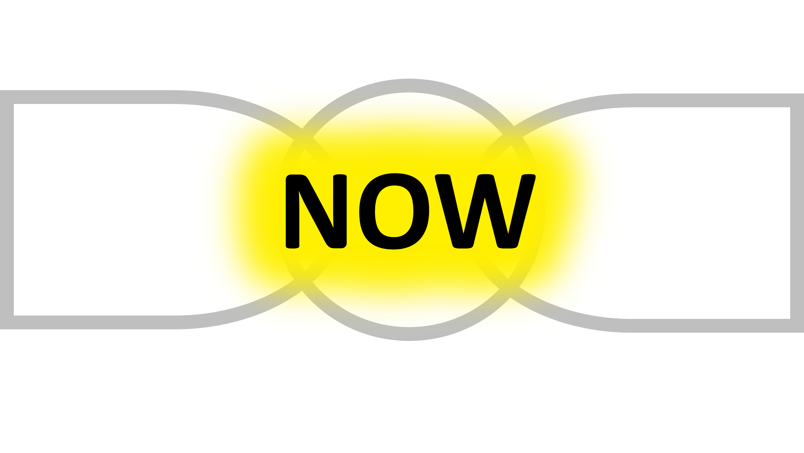

Slide 44
KEY OBLIGATION EXAMPLES
MUST
HAVE TO
NEEDN’T
NEEDN’T
MUST
WE VISIT THE DOCTOR
HAVE TO

Slide 45
PAST

Slide 46
NOW

Slide 47
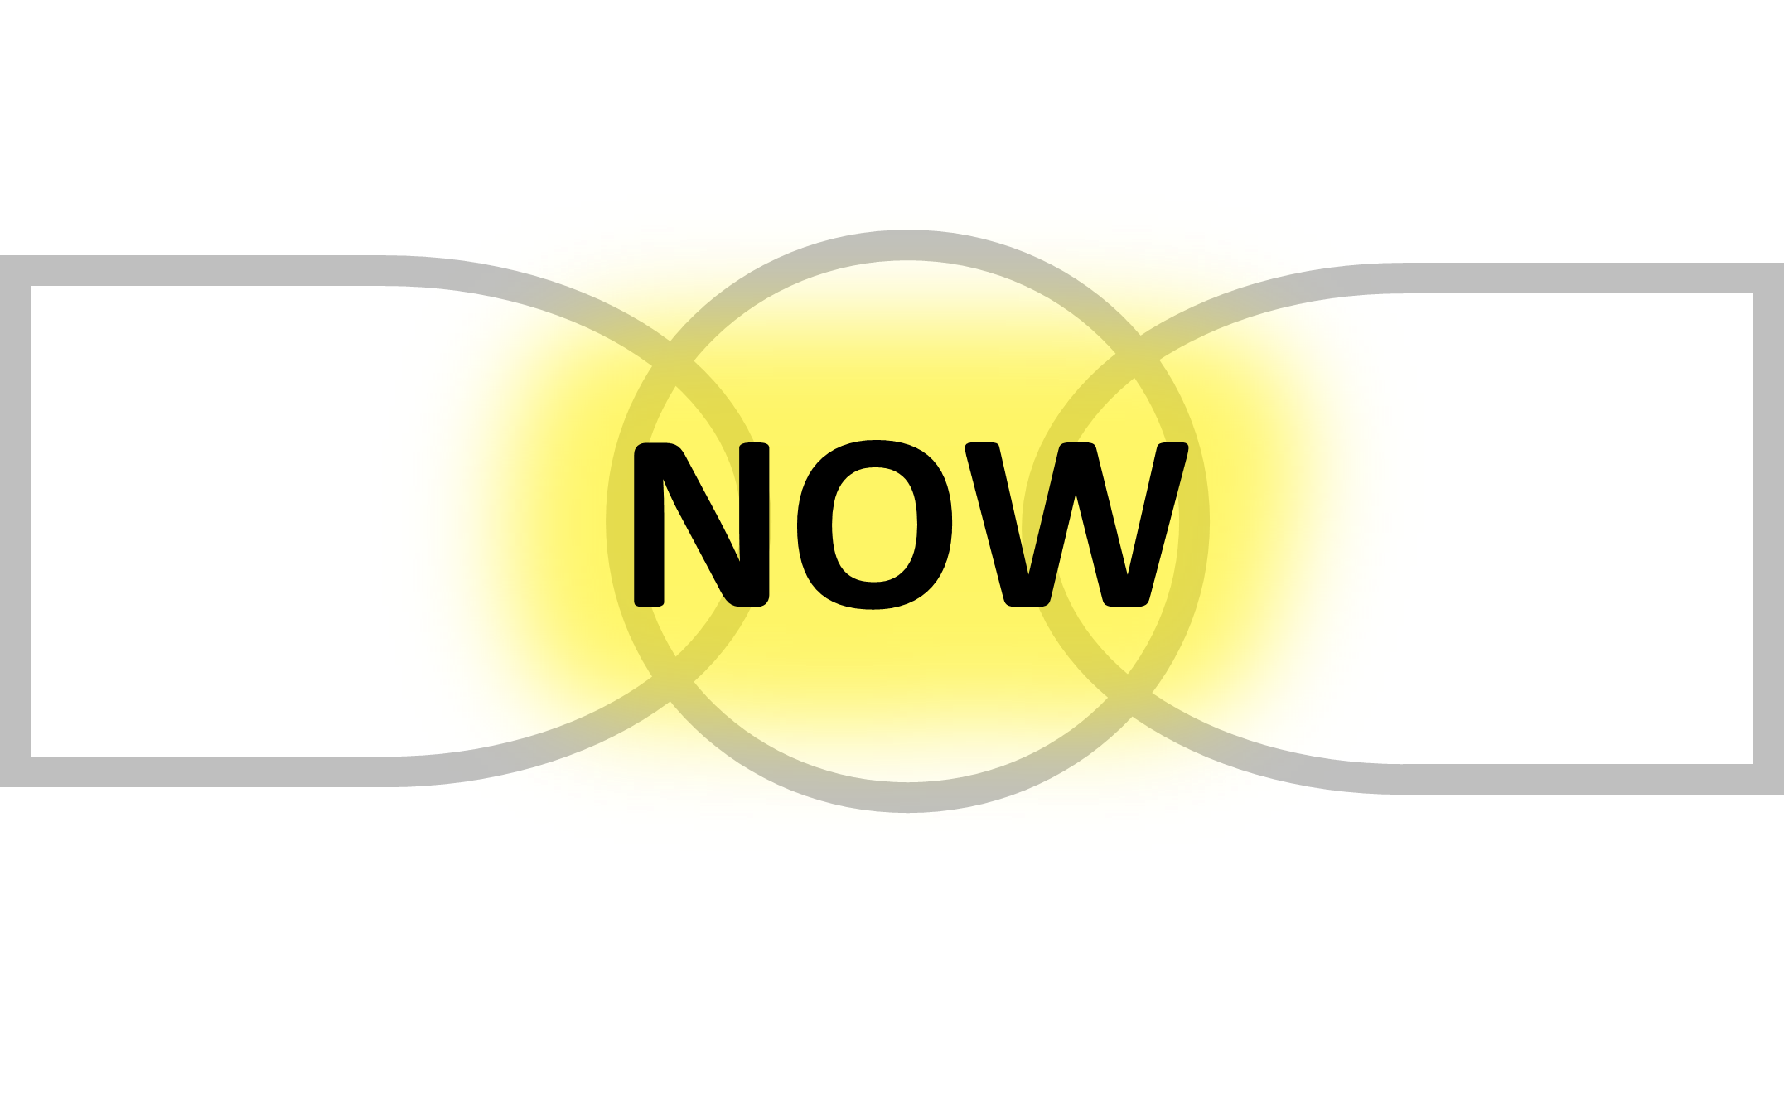

Slide 48
FUTURE

Slide 49
ALAN:
JOE:
ALAN:
JOE:
ALAN:
JOE:
ALAN:
JOE:
ALAN:
JOE:
ALAN:
JOE:

Slide 50
SUE:
SOPHY:
SUE:
SOPHY:
SUE:
SOPHY:
SUE:
SOPHY:
SUE:
SOPHY:
SUE:
SOPHY:

Slide 51
JEFF:
PAT:
JEFF:
PAT:
JEFF:
PAT:
JEFF:
PAT:
JEFF:
PAT:
JEFF:
PAT:

Slide 52
KATE:
WILL:
KATE:
WILL:
KATE:
WILL:
KATE:
WILL:
KATE:
WILL:
KATE:
WILL:

Slide 53
CHECK THIS WORD
IN YOUR LANGUAGE

Slide 56
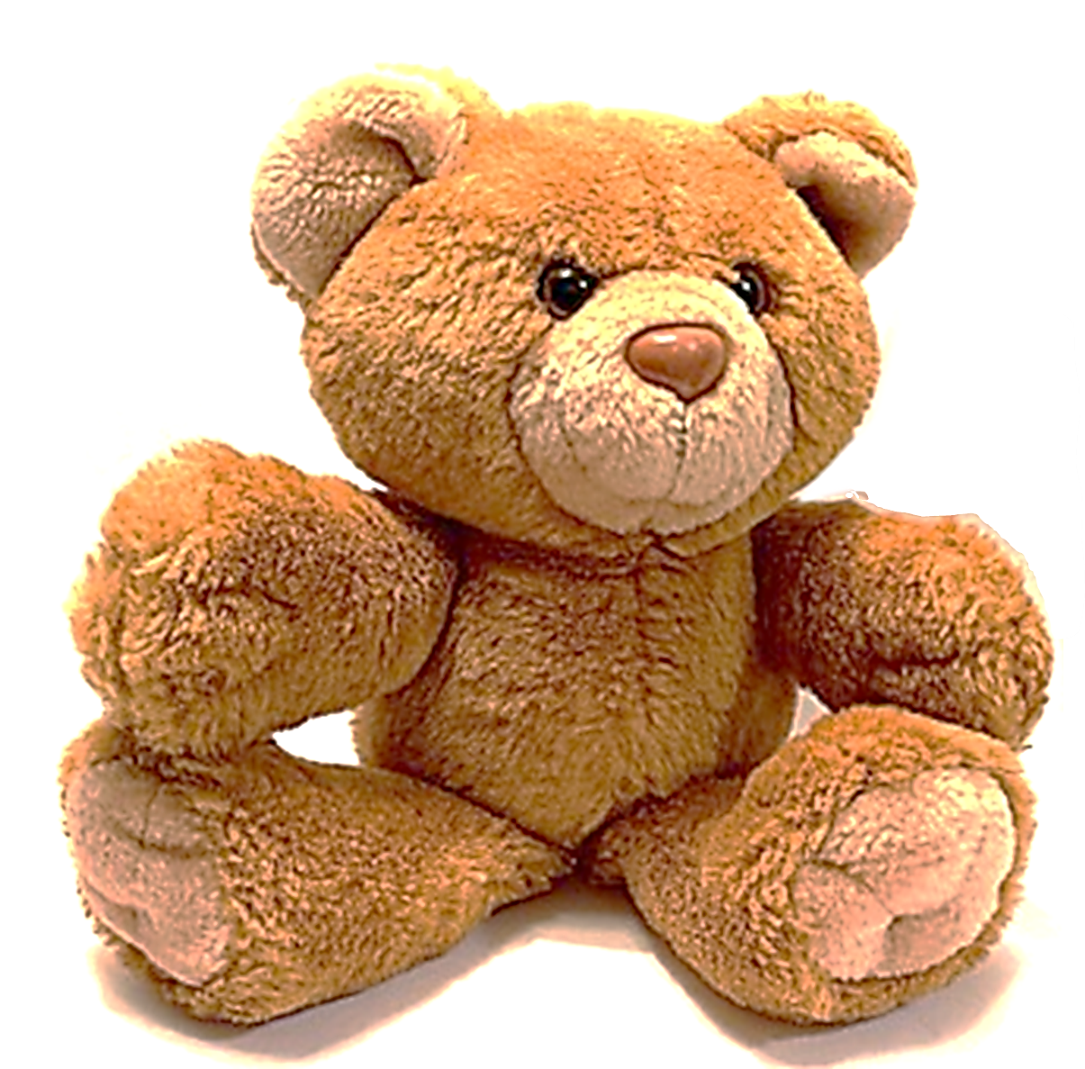

Slide 57
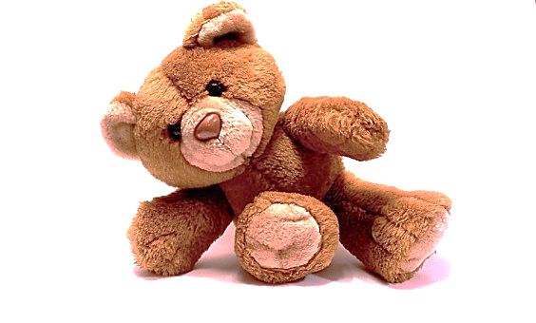

Slide 59
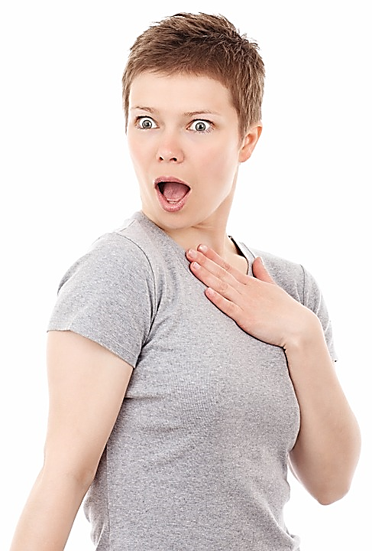
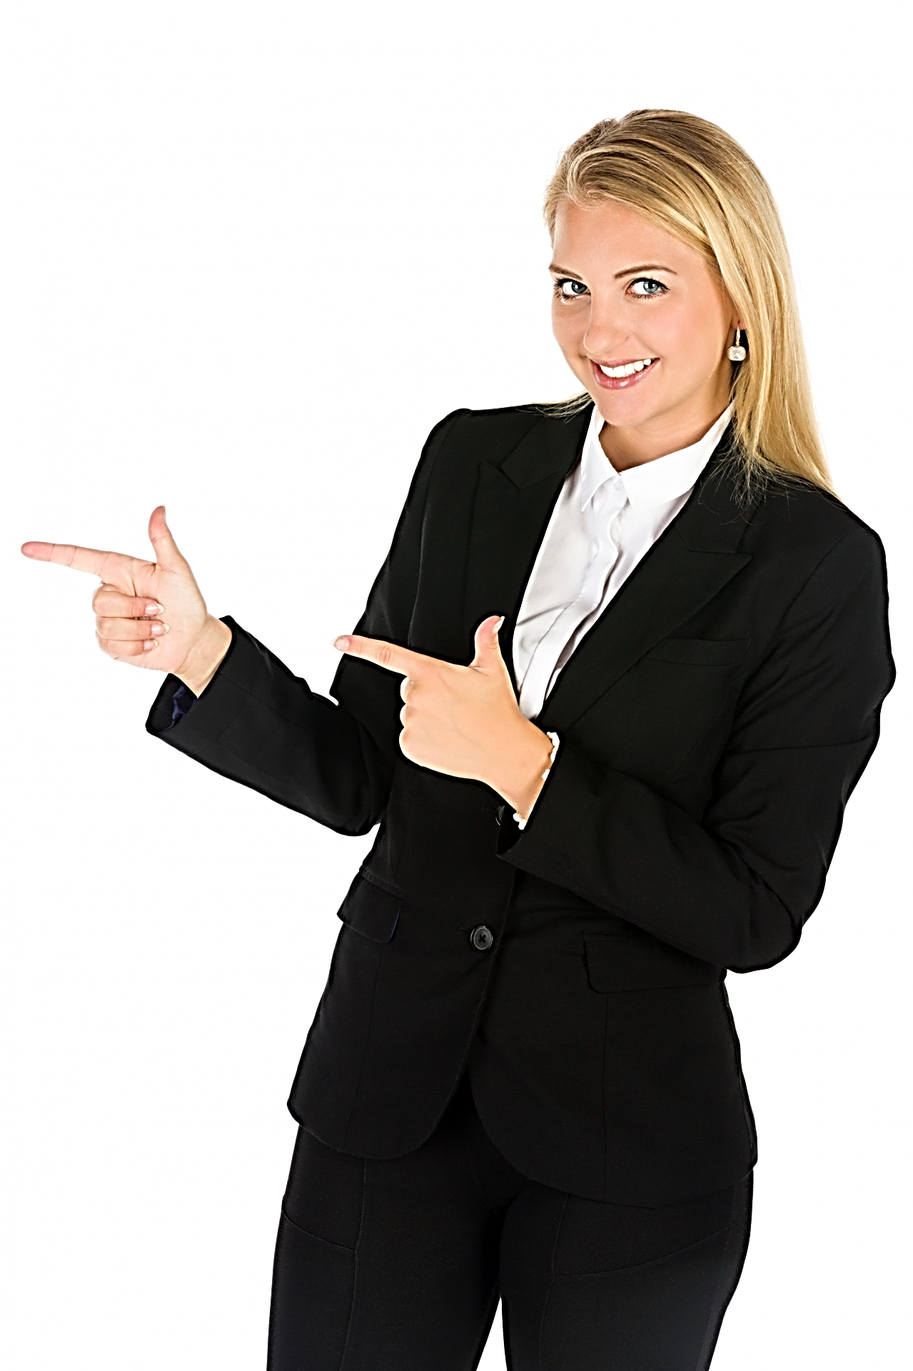
PAST IN THE FUTURE THead

Slide 60
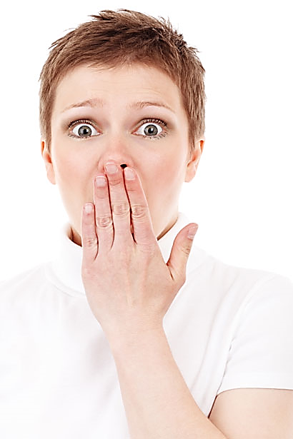
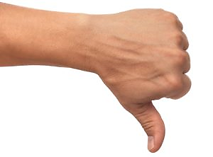
PAST IN THE FUTURE THead

Slide 61
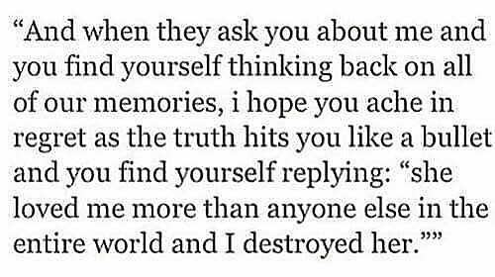

Slide 62
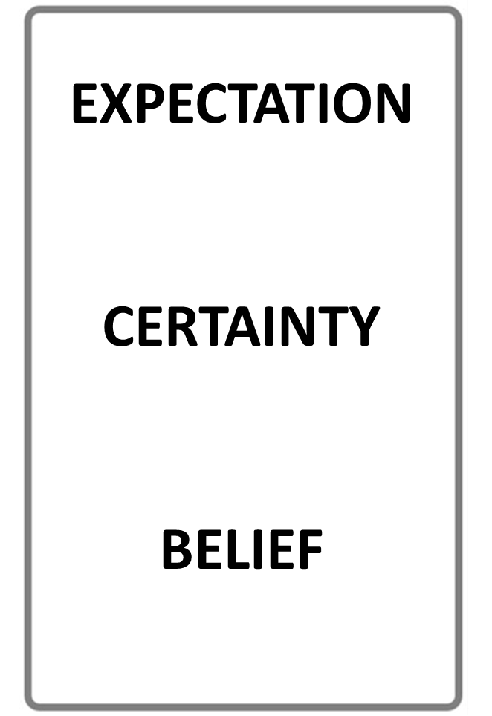
STOP THE VIDEO WHILE YOU CHECK

Slide 64
KEY IDEA

Slide 65
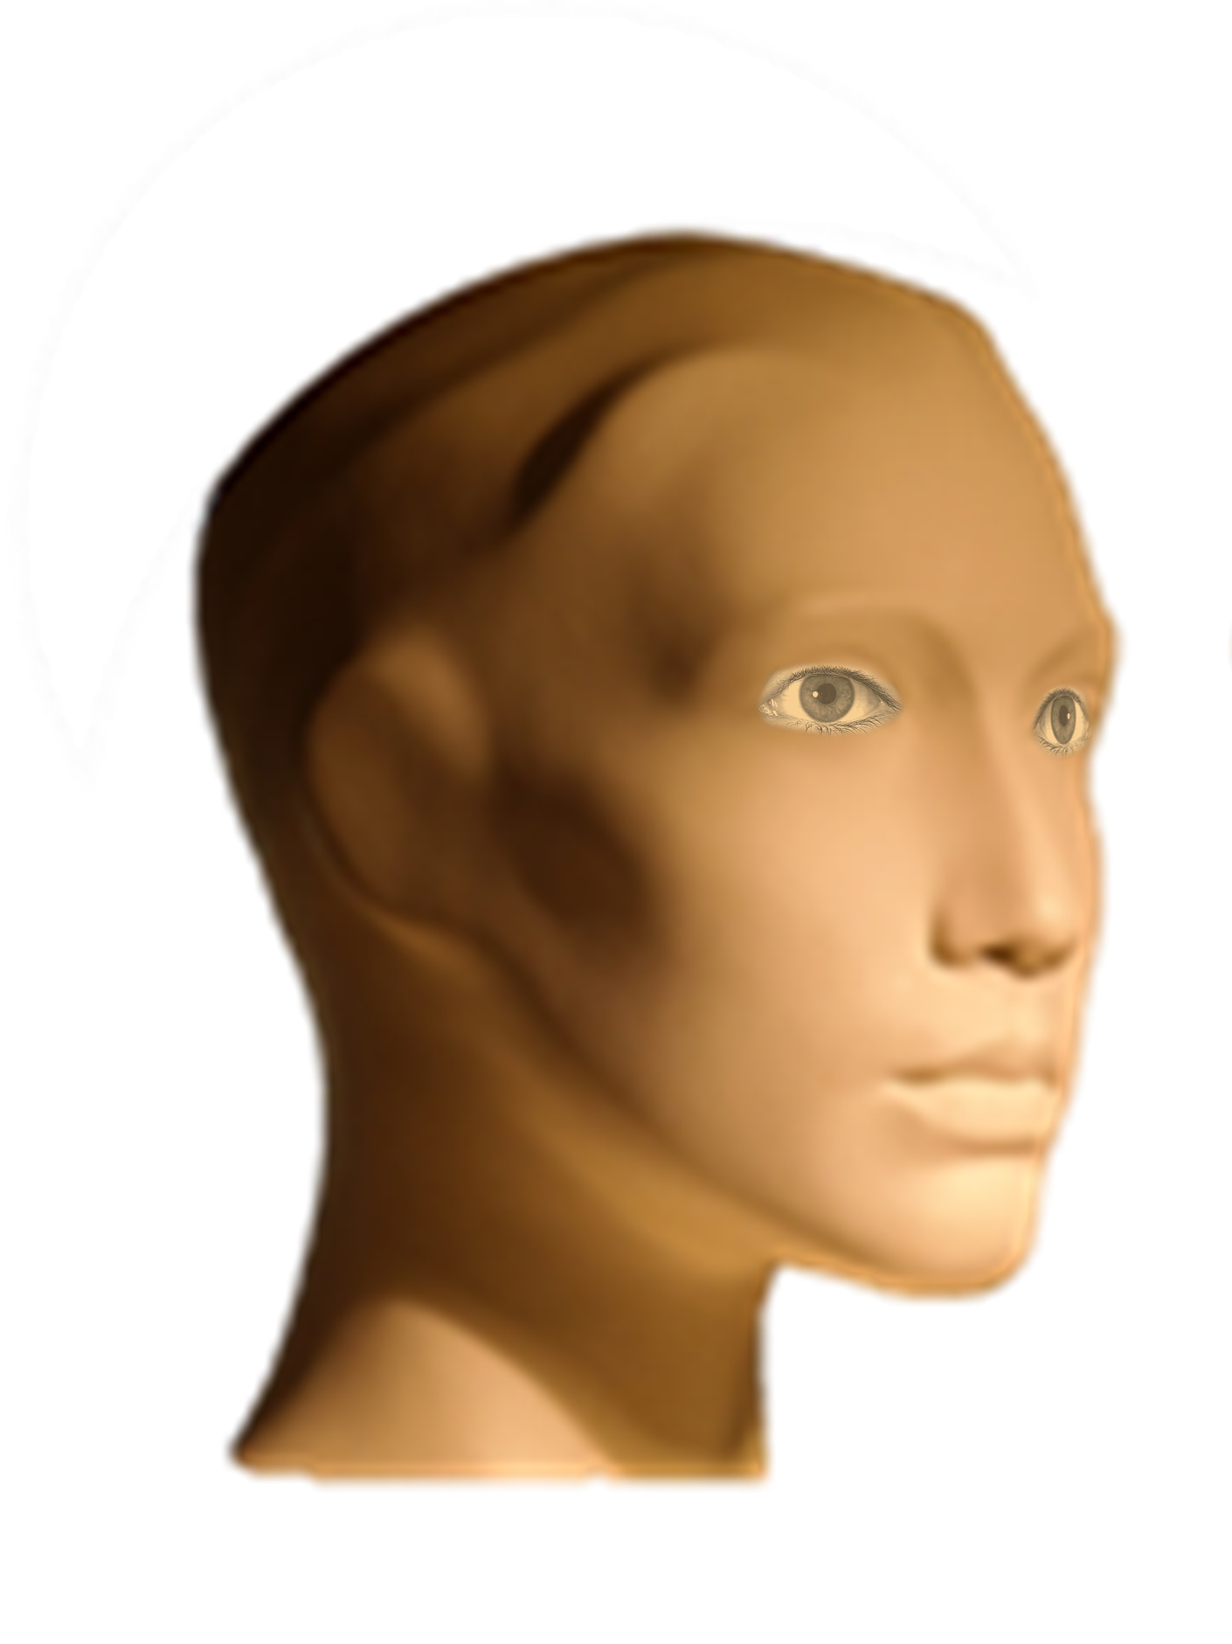

Slide 66
PAST
PRESENT
FUTURE

Slide 67
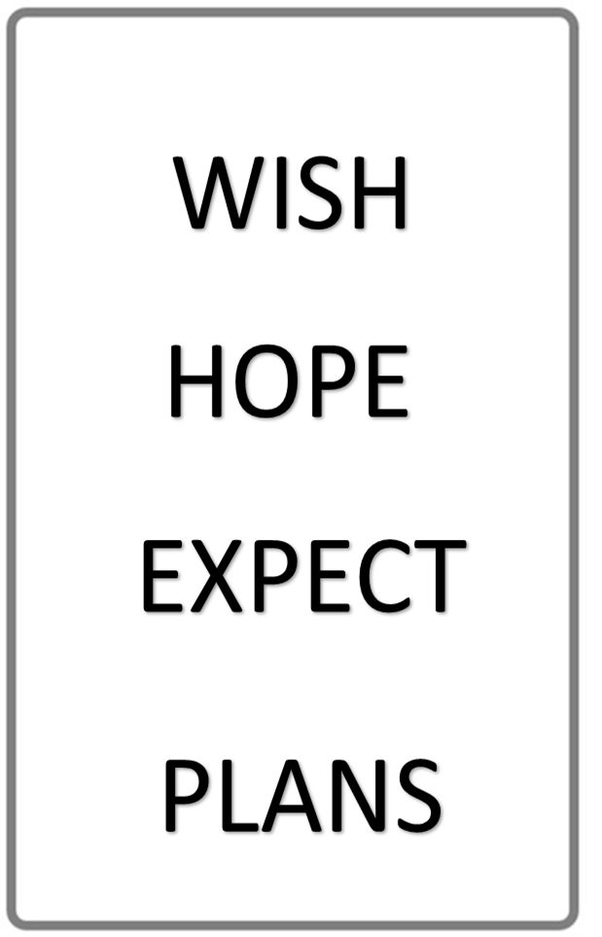
YOU WANT IT PERSONALLY
YOU WANT IT TO BE SO
DESIGNING THE FUTURE

Slide 68
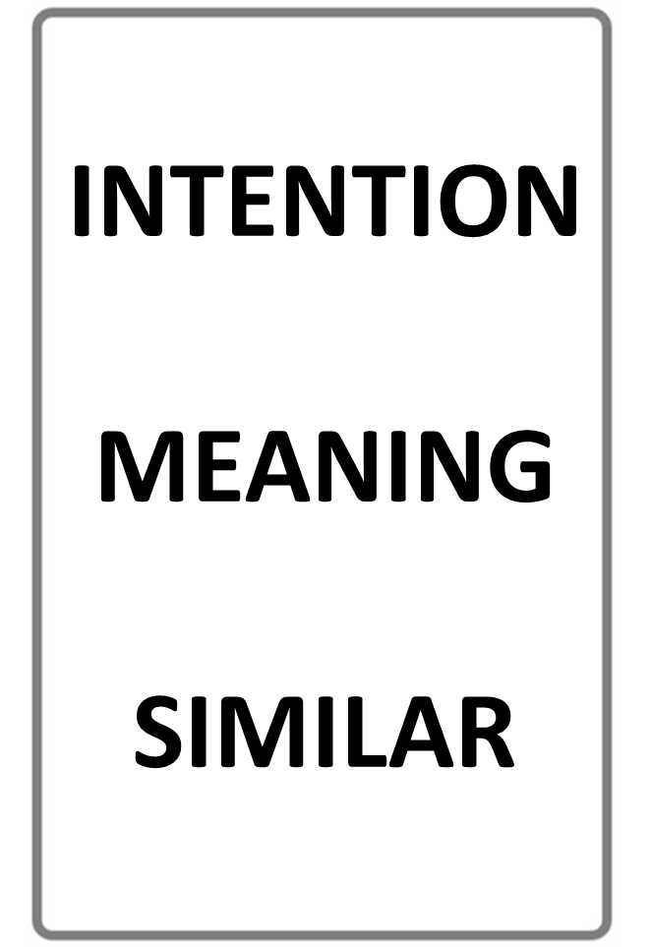
WHAT YOU REALLY PLAN TO DO
UNDERSTANDING A WORD
SEVERAL ASPECTS THE SAME
STOP THE VIDEO WHILE YOU CHECK

Slide 69
THE WILD CARD WOULD!
PREFERENCE
ADVICE
REPETITION
REFUSAL
ETC…
WHAT YOU REALLY LIKE
YOUR OPINION HOW TO DO SOMETHING
DOING THE SAME ACTION AGAIN AND AGAIN
SAYING NO !
STOP THE VIDEO WHILE YOU CHECK

Slide 70
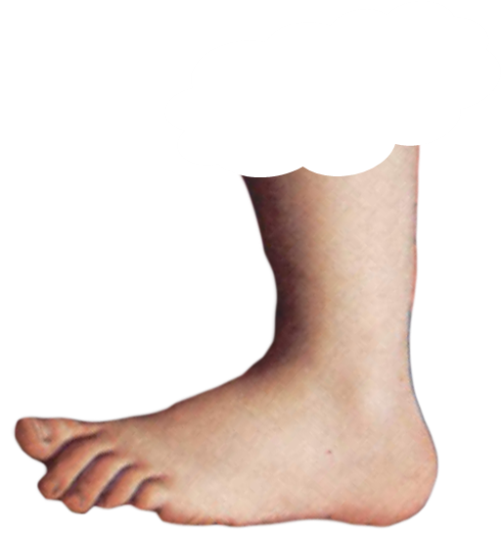
THE DICTIONARY NAME FOR THE PAST IN THE FUTURE
IS
FOOTNOTE
FOOTNOTE

Slide 71
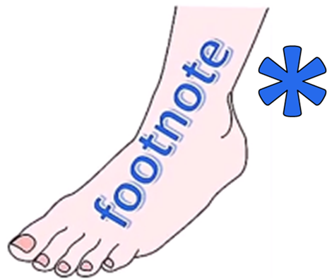

Slide 72
FOOTNOTE
FOOTNOTE

Slide 73
FOOTNOTE
FOOTNOTE

Slide 74
MORE

Slide 76
ENGLISH LANGUAGE STUDY
GRAMMAR AND LANGUAGE STUDY BOOKS LIST THIS AS MODAL AUXILIARY USE

Slide 77
THE DICTIONARY NAME FOR THE PAST IN THE FUTURE
IS
THE
FUTURE PERFECT
FOOTNOTE

Slide 78
FOOTNOTE

Slide 81
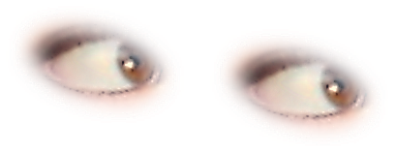

Slide 83
CAN
COULD
MUST
MAY
HAVE TO
MIGHT
NEEDN’T
WILL
SHALL
GOING TO

Slide 84
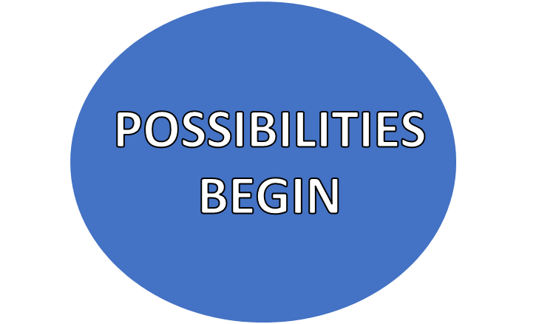
WE VISIT OUR FRIENDS
HERE !

Slide 85
WE VISIT THE CINEMA

Slide 86
WE VISIT THE DOCTOR

Slide 87
POSSIBILITY CONCEPT
WE VISIT OUR FRIENDS
HERE !

Slide 88
OBLIGATION BEGINS
WE WEAR CYCLE HELMETS
SEE THE OBLIGATION LESSONS FOR MORE INFORMATION !
HERE !

Slide 90
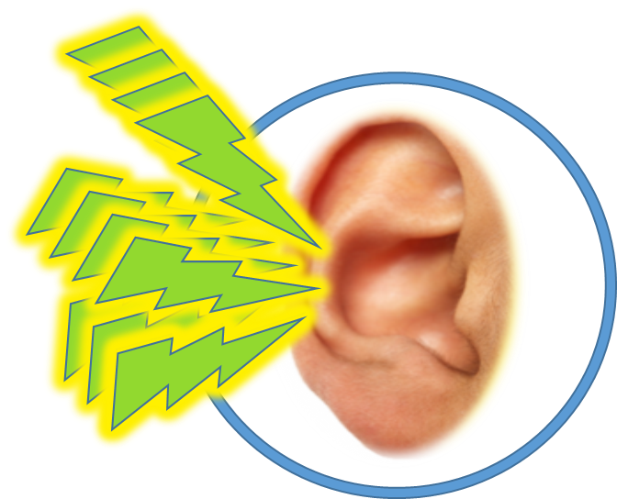
DIALOGUE TEXT

Slide 92
LISTENING PRACTICE
JUST LISTEN...

Slide 93
JUST LISTEN...

Slide 94
POSSIBILITY
PERMISSION
EVENTS
ABILITY

Slide 96
NOW LISTEN AGAIN

Slide 98
LISTENING PRACTICE
JUST LISTEN...

Slide 99
LISTENING PRACTICE
JUST LISTEN...

Slide 100
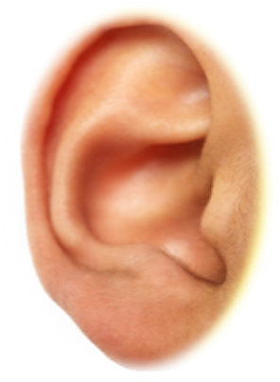
STORY BOARD

Slide 101
STORY BOARD

Slide 102
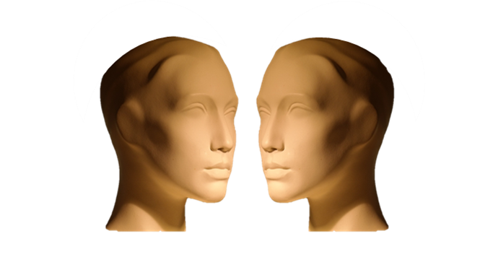
TYPICAL DIALOGUE
JUST LISTEN...

Slide 103
CHECK
THIS WORD

Slide 105
JOE
MELLY
BABY

