Slide 1
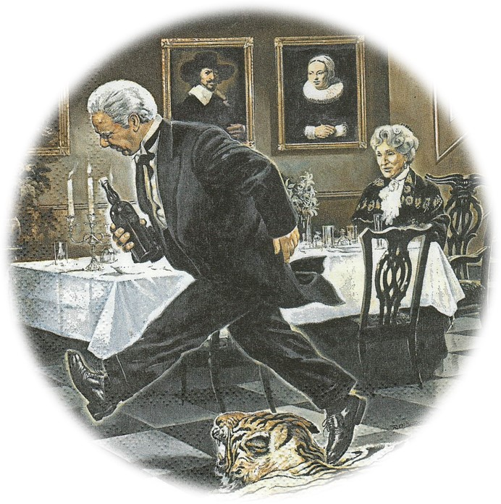
ENGLISH
BIT BY BIT
THE OUTSTANDINGLY DIFFERENT
ENGLISH LANGUAGE LEARNING AND PRACTICE CLUB
DINNER FOR ONE AND ALL!

Slide 2

ENGLISH
BIT BY
BIT
THE OUTSTANDINGLY DIFFERENT
ENGLISH LANGUAGE
LEARNING AND PRACTICE CLUB
DINNER FOR ONE AND ALL!

Slide 3
ENGLISH
BIT BY
BIT
THE OUTSTANDINGLY DIFFERENT
ENGLISH LANGUAGE
LEARNING AND PRACTICE CLUB
TEATIME ON THE ORIENT EXPRESS!

Slide 4
ENGLISH
BIT BY
BIT
THE OUTSTANDINGLY DIFFERENT
ENGLISH LANGUAGE
LEARNING AND PRACTICE CLUB
A PORT IN ANY STORM ?

Slide 5
ENGLISH
BIT BY
BIT
THE OUTSTANDINGLY DIFFERENT
ENGLISH LANGUAGE
LEARNING AND PRACTICE CLUB
WE ARE AMUSED?

Slide 6
ENGLISH
BIT BY
BIT
THE OUTSTANDINGLY DIFFERENT
ENGLISH LANGUAGE
LEARNING AND PRACTICE CLUB
WE ARE AMUSED?

Slide 7
TALKING ABOUT THE PAST
The story of our lives and memories
TALKING ABOUT THE PRESENT
Telling what’s happening now
TALKING ABOUT THE FUTURE
Our hopes and expectations

Slide 8
TALKING ABOUT THE PAST
The story of our lives and memories
TALKING ABOUT THE PRESENT
Telling what’s happening now
TALKING ABOUT THE FUTURE
Our hopes and expectations

Slide 9
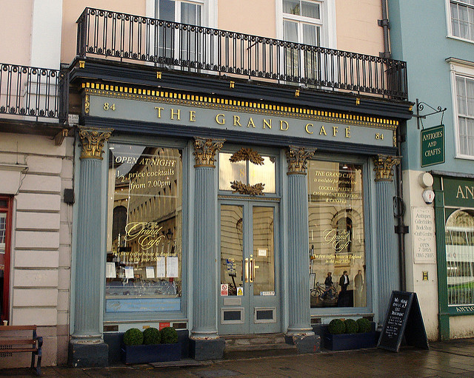

Slide 10
