Slide 1
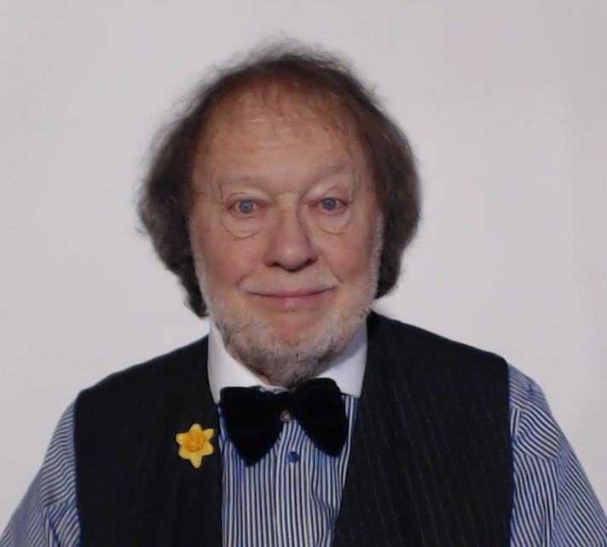
WELCOME TO THE GRAMMAR ZONE!
PLAY THIS VIDEO OR
CHOOSE A LESSON FROM THE LIST BELOW

