Slide 1
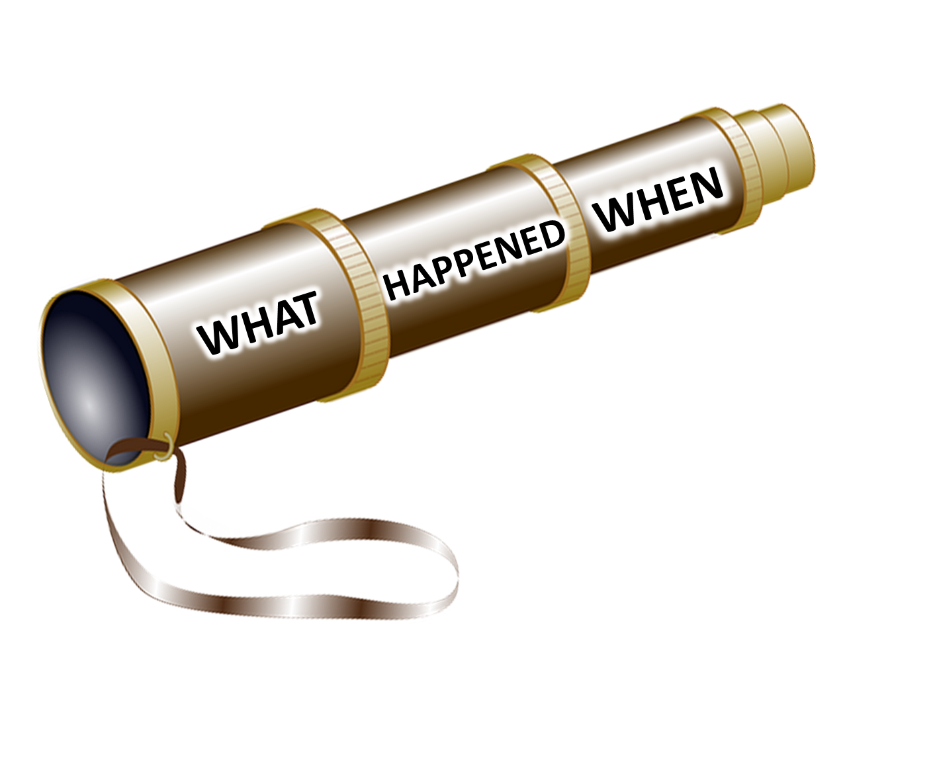


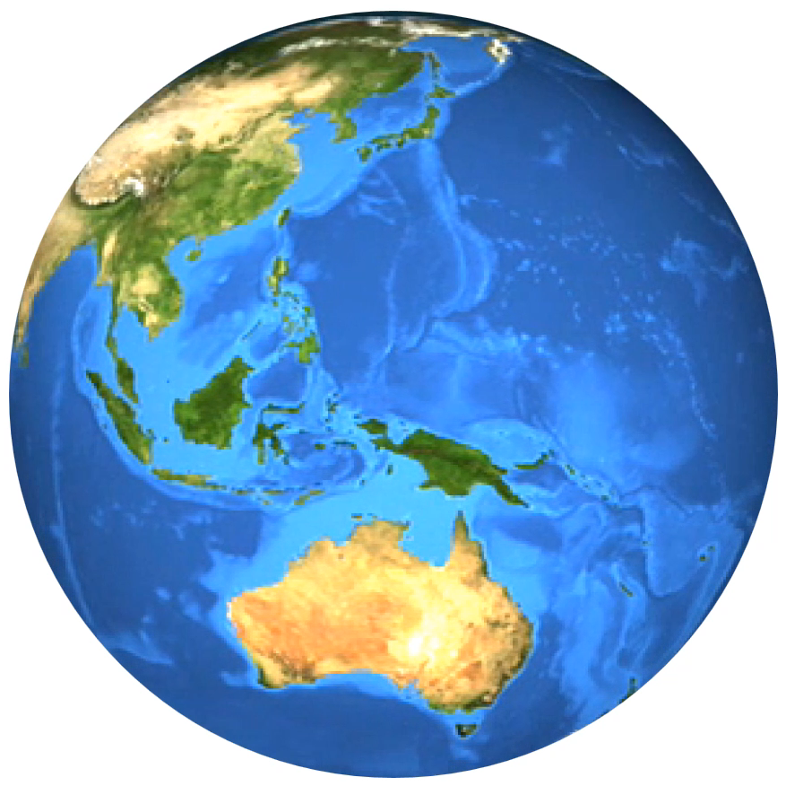

THE HISTORYSCOPE
BACK IN TIME WITH KEVIN SHAW

