Slide 1
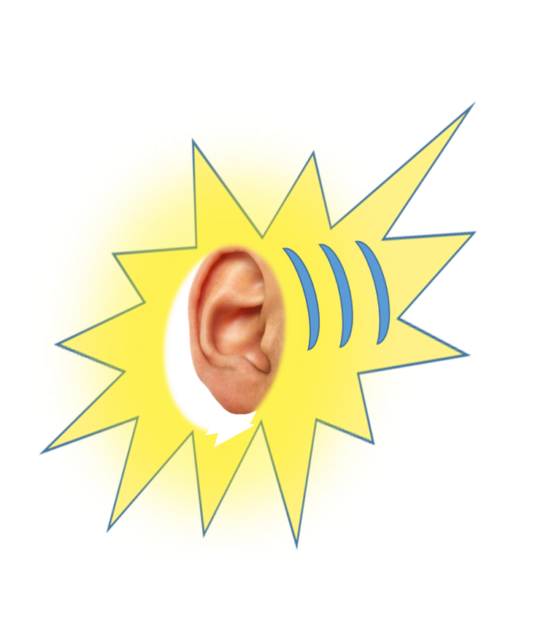


LISTENING PRACTICE
A KID QUESTIONS AN ARTIST
JUST LISTEN...

Slide 2
LISTENING PRACTICE
A KID QUESTIONS AN ARTIST
WHO ARE YOU? MY NAME’S BOB
WHERE DO YOU LIVE? I LIVE IN LONDON
ARE YOU ENGLISH? NO, I’M CANADIAN
WHAT IS YOUR JOB? I’M AN ARTIST
WHY DO YOU LIKE ART?
BECAUSE I LOVE SHAPES AND COLOURS
WHICH COLOUR DO YOU LIKE? ALL OF THEM!
HOW DO YOU TRAVEL TO WORK? ON FOOT
WHEN DO YOU RELAX? AFTER WORK!

Slide 3


