Slide 1
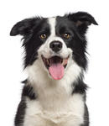
HAPPY
BIRTHDAY
TO LIZZY
FROM IKA AND WILL

