Slide 1
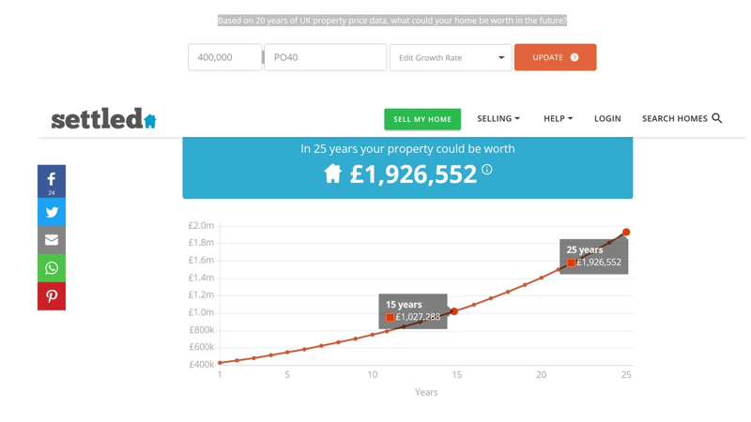
CURRENT SITUATION CONCERNING APPLETREE
To my best understanding the current value of Appletree is around £400,000.
The most reliable value forecasts I can obtain are shown below.
https://www.settled.co.uk/blog/property-price-calculator
£1,027,288 after 15 years
I have researched equity release through the Equity Release Council
http://www.equityreleasecouncil.com/home/
AMOUNT RELEASED £20,000
Drawdown to minimise interest accruals per month
Pros
Cons

Slide 2


