Slide 2
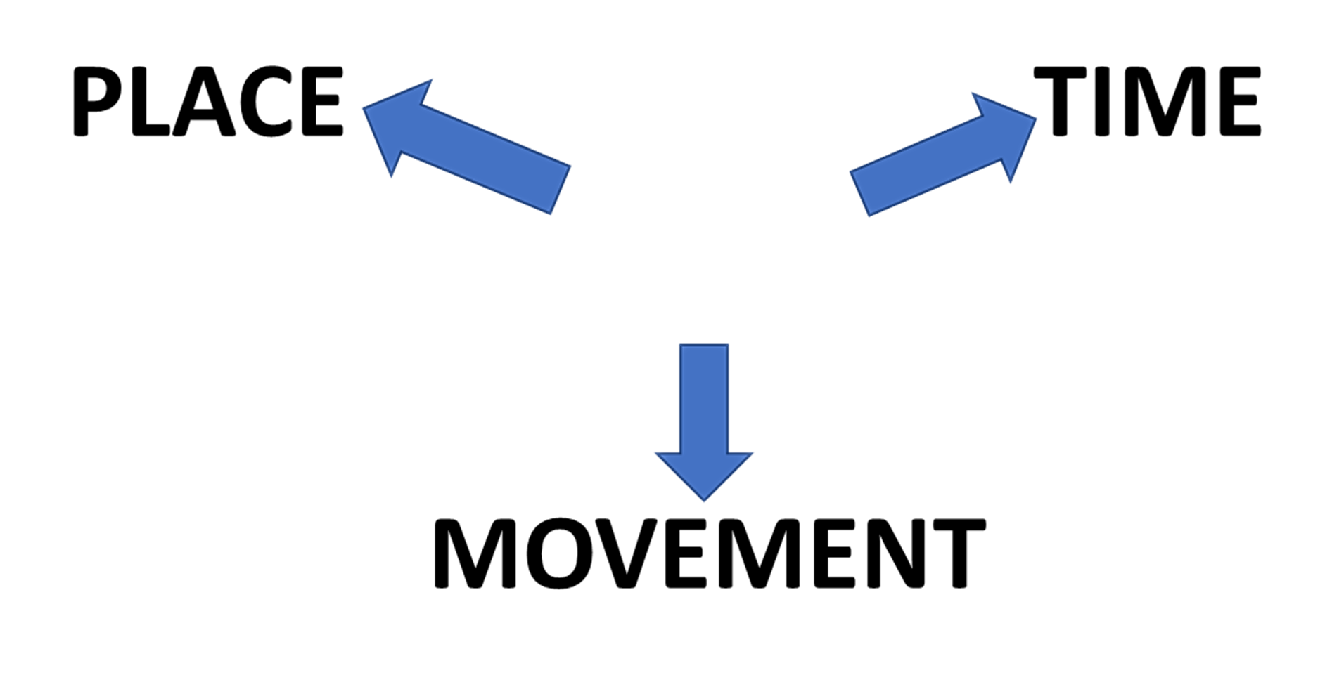
PREPOSITIONS
WITH

Slide 3

TYPICAL USES OF

Slide 4



START
LEAVING

Slide 5


BY
HERE THE CITY IS 12 MILES AWAY

Slide 6

START
NEXT WEEK THE NEW SHOP WILL BE OPEN

Slide 7
WE DROVE AWAY PARIS IN A HURRY!
FROM

Slide 8





Slide 11
KEY EXAMPLES
THE NEW LIBRARY WILL BE OPEN FROM NEXT WEDNESDAY
FROM HERE THE CITY IS 12 MILES AWAY
JACK COMES FROM SCOTLAND
I GOT THIS BOOK FROM JANE
HE RAN AWAY FROM HOME WHEN HE WAS 12 YEARS OLD
TIME
DISTANCE
PLACE
PLACE
MOVEMENT

