Slide 2
FUTURE PLANNED ACTION
WE ARE GOING TO VISIT FRIENDS IN YORK
FUTURE PLAN
VERB

Slide 3
INTENDED DESTINATION
WE ARE GOING TO VISIT YORK
TRAVEL NOW OR LATER
DESTINATION

Slide 4
When are we going to do this?
JUST AFTER
NOW
OR SOON
OR LATER
LET’S LOOK AT THE TIME FIELD!

Slide 5
FUTURE PLANNED ACTION
PAST
WE ARE
GOING TO VISIT
FRIENDS
IN YORK
FUTURE PLAN
VERB
JUST AFTER NOW
OR SOON
OR LATER

Slide 6
FUTURE ARRANGEMENT
WE ARE
GOING TO
MEET NEXT WEEK
AGREED NOW OR LATER
SURE EVENT

Slide 7
INTENDED DESTINATION
CHECK THIS WORD
TRAVEL NOW OR LATER
WE ARE
GOING TO
VISIT YORK

Slide 9
EXPECTED RESULTS
PLAN
ARRANGE
INTEND

Slide 10
INTEND
PLAN
ARRANGE
STRONG WISH FOR THE FUTURE
FUTURE
EVENTS ACTIONS FACTS
TIMES PLACES PEOPLE EVENTS
FIXED FOR THE FUTURE

Slide 11
WHAT IS A PLAN?
PLANNING
IS THINKING NOW HOW TO DO SOMETHING LATER
OFTEN MAKING A DIAGRAM OR LIST
TO EXPLAIN THE
PLAN
TO OTHER PEOPLE

Slide 12
PLAN
EVENTS ACTIONS FACTS FOR THE FUTURE

Slide 13
SOMETIMES THERE ARE ALTERNATIVE PLANS
A PLAN THAT CANNOT CHANGE IS NOT A GOOD ONE!
CHECK THIS WORD

Slide 14
ARRANGE?
CHECK THIS WORD
An arrangement is an agreement
we make
with somebody to do something

Slide 15
NEXT SUNDAY
WE ARE GOING TO MEET SOME
FRIENDS AT MIDDAY AT THE MARKET PLACE FOR LUNCH
THEN WE ARE GOING TO WALK UP THE MOUNTAIN TO THE OLD CASTLE
ARRANGE
TIMES PLACES PEOPLE
FIXED FOR THE FUTURE

Slide 16
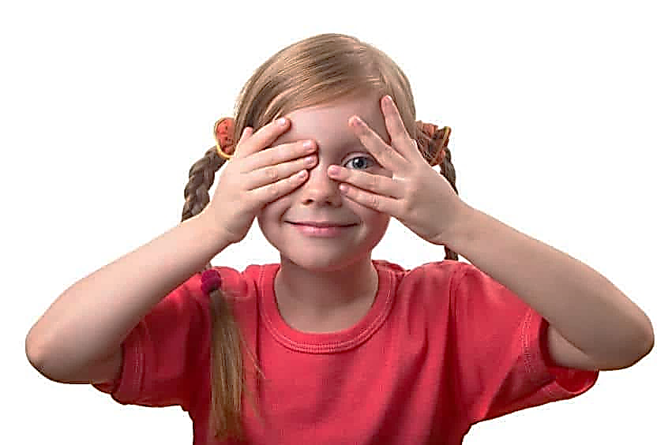
INTEND ?
IF YOU HIDE, I’M GOING TO FIND YOU!

Slide 17
INTEND
STRONG WISH
FOR THE FUTURE
I’M GOING TO GET A BETTER JOB
I’M GOING TO GET A BETTER LIFE!

Slide 19
THESE THREE LADIES ARE
GOING TO
DO SOMETHING…
WHO HAS A PLAN
WHO HAS AN ARRANGEMENT
WHO HAS AN INTENTION

Slide 20
I’M GOING TO GET BOB TO VISIT ME
I’M GOING TO CHANGE MY JOB
I’M GOING TO BOOK A CLINIC VISIT

Slide 21
SO YOU DECIDE
WHICH IS A PLAN
WHICH IS AN ARRANGEMENT
WHICH IS AN INTENTION

Slide 22
I’M GOING TO GET BOB TO VISIT ME
I’M GOING TO CHANGE MY JOB
I’M GOING TO BOOK A CLINIC VISIT
This Photo by Unknown Author is licensed under CC BY-NC

Slide 23
I’M GOING TO GET BOB TO VISIT ME
I’M GOING TO CHANGE MY JOB
I’M GOING TO BOOK A CLINIC VISIT
This Photo by Unknown Author is licensed under CC BY-NC

Slide 25
EXPECTED RESULTS
PLAN
ARRANGE
INTEND

Slide 26
PLAN
ARRANGE
INTEND

Slide 27
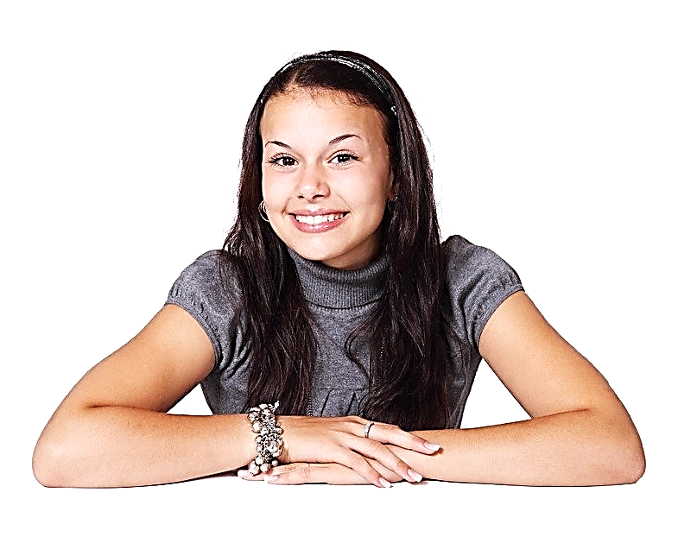
SO WHAT ARE YOU GOING TO DO?
What are your plans arrangements intentions?

Slide 28
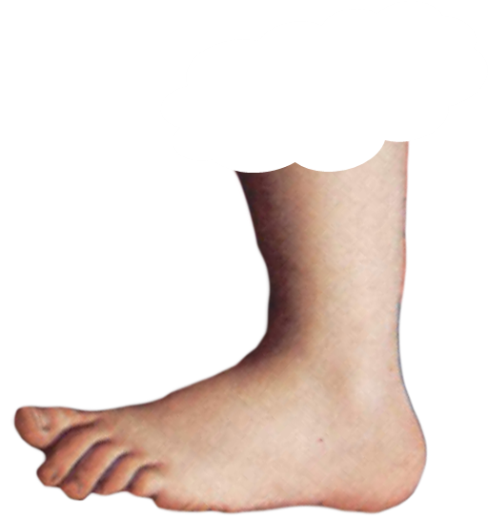
GOING TO
IS USED VERY OFTEN IN THE WHOLE ENGLISH SPEAKING WORLD
LISTEN TO THESE VARIATIONS
FOOTNOTE
FOOTNOTE

Slide 29
I ‘M GOING TO FIND A PRESENT FOR TARA

Slide 31
GOING TO

Slide 32
PLAN
ARRANGE
INTEND

