Slide 1

CONTEXT

Slide 2
CONTEXT
RESPONDING

Slide 3
HOME
RESPONDING

Slide 4
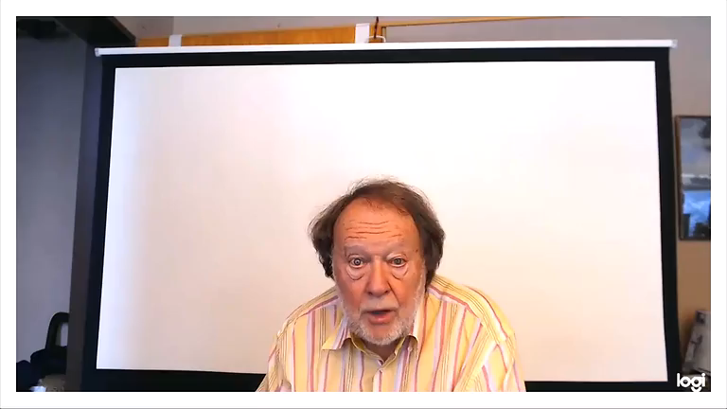
REACTING
AND RESPONDING

Slide 5
REACTING
AND RESPONDING

Slide 6
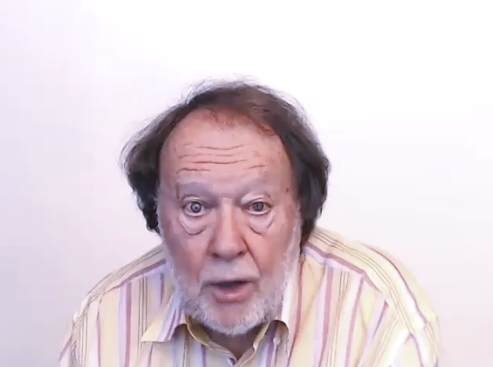
REACTING
AND RESPONDING

Slide 7
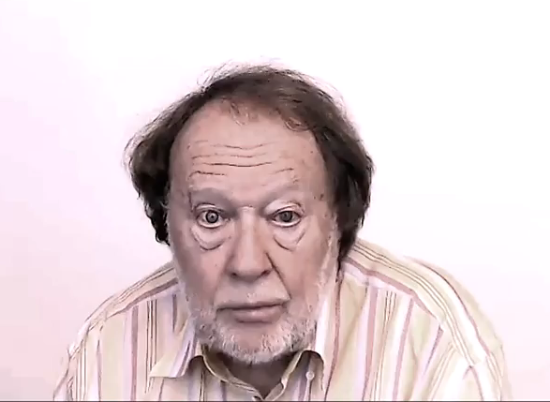
REACTING
AND RESPONDING

Slide 8
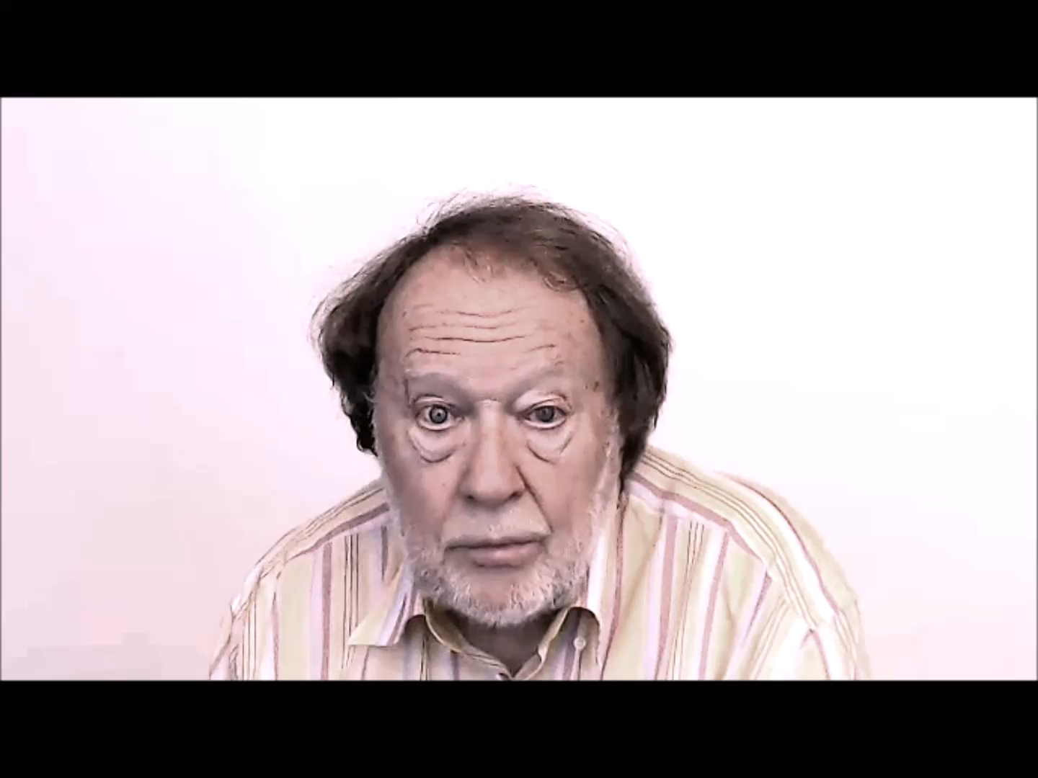
REACTING
AND RESPONDING

Slide 9


Slide 10
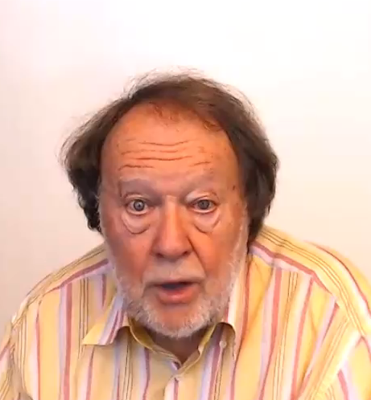
REACTING
AND RESPONDING

